Slide 1
Principles of Microeconomics
Lecture 9: An introduction to firms

Slide 2
Overview
Short-run v. long-run production
The production function
Product of labour curves (short-run)
Cost curves (short-run)
Cost curves (long-run)
Economies of scope

Slide 3
Short-run v. long-run production
Short-run:
The period of time during which one of a firm’s inputs is fixed
Usually K is fixed, L is flexible
Long-run:
The period of time which is long enough for a firm to vary all of its inputs
I.e. Both K and L are flexible

Slide 4
Short-run v. long-run production
How does this relate to our mathematical understanding of production costs?
Total cost = fixed cost + variable cost
Can only be varied in the long-run
Can be varied in the short-run and the long-run

Slide 5
Short-run v. long-run production
Accounting profit v. economic profit (π)
π = Total revenue – total costs
In economics, costs include opportunity costs!
Normal π: π = 0 [this is the minimum π required to stay in the market]
Supranormal π: π > 0
Loss: π < 0

Slide 6
The production function
So far we’ve been talking mostly about cost… but what about output (Q) ?
The production function:
Q = f(L, K)
However, this is a gross oversimplification!
Assumption is usually that K is a fixed cost (FC) and L is a variable cost (VC)
Notes:
"The production function has been a powerful instrument of miseducation. The student of economic theory is taught to write Q = f (L, K ) where L is a quantity of labour, K a quantity of capital and Q a rate of output of commodities. He is instructed to assume all workers alike, and to measure L in man-hours of labour; he is told something about the index-number problem in choosing a unit of output; and then he is hurried on to the next question, in the hope that he will forget to ask in what units K is measured. Before he ever does ask, he has become a professor, and so sloppy habits of thought are handed on from one generation to the next"

Slide 7
The production function
Now let’s relate output to cost…
We start with our cost function:
TC = FC + VC
Then divide by Q (output)
=> Average TC = Average FC + Average VC
=> ATC = AFC + AVC

Slide 8
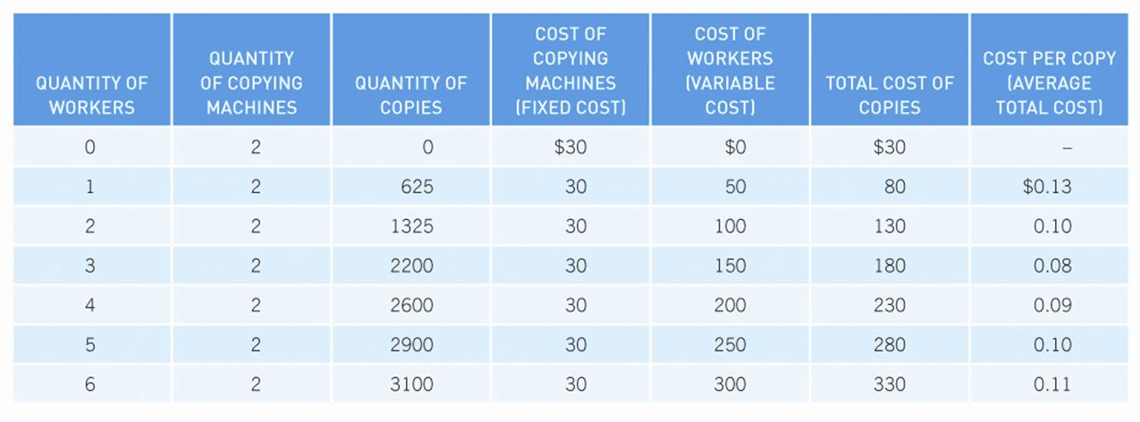
An example: Julie’s photocopying shop

Slide 9
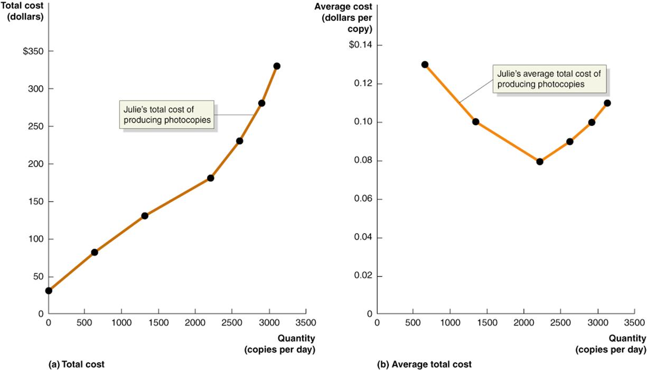
The production function

Slide 10
Product of labour curves (short-run)
Earlier we talked about how decisions are made at the margins…
Marginal product of labour (MP_{L})
The additional output produced by one additional worker
The law of diminishing returns:
Assuming you keep fixed inputs constant, as you add more and more variable inputs (e.g. L) eventually their marginal product will decline

Slide 11
Product of labour curves (short-run)
Average product of labour (AP_{L})
Simply average the MP_{L} for each worker
Σ MP_{L} [Add up all the MP_{L} and divide
L by number of workers (L)]
If next MP_{L} > AP_{L} : AP_{L} must be increasing
If next MP_{L} < AP_{L} : AP_{L} must be decreasing
If next MP_{L} = AP_{L} : no change in AP_{L}
Remember, this is the short-run – in the long-run we can always change K !

Slide 12
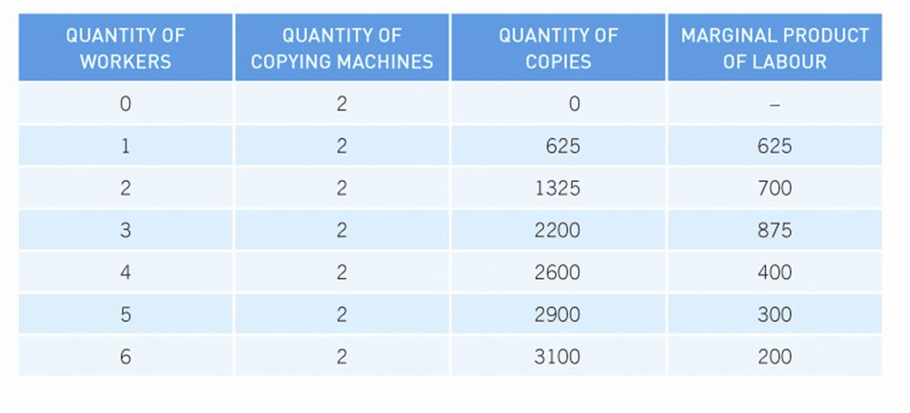
Back to our example: Julie’s photocopying shop

Slide 13
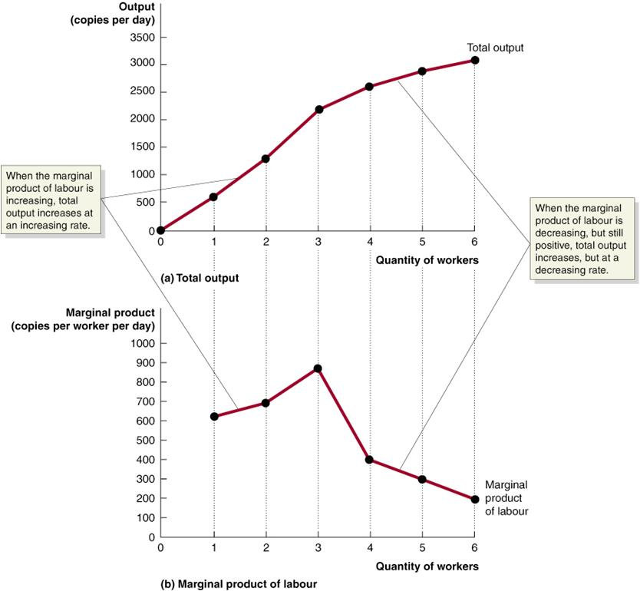

Slide 14
Cost curves (short-run)
All good so far! But to make production decisions, we need to know the marginal cost (MC) of our output
MC is the additional cost to a firm of producing one more unit of a good or service
MC = ΔTC / ΔQ

Slide 15
A note on MC
The MC curve is the individual firm’s supply curve, but only where P ≥ AVC
[we will learn why next lecture !]
To find the market supply curve, we simply add up (horizontally) all of the firm’s MC curves

Slide 16
Cost curves (short-run)
How does MC relate to ATC?
When MC < ATC : ATC is falling
When MC > ATC : ATC is rising
Therefore, MC = ATC at the lowest point in the ATC curve
This relationship between MC and ATC also explains why the ATC is U-shaped...

Slide 17
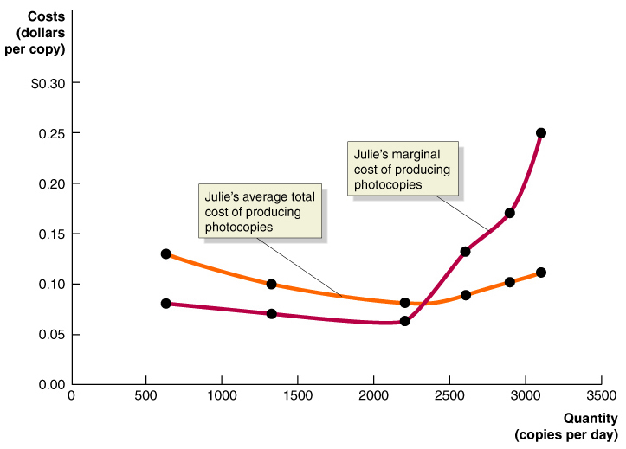

Slide 18
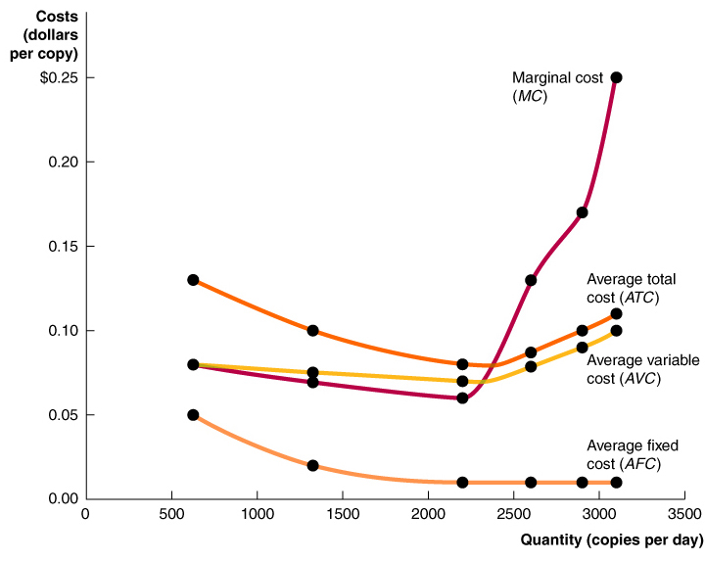
Note the shape of the curves!

Slide 19
Cost curves (long-run)
In the long-run, we can change all the inputs to production (i.e. both L and K)
We can then graph a long-run ATC curve (LR ATC)
Economies of scale:
LR ATC falls as the firm increases output (Q)
Constant returns to scale:
LR ATC is unchanged as the firm increases output
Diseconomies of scale:
LR ATC rises as the firm increases output

Slide 20
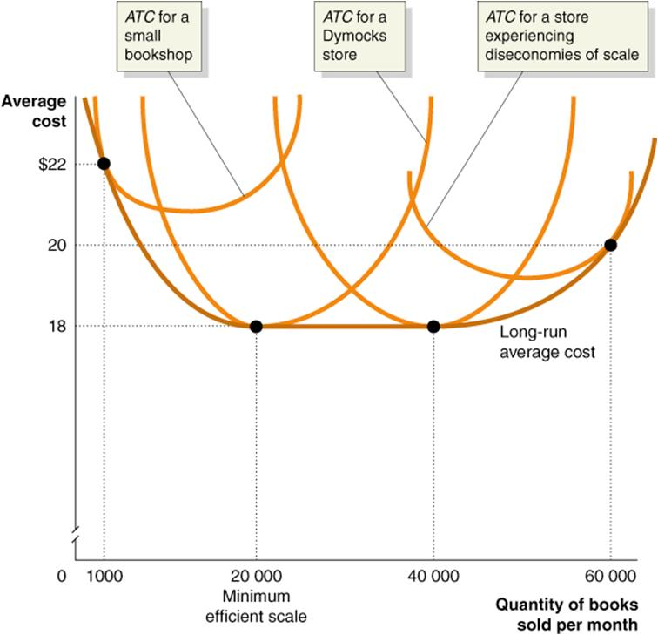

Slide 21
Economies of scope
Lower LR ATC derived from producing more than one product with similar components or tasks
E.g. photocopiers and faxes; legal services and conveyancing

