Slide 1
Principles of Microeconomics
Lecture 3: Introducing Demand
and Supply

Slide 2
Overview
Demand
Utility
Extension: How we derive the demand curve
Supply
The demand and supply model in equilibrium
A note on notation

Slide 3
Demand
The law of demand:
There is an inverse relationship between the price of a product and the quantity demanded
I.e. as the price of a good increases, people become less willing to buy it, and vice-versa!
Conditions:
Ceteris parabis (‘all else being equal’;
i.e. holding other variables constant)

Slide 4
Demand
Three reasons why the law of demand holds true:
Income effect
Substitution effect
Diminishing marginal utility

Slide 5
Demand
Income effect:
When the price of a product is lower, a consumer can afford more of the product without giving up other products
The decline in prices therefore increases the purchasing power of consumers, and increases their real income

Slide 6
Demand
Substitution effect:
When the price of a product is lower, consumers have a greater incentive to substitute other products for it
E.g. beef and lamb

Slide 7
Demand
Diminishing marginal utility
The utility gained from each additional unit of product decreases (as more of it is purchased)
Utility?
The satisfaction derived from (in our case) the product that is purchased
Prices must therefore be lower for greater quantities to be purchased

Slide 8
Demand
An example:
Price Quantity demanded
per unit per week
a 5 10
b 4 20
c 3 35
d 2 55
e 1 80

Slide 9
P
a
5
4
3
2
1
b
c
Price ($ per unit)
d
e
D
0
Q
10 20 30 40 50 60 70 80
Quantity demanded (units per week)

Slide 10
Demand
Why are they called curves?
Individual demand v. market demand
Calculating market demand: simply sum (horizontally) all of the individual demand curves!

Slide 11
Demand
Movements along the curve are due to price
Shifts of the curve are due to:
A change in price of a related good
Substitutes
Complements
Changes in tastes and preferences
Income
The number of consumers
Expected future prices

Slide 12
P
5
4
3
2
1
Movements along a
demand curve
Price ($ per unit)
D₀
0
10 20 30 40 50 60 70 80
Q
Quantity demanded

Slide 13
P
5
4
3
2
1
Expansion in
demand
Price ($ per unit)
D₁
D₀
0
10 20 30 40 50 60 70 80
Q
Quantity demanded

Slide 14
P
5
4
3
2
1
Contraction in
demand
Price ($ per unit)
D₀
D₁
0
10 20 30 40 50 60 70 80
Q
Quantity demanded

Slide 15
Utility
Again: utility = satisfaction
I.e. The level of utility derived from the purchase of a good is the level of satisfaction that good gives the consumer…

Slide 16
Utility
Utility is ordinal, not cardinal
(e.g. U = 10 is not twice the utility of U = 5)
When we plot them, utility curves cannot intersect => they are always parallel!

Slide 17
Utility
Diminishing marginal utility is what makes utility curves inwards-bending
Utility curves can also be called indifference curves

Slide 18
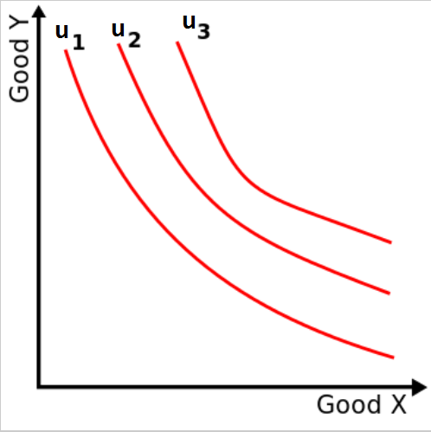
An example of utility curves (‘indifference curves’)

Slide 19
Extension: How we derive the demand curve
We now know the basic reasons for why the demand curve is sloped the way it is
I.e. We now know why the law of demand holds true
But how do we know the exact points along which we should draw the demand curve??
I.e. How do we derive the demand curve?

Slide 20
Extension: How we derive the demand curve
We know how to derive the supply curve, because – as we will see later in the course – we know that producers seek to maximise profit
But what are consumers trying to maximise??

Slide 21
Extension: How we derive the demand curve
Answer: Utility!
But utility (satisfaction) is not measured in $$ => i.e. ‘5 Kina of utility’ makes no sense!
Keep in mind that the utility you get from a product CHANGES as you consume more of it!
Remember diminishing marginal utility? ☺

Slide 22
Extension: How we derive the demand curve
So how do we relate utility (a non-$$ variable) to the demand and supply model, which requires that we think in $$?
We look at how much utility we get with different budget constraints…
…but budget constraints in terms of quantity rather than price!

Slide 23
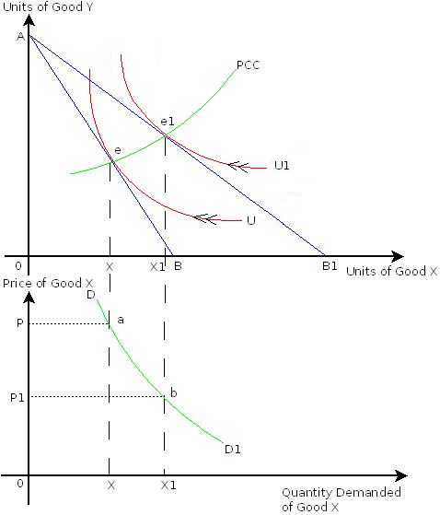
PCC = Price consumption curve (tracks the quantity consumed as the price of X changes)
= Budget constraint .
As we increase our budget constraint (from AB to AB1), we can see where we maximise utility and track how the quantity of X changes...
...and we can read down to the demand curve to see what is happening to price to induce these changes in quantity...

Slide 24
Supply
The law of supply:
There is a positive relationship between the price of a product and the quantity supplied
Conditions:
Ceteris parabis
Individual supply v. market supply
Again, simply horizontally sum the quantities

Slide 25
Supply
An example:
Price Quantity supplied
per unit($) per week
a 5 12 000
b 4 10 000
c 3 7 000
d 2 4 000
e 1 1 000

Slide 26
P
a
S
5
4
3
2
1
b
c
Price ($ per unit)
d
e
Q
0
2 4 6 8 10 12 14 16
Quantity supplied (000/week)

Slide 27
Supply
Movements along the curve are due to price
Shifts of the curve are due to:
Prices of inputs (i.e. changes in production costs)
Technological change / productivity
Number of firms in the market
Expected future prices
Prices of substitutes

Slide 28
P
S
5
4
3
2
1
Movements along
a supply curve
Price ($ per unit)
Q
0
2 4 6 8 10 12 14 16
Quantity supplied (000/week)

Slide 29
P
S₀
S₁
5
4
3
2
1
An expansion in
supply
Price ($ per unit)
Q
0
2 4 6 8 10 12 14 16
Quantity supplied (000/week)

Slide 30
P
S₁
S₀
5
4
3
2
1
A contraction in
supply
Price ($ per unit)
Q
0
2 4 6 8 10 12 14 16
Quantity supplied (000/week)

Slide 31
Supply
We showed how we derive the demand curve with the help of utility… but what about deriving the supply curve?
This we do much later in the course – in Lecture 9
But for the moment, just remember that the principle is that producers seek to maximise profit

Slide 32
The supply and demand model in equilibrium
When combining a market’s demand and supply curves into a single graph, we find the equilibrium price and quantity
Note: Ensure that units of both time and quantity are the same for both demand and supply!
E.g. packets per week, tonnes per year, etc.

Slide 33
P
5
4
3
2
1
S
Equilibrium price
and quantity
Price ($ per unit)
D
0
Q
2 4 6 7 8 10 12 14 16 18
Units of X (000/week)

Slide 34
P
5
4
3
2
1
S
Surplus
Equilibrium price
and quantity
Price ($ per unit)
D
0
Q
2 4 6 7 8 10 12 14 16 18
Units of X (000/week)

Slide 35
P
5
4
3
2
1
S
Surplus
Equilibrium price
and quantity
Price ($ per unit)
Shortage
D
0
Q
2 4 6 7 8 10 12 14 16 18
Units of X (000/week)

Slide 36
The supply and demand model in equilibrium
Important:
While we may perceive it as static when we simply look at the graph, market supply and demand are constantly adjusting
The model actually shows a dynamic equilibrium
I.e. How do shortages and surpluses resolve themselves?

Slide 37
A note on notation
Use shorthand! E.g.: ↑S => ↓P, ↑Q [an expansion in
supply leads to a decrease in price and increase in quantity]
Q_{D} = Quantity demanded
Q_{S} = Quantity supplied
Use when you need to differentiate Q!
E.g.: In a shortage, Q_{D} > Q_{S}
When you are comparing multiple P and Q, you can use the
following notation to make it clear when you are referring to
equilibrium P and Q:
P* = Equilibrium price [P_{e} is also common]
Q* = Equilibrium quantity [Q_{e} is also common]

