Slide 1
Principles of Microeconomics
Lecture 10: Perfect competition

Slide 2
Overview
Markets: four basic categories
Perfect competition
Losses in the short run
Entry/exit of firms
Conclusions

Slide 3
Markets: four basic categories
Characteristic | Perfect competition | Monopolistic competition | Oligopoly | Monopoly
Number of firms | Many | Many | Few | One!
Type of product | Identical | Differentiated | Identical or differentiated | Unique
Barriers to entry/exit | None | Low | High | Entry blocked
Price taker / maker? | Taker | Taker | Maker | Maker
Examples of industries | Rice Wheat | Hairdressers Restaurants | Banking Supermarkets | Letter delivery Tap water
M

Slide 4
Perfect competition
Characteristic | Perfect competition
Number of firms | Many
Type of product | Identical
Barriers to entry/exit | None
Price taker / maker? | Taker
Examples of industries | Rice Wheat
The demand curve facing individual
firms in a perfectly competitive market
is horizontal – i.e. perfectly elastic
This does not change the market-level supply and demand analysis
I.e., the demand curve facing the market is not flat!

Slide 5
Perfect competition
Marginal revenue (MR):
The revenue generated from the additional (‘next’) unit sold
Average revenue (AR):
Total revenue ÷ quantity = TR = Average P x Q
Q Q
In a perfectly competitive market:
Demand curve = P = MR = AR

Slide 6
An example
Number of bushels (Q) | Market price per bushel ($P) | Total revenue (TR) | Average revenue (AR) | Marginal revenue (MR)
0 | $4 | $0 | - | -
1 | 4 | 4 | $4 | $4
2 | 4 | 8 | 4 | 4
3 | 4 | 12 | 4 | 4
4 | 4 | 16 | 4 | 4
5 | 4 | 20 | 4 | 4
6 | 4 | 24 | 4 | 4
7 | 4 | 28 | 4 | 4
8 | 4 | 32 | 4 | 4
9 | 4 | 36 | 4 | 4
10 | 4 | 40 | 4 | 4

Slide 7
Perfect competition
Producers in a perfectly competitive market can sell as much produce as they want to at the same constant price
The profit-maximising level of output is:
Where the difference between total revenue and total cost is the greatest
Where MR = MC
Note:
The MR = MC rule applies for ALL market types

Slide 8
An example
Quantity (bushels)(Q) | Total revenue (TR) | Total cost (TC) | Profit (TR – TC) | Marginal revenue (MR) | Marginal cost (MC)
0 | $0 | $1.00 | - $1.00 | - | -
1 | 4.00 | 4.00 | 0.00 | $4.00 | $3.00
2 | 8.00 | 6.00 | 2.00 | 4.00 | 2.00
3 | 12.00 | 7.50 | 4.50 | 4.00 | 1.50
4 | 16.00 | 9.50 | 6.50 | 4.00. | 2.00
5 | 20.00 | 12.00 | 8.00 | 4.00 | 2.50
6 | 24.00 | 15.00 | 9.00 | 4.00 | 3.00
7 | 28.00 | 19.50 | 8.50 | 4.00 | 4.50
8 | 32.00 | 25.50 | 6.50 | 4.00 | 6.00
9 | 36.00 | 32.50 | 3.50 | 4.00 | 7.00
10 | 40.00 | 40.50 | - 0.50 | 4.00 | 8.00

Slide 9
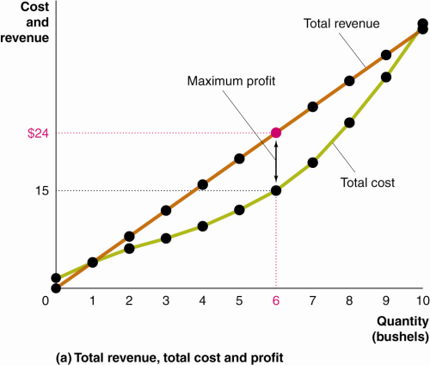
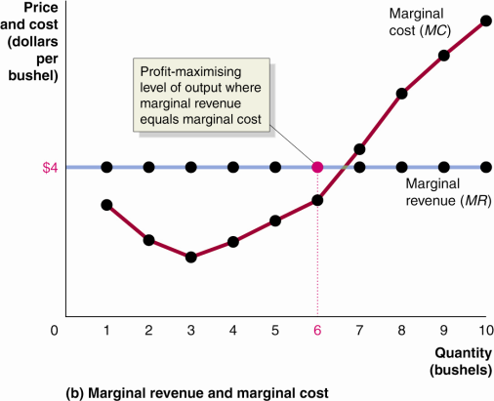
An example (cont.)

Slide 10
Firm level analysis: Putting it all together…
Price
(and cost)
MC
Total π =
(P – ATC) x Q
ATC
P*
D = MR
0
Q
Quantity
π-maximising level of output

Slide 11
Perfect competition
Profits (π):
Where P > ATC: firm makes supranormal π
Where P = ATC: firm makes normal π
Where P < ATC: firm experiences losses
These apply in all markets!

Slide 12
P = ATC = MC
Price
(and cost)
Break-even point
(Total π = 0)
MC
ATC
P*
D = MR
0
Q
Quantity
π-maximising level of output

Slide 13
P < ATC
Price
(and cost)
MC
ATC
Losses =
(P – ATC) x Q
P*
D = MR
0
Q
Quantity
Loss minimising level of output

Slide 14
Perfect competition: Losses in the short-run
In the short-run, a firm suffering losses has two choices:
Continue to produce
Stop production and shut down temporarily
A note on sunk costs
Sunk cost: A cost that has already been paid and cannot be recovered, and thus, logically, should not be considered in future decision-making
A fixed cost is not necessarily a sunk cost!

Slide 15
Perfect competition: Losses in the short-run
P > AVC
Even if a firm suffers losses, it should continue to operate as long as it can recover its variable costs
P = AVC
The firm is indifferent as to whether it operates or shuts down temporarily
P < AVC [‘Shutdown point’]
The minimum point on a firm’s average variable cost curve; if the price falls below this point, the firm shuts down production

Slide 16
Illustrating the shutdown point
The supply curve for the firm in the short run
Price
(and cost)
MC
ATC
AVC
The minimum price at which the firm will continue to produce
P_{MIN}
Shutdown point
0
Q_{SD}
Quantity

Slide 17
Perfect competition: Entry / exit of firms
Where supranormal profits exist, new firms will enter the market
=> ↑ Supply => ↓P, ↑Q
Where losses persist, firms will exit the market
=> ↓ Supply => ↑P, ↓Q
Long-run equilibrium?
Normal economic profits!
Remember, there are no significant barriers to entry/exit!

Slide 18
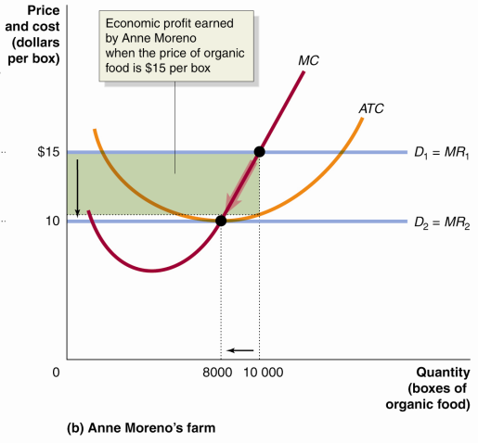
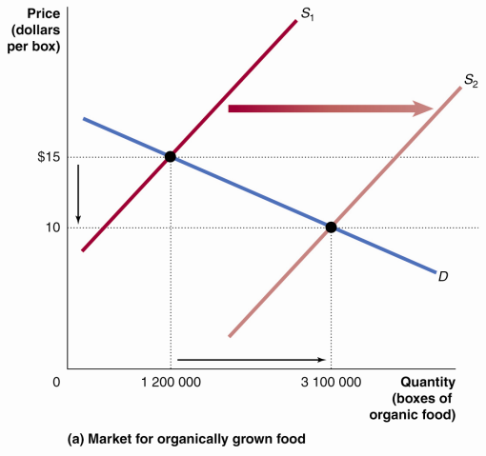
Where supranormal profits exist…

Slide 19
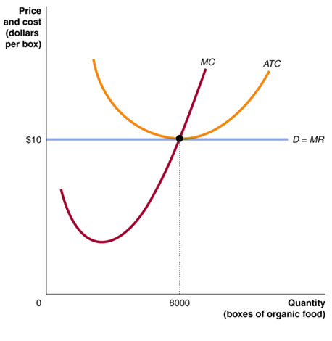

Slide 20
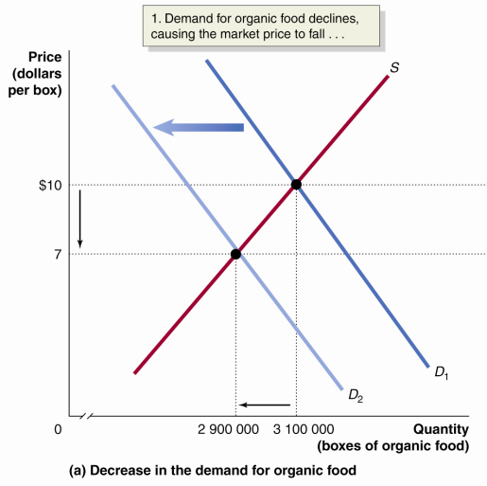
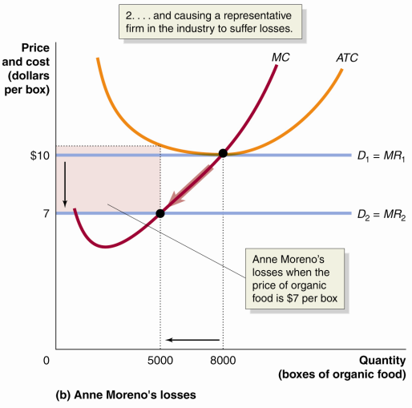
Where losses exist…

Slide 21
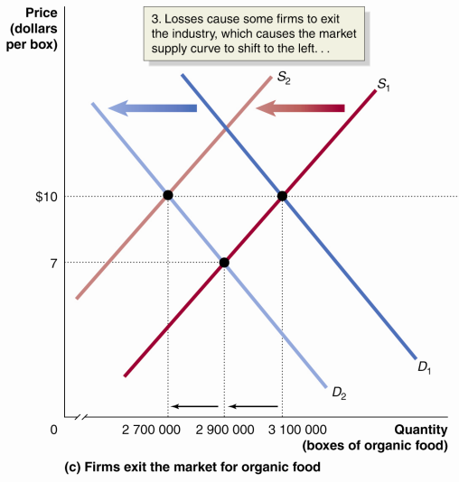
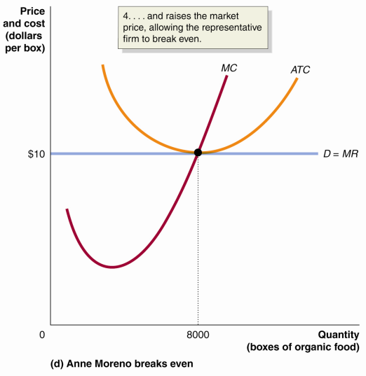

Slide 22
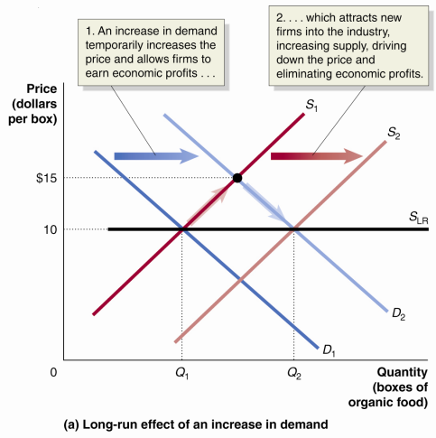
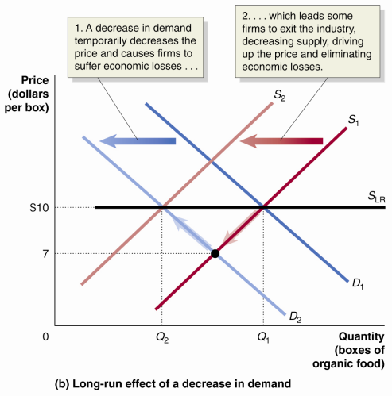
In summary:

Slide 23
Perfect competition: Conclusions
Productive efficiency?
Allocative efficiency?
Dynamic efficiency?
Sounds great!
But unfortunately, few markets are perfectly competitive...
Dynamic efficiency:
The ability of firms to develop and adapt to change over time (especially re: technology)

