Slide 1
Economic Development
Lecture 19: International Aid
Graphs courtesy of Prof. Stephen Howes

Slide 2
Overview
Definitions
The 0.7% goal
Trends in aid
The relative importance of aid flows
The role of aid
Is aid a good thing?
How can we improve aid?

Slide 3
Definitions
International aid / international development
ODA
  Provided by official agencies (read: governments)
  Promotion of economic development and welfare of developing countries as its main aim
  Is concessional in character
Non-official development assistance
Bilateralism / multilateralism

Slide 4
The 0.7% goal
Pearson Commission (1969), adopted in 1970 by UN:
  “Each economically advanced country will progressively its ODA to the developing countries and will exert its best efforts to reach a minimum net amount of 0.7% of its GDP by the middle of the decade”
Was based on a financing gap model
Is it relevant?
Very few governments have reached this level
Australia? 0.5% by 2015 (but we’ll see…)

Slide 5
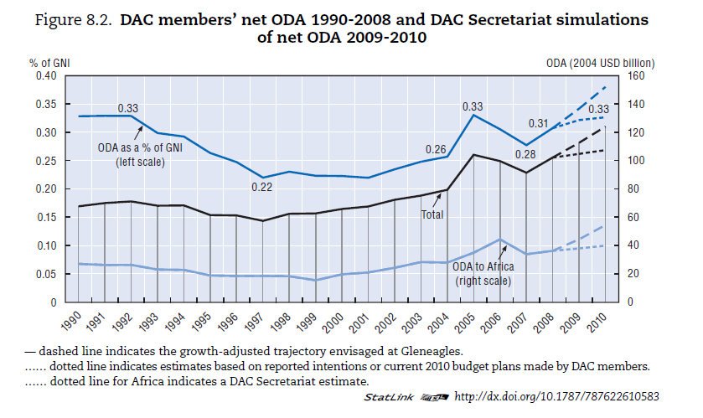
Trends in International Aid
Source: OECD DAC Development Cooperation Report 2010

Slide 6
Australia’s aid program
Source: Aust. budget documents
5

Slide 7
Aid, exports and FDI for developing countries (current USD billion)
The relative importance of aid

Slide 8
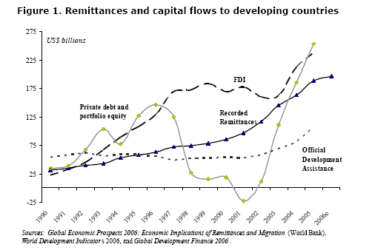

Slide 11
Aid as a % of GDP for SS-African countries (2007)

Slide 16
Aid as a % of GDP for Pacific / some East Asian countries (2007)

Slide 17
The role of aid
Innovation and ideas
  Is this all good?
Stabilisation
Emergency and food aid
For security and geopolitical reasons
Economic growth?
Poverty reduction?

Slide 18
Is aid a good thing?
Four broad perspectives:
Very good, very important
  Jeffery Sachs [Book: The End of Poverty]
  The ‘poverty trap’
  Complementary and simultaneous investments

Slide 19
Is aid a good thing?
Very bad (and thus very important in a bad way!)
  Peter Bauer [Book: Dissent on Development]
  Corrosive influence
  Dependency
  Politicisation of developing country economy
  Central planning
  Rent-seeking

Slide 20
Is aid a good thing?
Marginally good, but not too important
  Policies and institutions are most important
  …but aid can help at the margins
Marginally bad, but not too important
    Bill Easterly [Book: White Man’s Burden]
    Planners v. searchers

Slide 21
Is aid a good thing?
The verdict?
Evidence mixed…
Lack of counterfactual
Econometric studies
Poverty reduction
The equity argument
…and perhaps the better question is:

Slide 22
How can we improve aid?
My preferred approach – consider these three elements:
  Recipient
  Donor
  The relationship between the two

Slide 23
How can we improve aid?
Recipient:
Governance-centric
  Conditionality
    Domestic influences / political support
  Technical assistance
    But is there commitment to reform?

Slide 24
How can we improve aid?
Donor:
Knowledge burden
Development is complex (in case you hadn’t worked it out by now!)
Doing a lot of ‘a little’
Problems getting data
Lack of feedback loops

Slide 25
How can we improve aid?
The relationship:
One recipient, but many donors
Heavy transaction costs
Harmonisation
Alignment

