Slide 1
Economic Development
Lecture 12: Environment

Slide 2
Overview
Introduction
Sustainable development
Rural development and the environment
Case study: Lake Chad
Urban development and the environment
Climate change
The models
Policy options

Slide 3
Introduction
Environmental dependence
60% of world’s poor live on marginal soil
270,000 km² lost land every year (4 x Tasmania)
Annual loss is 0.5% to 1.5% of global agricultural output
Per capita food production in Sub-Saharan Africa is declining

Slide 4
Introduction
Environmental degradation causes:
Decreases in productivity of land
Decreases in total output
Health impacts
Climate change
Population pressures
Lurking variable: poverty

Slide 5
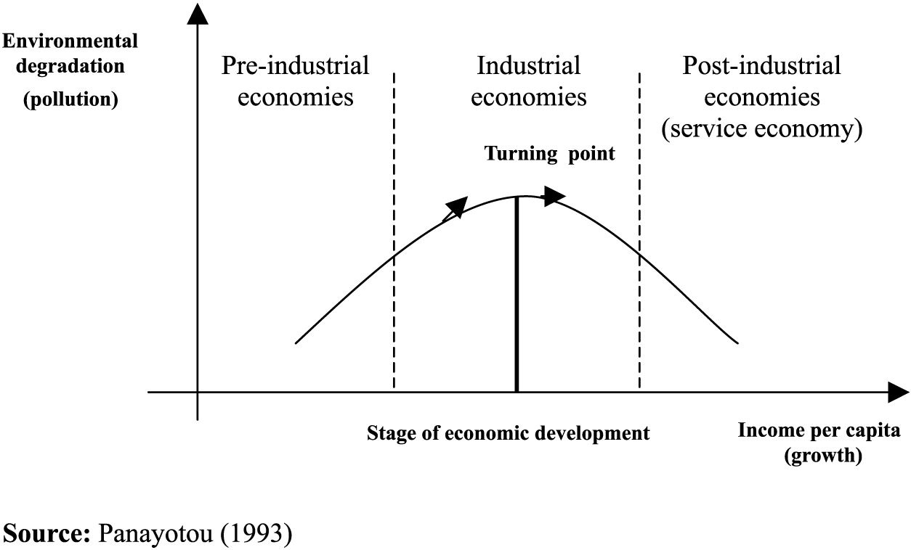
Environmental Kuznets Curve

Slide 6
Sustainable development
Brundtland Commission Report: ‘Our Common Future’
“meeting the needs of the present generation without compromising the needs of future generations”
Natural capital not closely substitutable
Technology?

Slide 7
Sustainable development
Environmental accounting:
NNI* = GNI – D_{m} – D_{n} – R – A
[NNI* = sustainable net national income; D_{m} = depreciation of physical K; D_{n} = depreciation of natural K; R = environmental restoration costs; A = environmental destruction aversion costs]
The triple bottom line

Slide 8
Rural development and the environment
The role of women
Food production needs to expand by 50% by 2025 to feed developing world
Deforestation for fuel -> soil erosion -> desertification

Slide 9
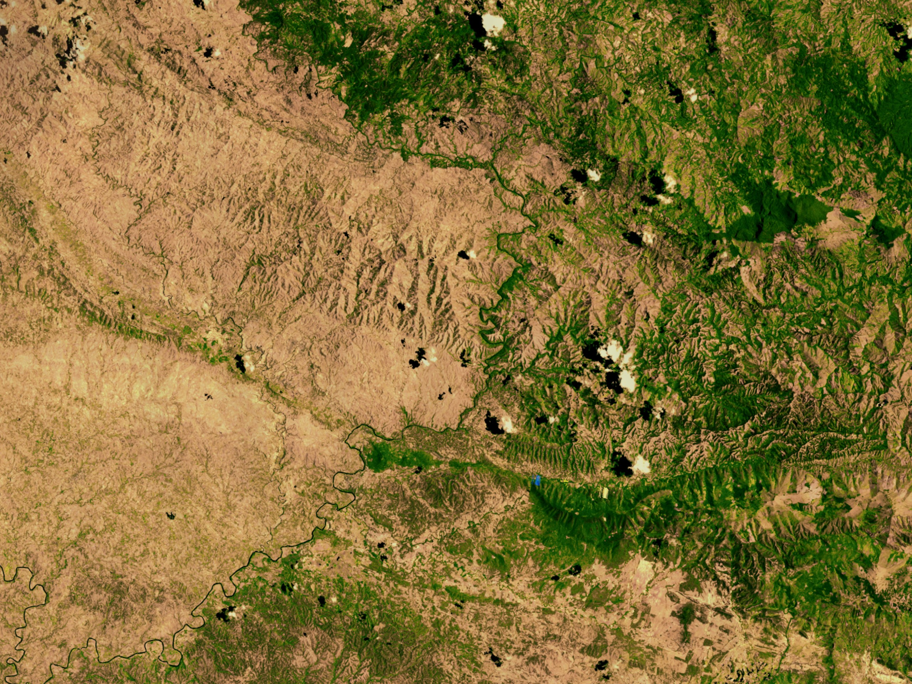
Haiti v. The Dominican Republic
Source: Nasa, 2002

Slide 10
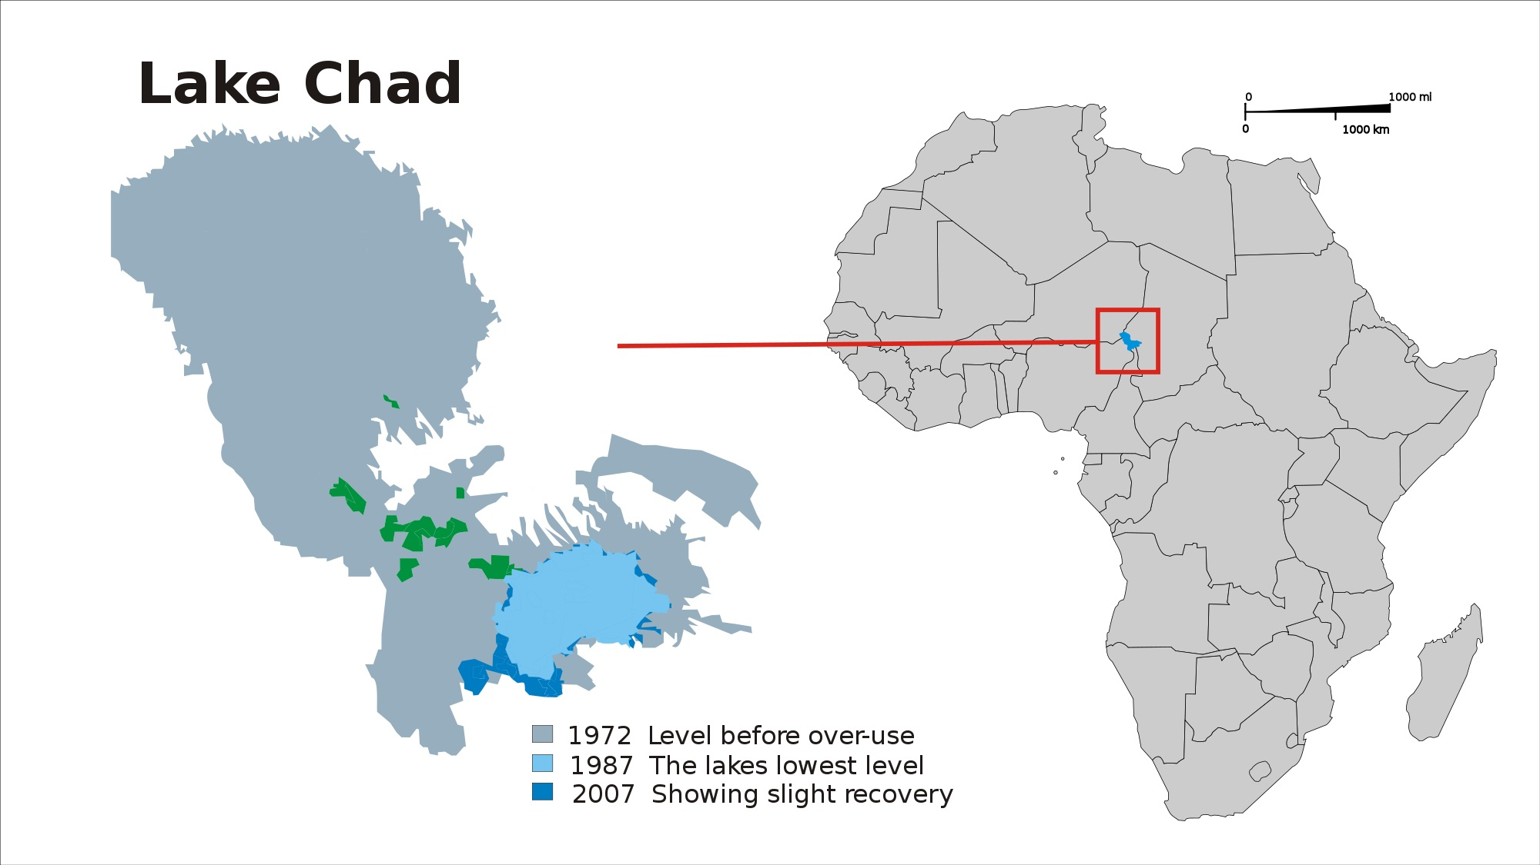
Lake Chad disappears…

Slide 11
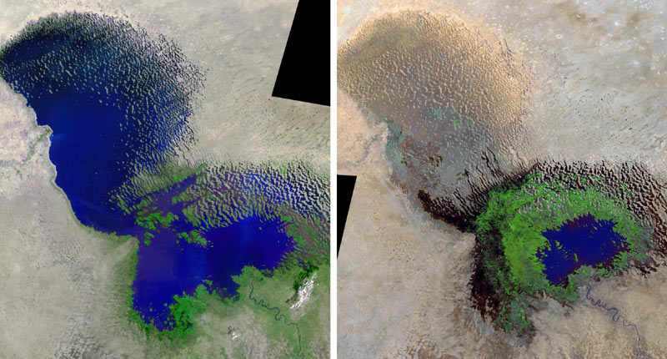
Lake Chad disappears…
Circa 1970
Circa 2005
Source: NASA

Slide 12
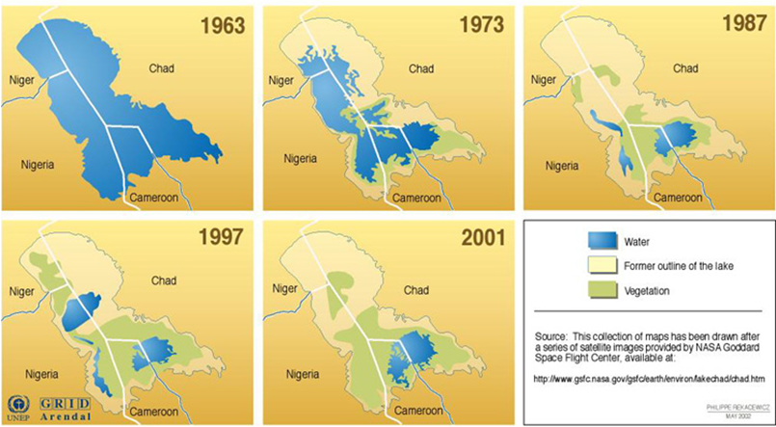
Lake Chad disappears…
Source: NASA

Slide 13
Urban development and the environment
Water pollution; sanitation; disease
‘Increasing costs to scale’ to environment
Congestion
Air pollution

Slide 14
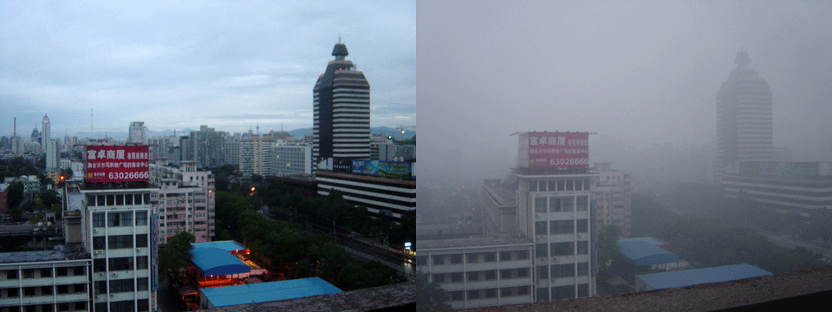
Urban Air Pollution: Beijing (2005)

Slide 15
Climate change
Africa becomes drier...
Rising water levels
Small island states
Deltas
2100: Sea levels will have risen of 18 cm to 59 cm, barring ice shelf break up
[Intergovernmental Panel on Climate Change's Fourth Assessment Report, 2007]

Slide 16
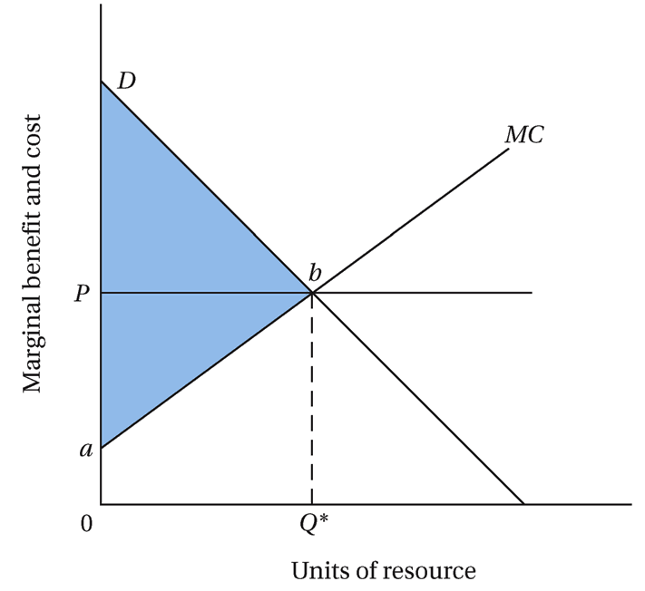
The models: Private resources

Slide 17
The models: Private resources
Scarcity rents
Property rights:
Universality
Excludability
Transferability
Enforceability

Slide 18
The models: Common property
No scarcity rents
‘Tragedy of the commons’: private gain v social cost
Regulation
Private resources more efficient

Slide 19
The models: Public goods (and bads)
Undersupply of public goods
Oversupply of public bads
Internalise the externality!
Global public goods:
Biodiversity
The lungs of the world

Slide 20
Policy options: Developing countries
Proper resource pricing
Community involvement
Private resources / property rights
Provide economic alternatives?
Focus on women
Reduce emissions
Proactive response

Slide 21
Policy options: Developed countries
Trade policy
Aid / debt relief
Reduce emissions
R&D
Import restrictions

