Slide 1
International Economics
Lecture 8: Trade Models IV –
The Standard Trade Model

Slide 2
Overview
Introduction
Setting up the Model
Adding in the Trade
Using the Model

Slide 3
Introduction
So far:
The Ricardian Model:
How comparative advantage leads to gains from trade
The Specific Factors Model
Tracks distributional effects of trade in the short-run
The Heckscher-Ohlin Model
Tracks distributional effects of trade in the long-run
Shows that differences in resource endowments drive trade

Slide 4
Introduction
The Standard Trade Model
The Standard Trade Model attempts to capture the key insights of the previous three models and create a general model
I.e. A model that can be applied generally, rather than to the more specific situations that the earlier models address

Slide 5
Introduction
The Standard Trade Model
The Model incorporates four key relationships:
The PPF and relative supply
Relative prices and relative demand
World relative supply and world relative demand (‘general equilibrium’)
The effects of terms of trade

Slide 6
Setting up the Model
Relationship 1: The PPF and relative supply
Let’s use cloth and food again as our two products
Like the Heckscher-Ohlin Model, our PPF is outwards-bending and we produce where we maximise the value of our production
This is where the isovalue line is tangential to the PPF
Our isovalue lines all have: Slope = – P_{C} / P_{F}

Slide 7
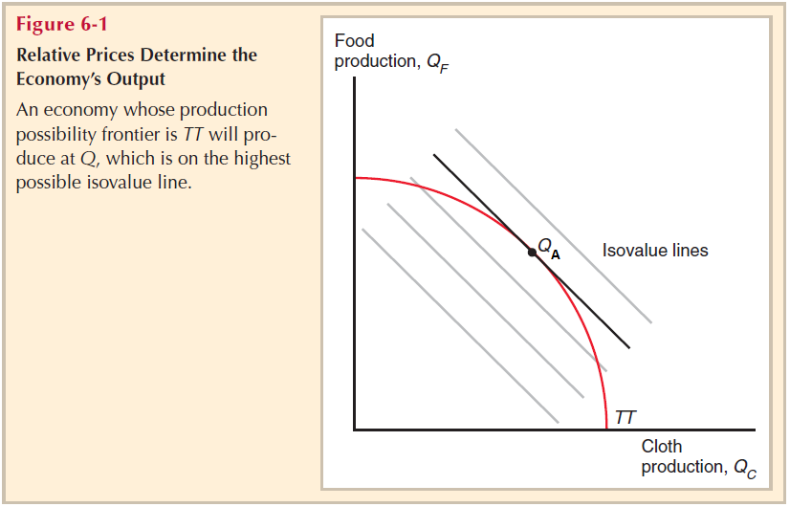
Slope of isovalue lines
= – P_{C} / P_{F}

Slide 8
Setting up the Model
Relationship 1: The PPF and relative supply
As the relative price changes, it traces out the PPF
I.e. The relative price line bends around the PPF
However, our relative price is determined by the relative supply curve

Slide 9
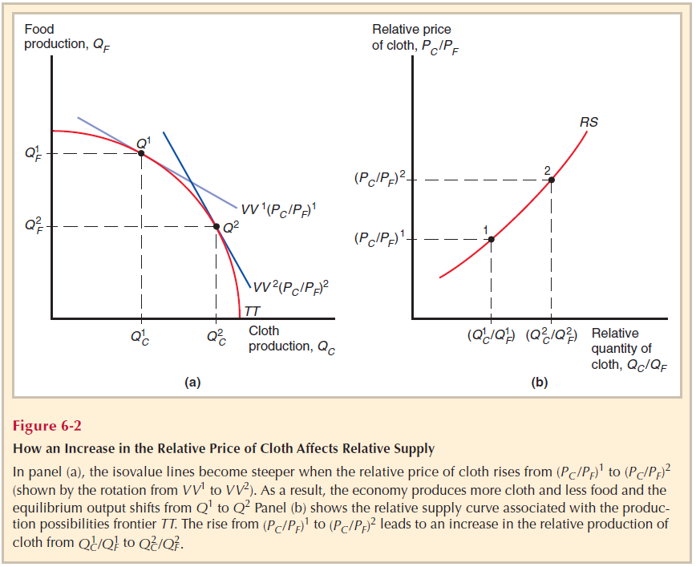

Slide 10
Setting up the Model
Relationship 2: Relative prices and relative demand
In autarky, where producers maximise value is also where we maximise benefit to consumers
In short, supply = demand !
Thus, value of output (V):
V = (P_{C} * QS_{C}) + (P_{F} * QS_{F}) = (P_{C} * QD_{C}) + (P_{F} * QD_{F})
[where QS = Q supplied; QD = Q demanded/consumed]
Note: The textbook uses ‘D’ rather than QD as notation for quantity demanded/consumed

Slide 11
Setting up the Model
Relationship 2: Relative prices and relative demand
However, when we add trade into the Model, consumers can now consume anywhere along the world relative price line (slope = – P*_{C} / P*_{F})
The world relative price line is also the isovalue line with trade
For this reason, the world relative price line is sometimes called the trade line or line of trade

Slide 12
Setting up the Model
Relationship 2: Relative prices and relative demand
This also means that although the value of domestic production is equal to the value of domestic consumption, they are now at different points
We determine where domestic consumption is along the trade line by introducing the concept of indifference curves

Slide 13
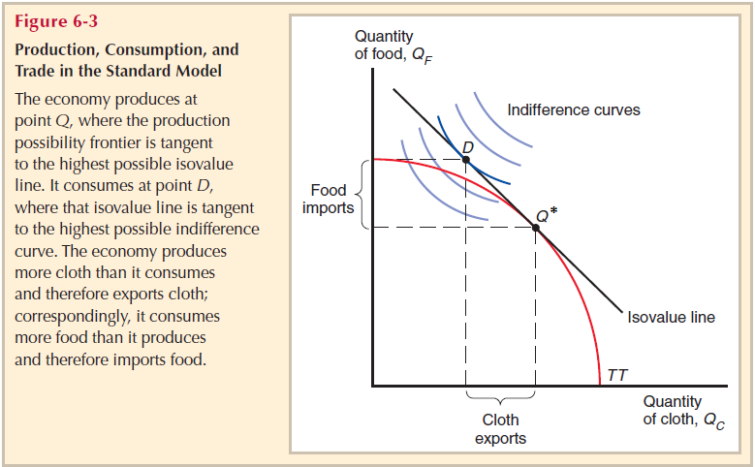
Introducing indifference curves

Slide 14
Setting up the Model
Indifference curves
All points along a curve measure the same level of utility (satisfaction from consumption)
This means that consumers are indifferent about where they consume on the same curve
Often called ‘utility curves’
Rules:
Cannot intersect (always parallel)
Utility functions are ordinal not cardinal
(e.g. U = 10 is not twice the utility of U = 5)

Slide 15
Setting up the Model
Indifference curves
Shape:
Inwards-bending, which means diminishing marginal utility
Straight indifference curves are possible: this means that the products are perfect substitutes
Right-angled indifference curves are also possible: this means that the products are perfect complements

Slide 16
Setting up the Model
Relationship 3: World relative supply and demand
Essentially, we find the world relative price where world RS = RD
We looked at this in our last lecture…
…but here it is again!

Slide 17
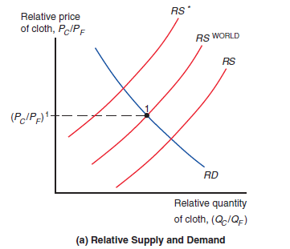
Remember:
We assume that RD is the same everywhere in the world (this means the same consumer preferences)

Slide 18
Setting up the Model
Relationship 4: The effect of terms of trade
Terms of trade = price of exports / price of imports = P_{X} / P_{M}
A rise in a country’s terms of trade [↑P_{X} or ↓P_{M}] leads to an increase in welfare
A fall in a country’s terms of trade [↓P_{X} or ↑ P_{M}] leads to a decrease in welfare
Both are measured by where a country can consume

Slide 19
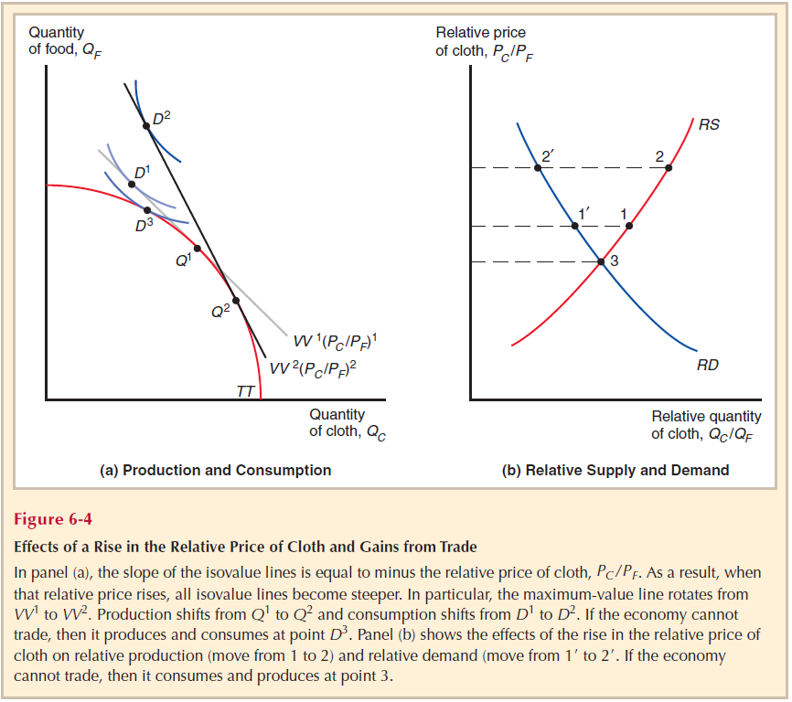
RS = Domestic RS
As the terms of trade increase [↑(P_{C}/P_{F})], welfare increases
[D3 => D1= > D2]

Slide 20
Adding in the Trade
In a two-economy world, the amount of exports for one country are the imports for the other
E.g. Home’s imports = Foreign’s exports; Home’s exports = Foreign’s imports
This creates trade triangles on our diagram of equal base and height (i.e. equal size!)

Slide 21
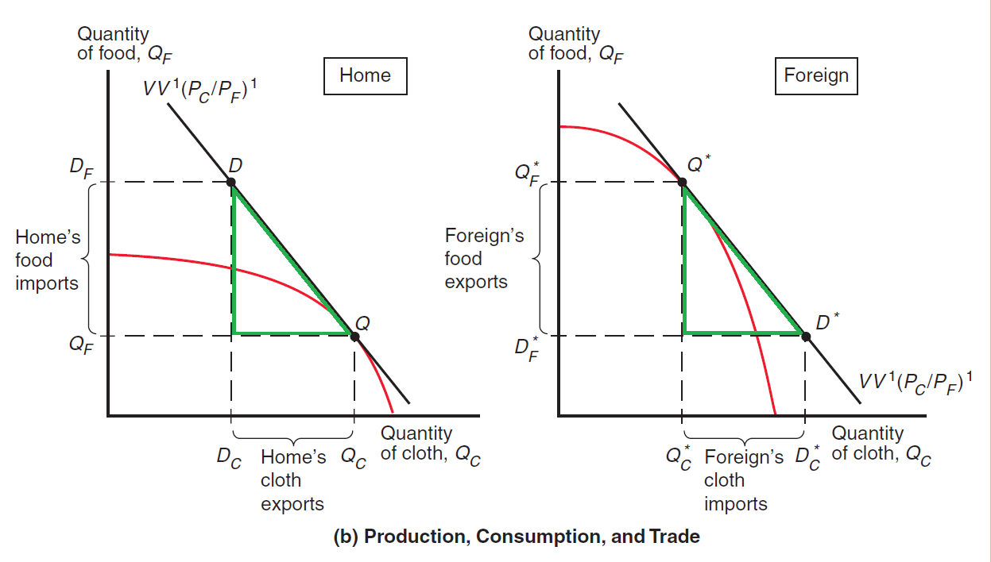
Trade triangles [in green]

Slide 22
Using the Model
Now that we have the Standard Trade Model all worked out, let’s do things with it!
First, let’s look at the effect of economic growth on the Model
Growth inevitably has a bias towards one product or the other (‘biased growth’)

Slide 23
Using the Model
There are two main reasons for growth:
Technological progress in one sector will expand the PPF more in that product’s direction [as per the Ricardian Model]
An increase in a factor endowment will expand the PPF more in the direction of the product that uses that factor intensively [as per the Heckscher-Ohlin Model]

Slide 24
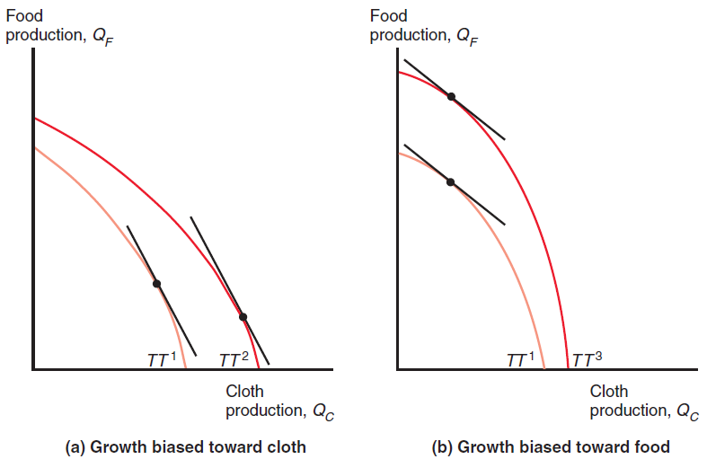

Slide 25
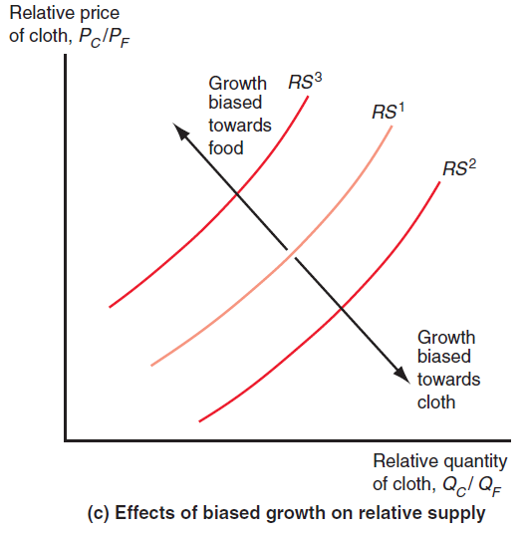
Note:
These are domestic RS curves

Slide 26
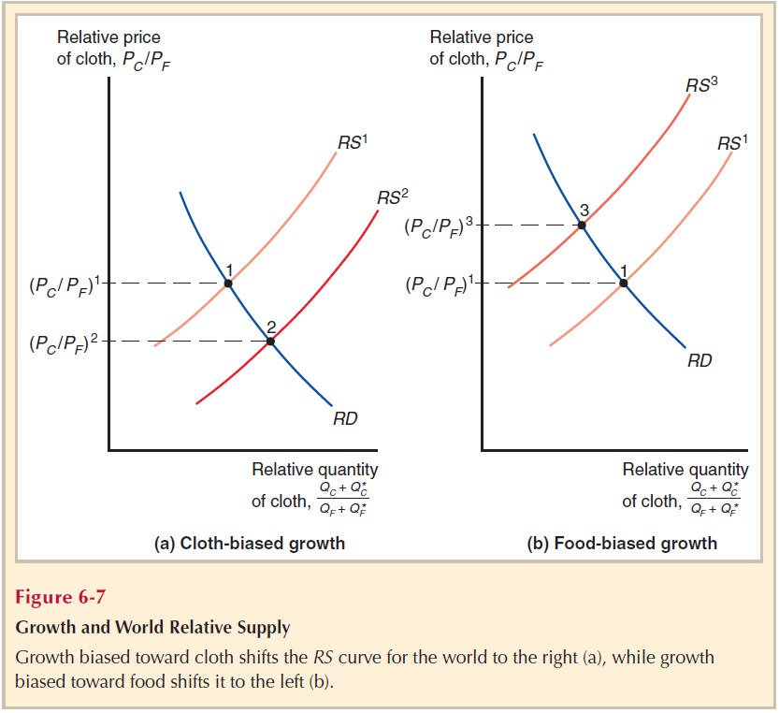
...and these are world RS curves!

Slide 27
Using the Model
Note from the last slide that the product bias of the economic growth leads to a fall in the relative price of that product
One the face of it, this seems like a bad thing for the country that exports that product
But you have to remember that there is also a volume effect with economic growth

Slide 28
Using the Model
So it depends which change is bigger:
↓P_{C}/P_{F} , or ↑Q_{C}
For a small economy, the quantity effect (↑Q_{C}) would usually be bigger
However, if the price effect (↓P_{C}/P_{F}; a drop in its terms of trade) is bigger than the quantity effect, then we get immiserising growth
I.e. growth that is bad, and makes you miserable!

