Slide 1
International Economics
Lecture 5: Trade Models I –
The Ricardian Model

Slide 2
Overview
Introduction
Setting up the Model
Adding trade into the Model
Misconceptions about comparative advantage
Empirical evidence for the Model

Slide 3
Introduction
Productive efficiency
A product is made using the least amount of resources
Allocative efficiency
Resources are allocated according to their most productive social use

Slide 4
Introduction
Autarky
An economy that does not trade internationally
Opportunity cost
The value of the next best alternative
Distinguishes the decision-making in economics from mere accounting!

Slide 5
Introduction
PPFs and PPCs
Illustrate the principle of opportunity cost
Shows the all of the possible combinations of two products that can be produced
Hence the name: production possibility frontier!

Slide 6
Introduction
PPFs and PPCs (cont.):
Assumptions:
Fixed resources
Fixed technology
Productive efficiency
Full employment
For our purposes, two products only

Slide 7
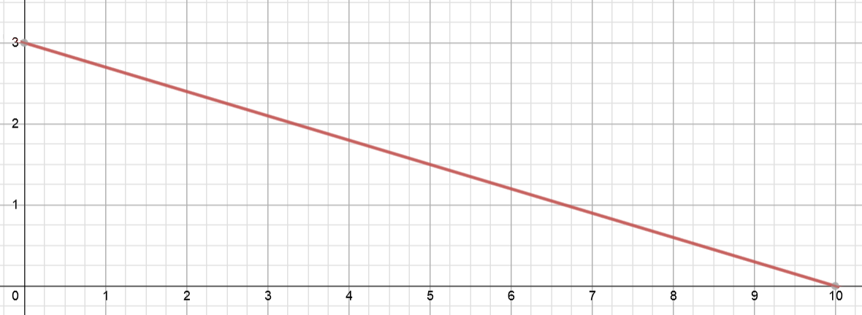
An example of a straight-line PPF:
a pizza shop that produces only two products
Pizzas
Garlic breads
What type of opportunity cost does this show?

Slide 8
Introduction
Factors of production:
Labour (‘L’)
Income paid on labour is a wage
Capital (‘K’)
Income paid on capital is rent (or interest)
Land (‘T’) (but the category is broader than ‘land’!)
Income paid on land is rent
Entrepreneurship
Income paid on entrepreneurship is profit

Slide 9
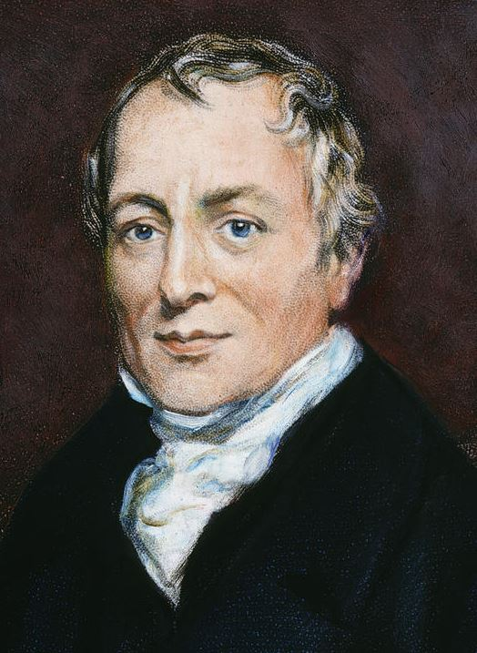
Introduction
Who was Ricardo?
British political economist
Born: 1772, Died: 1823
Made his fortune speculating
on the outcome of the Battle
of Waterloo!!
Mercantilism v. free trade
Created the theory of comparative advantage

Slide 10
Introduction
Absolute advantage
The ability to produce more of a product than other producers using the same amount of resources
Comparative advantage
The ability to produce a product at a lower opportunity cost than other producers

Slide 11
Introduction
The Ricardian Model:
Hypothesis:
International trade is caused by differences in labour productivity
We make no assumptions about why labour productivity is different – it could be technology, climate, resource endowments – anything!
However, the labour itself is homogenous

Slide 12
Setting up the Model
Imagine an economy with only one factor of production: Labour (L)
Simple model: only two products in our economy
Each product requires a certain amount of labour to produce each unit
This is the unit labour requirement (α)
E.g. one unit of Good A requires three hours of labour

Slide 13
Setting up the Model
&
An example: Cheese and Wine
Unit labour requirements:
Cheese: α_{LC}
Wine: α_{LW}
Total labour = L
Production (Q):
Q_{C} = Quantity of cheese produced
Q_{W} = Quantity of wine produced

Slide 14
Setting up the Model
&
What is the cost of production for cheese?
Total cost = Quantity * Price (i.e. cost per unit)
= Q_{C} x α_{LC} (Q of cheese produced * unit L requirements/costs)
What is the cost of production for wine?
Total cost = Quantity * Price (i.e. cost per unit)
= Q_{W} x α_{LW} (Q of wine produced * unit L requirements/costs)
Okay, so lets put in some numbers…

Slide 15
Setting up the Model
&
Let’s set total labour (L) = 1,000 hours
…and say that it takes 1 hour of labour to produce cheese: α_{LC} = 1
…and 2 hours of labour to produce wine: α_{LW} = 2
Therefore, the total production must be:
(1 hour * Q_{C}) + (2 hours * Q_{W}) ≤ 1,000 hours
General equation: (α_{LC} * Q_{C}) + (α_{LW} * Q_{W}) ≤ L

Slide 16
Setting up the Model
&
If all available labour was devoted to making cheese, we would have: L / α_{LC} = 1,000 / 1 = 1,000 cheese
Or, if all available labour was devoted to making wine: L / α_{LW} = 1,000 / 2 = 500 wine
Now let’s graph it!
We’ll call our economy ‘Home’

Slide 17
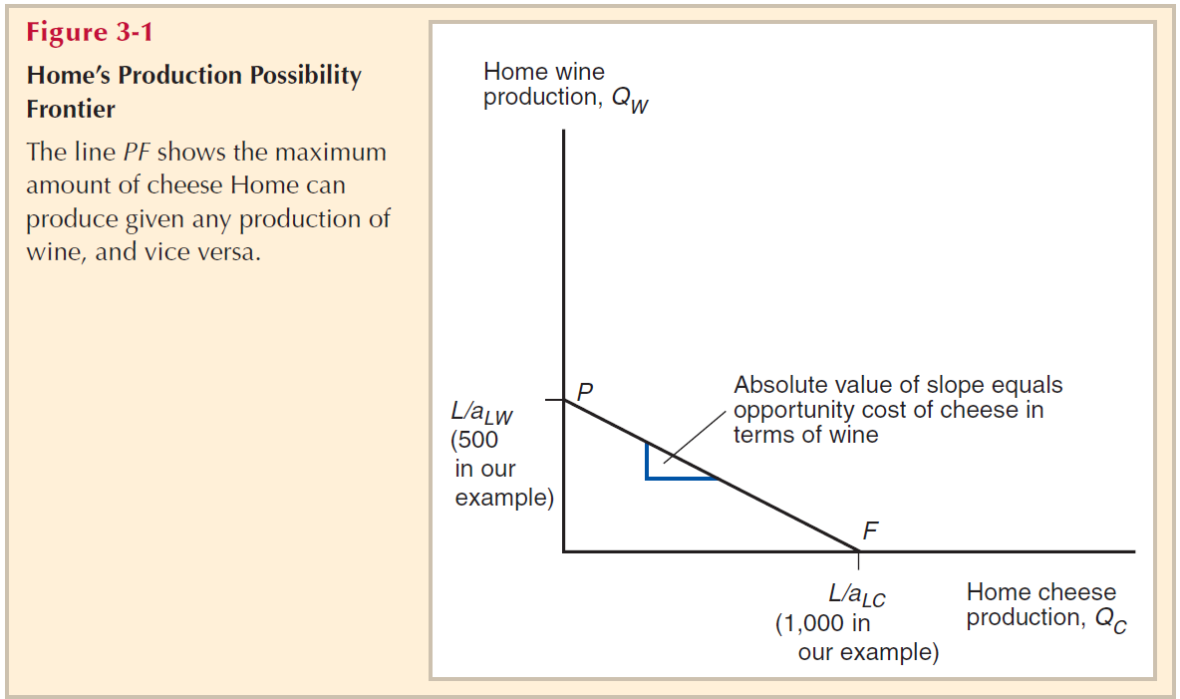
Our wine and cheese economy... (‘Home’)
Remember: A straight-line PPF means constant opportunity cost!

Slide 18
Setting up the Model
&
So what are the opportunity costs here?
The absolute slope of the PPF tells us the opportunity cost of the x-axis (cheese in our example) in terms of the y-axis (wine in our example)
Thus: the opportunity cost of cheese = x / y = 2
...and the opportunity cost of wine = y / x = ½
Note: the opportunity costs are always inverse of each other!

Slide 19
Setting up the Model
&
So what should the economy specialise in?
This depends on the actual prices!
What if cheese was $4.00, and wine was $6.00 ?
What if cheese was $2,00 and wine was $6,00 ?
What if cheese was $3.50, and wine was $7.00 ?
However, ceteris paribus, we expect prices to
be in the same ratio as the opportunity costs

Slide 20
Setting up the Model
&
What we are doing here is comparing relative prices
to the opportunity costs
The relative price is just the price of one product relative to the other (α_{LC} / α_{LW}):
E.g. The relative price of cheese (to wine) is: P_{C} / P_{W}
If P_{C} / P_{W} > α_{LC} / α_{LW}, then Home should specialise in cheese
If P_{C} / P_{W} < α_{LC} / α_{LW}, then Home should specialise in wine
We are just comparing price to cost!

Slide 21
Setting up the Model
&
Wages (w):
The wage for each hour of labour should simply equal the price of the product, divided by how many hours it takes to produce: w = (P / α)
E.g. If wine is worth $7.00, and it takes
2 hours to produce, then the wage in
the wine industry is:
w_{W} = P_{W} / α_{LW} = 7.00/2 = $3.50/hr
Note:
This assumes no supranormal π... i.e. perfect competition!

Slide 22
Adding trade into the Model
Note:
The notation we use for ‘foreign’ is an asterisk (*)
Now we need to add in the trade part!
Assumptions:
Two countries, called Home and Foreign*
Again, only one factor of production (L)
Home will have a comparative advantage in cheese
I.e. the relative (unit) cost of cheese (compared to wine) in Home is less than that in Foreign
Thus: α_{LC} / α_{LW} < α*_{LC} / α*_{LW}

Slide 23
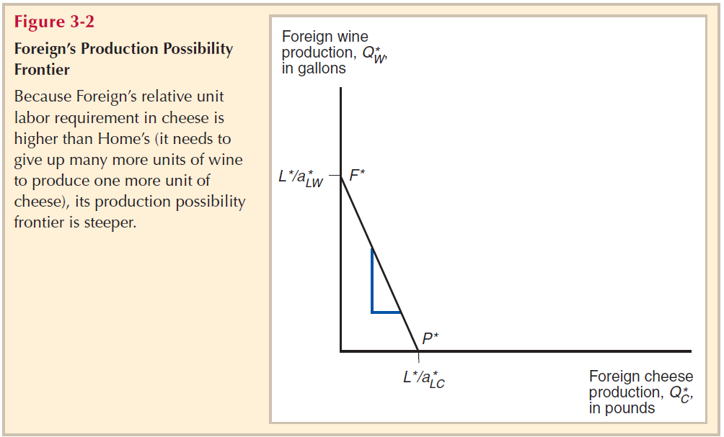
The PPF for Foreign
Without any numbers, we don’t know the absolute slope or exact opportunity costs for Foreign, only that it is steeper (has a higher opportunity cost of cheese in terms of wine) than Home

Slide 24
Adding trade into the Model
Don’t assume that comparative advantages can be determined by comparing the unit cost alone!
This only tells us the absolute advantage
I.e. If α_{LC} < α*_{LC} , then Home has an absolute advantage in producing cheese
However, to determine comparative advantage, we must compare the opportunity costs of producing a product, not their accounting costs!

Slide 25
Adding trade into the Model
In the absence of trade, we expect relative prices to equal relative costs...
In Home: P_{C} / P_{W} = α_{LC} / α_{LW}
In Foreign: P*_{C} / P*_{W} = α*_{LC} / α*_{LW}
With trade, we assumed that Home had the comparative advantage in cheese – and this means that Foreign has a comparative advantage in wine
THUS: Home should trade cheese in return for Foreign wine

Slide 26
Adding trade into the Model
But what will world prices be with trade?
We need to have a model that does not just look at the market for cheese, or the market for wine…
…but instead models both markets together!
This is called general equilibrium analysis
For this, we need the concept of relative demand and relative supply

Slide 27
Adding trade into the Model
Relative demand; relative supply: shows relationship between a relative price and a relative quantity
Relative prices we already know…
E.g. the relative price of cheese (in terms of wine) = P_{C} / P_{W}
Relative quantity is a similar idea, but with quantities:
Relative quantity of cheese = Q_{C} + Q*_{C}
Q_{W} + Q*_{W}

Slide 28
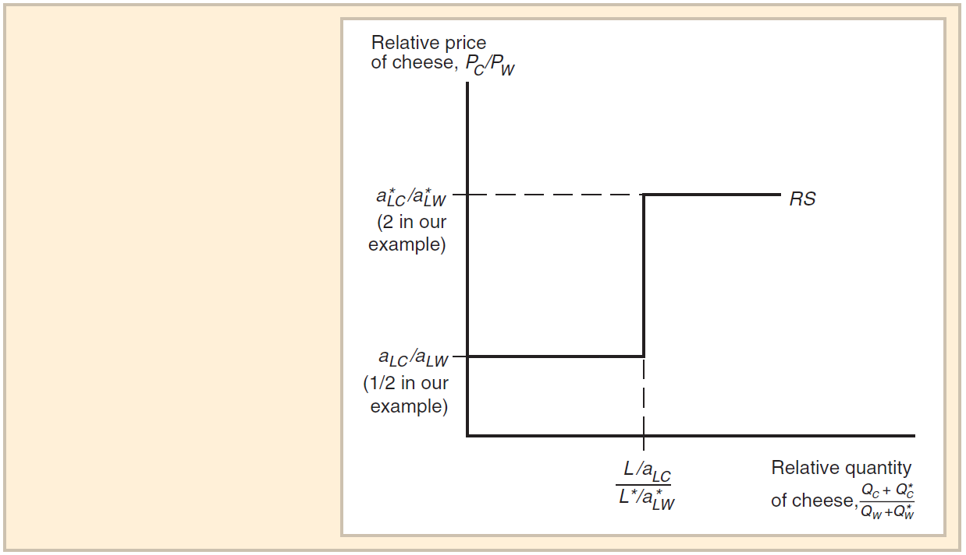
General equilibrium analysis: relative supply
Both Home
and Foreign specialise in cheese if price is above α*_{C} / α*_{W}
Any price in between leads to Home to fully specialise in cheese, and Foreign to fully specialise in wine
The quantities produced when both countries fully specialise
No supply of cheese if price drops below
α_{C} / α_{W}

Slide 29
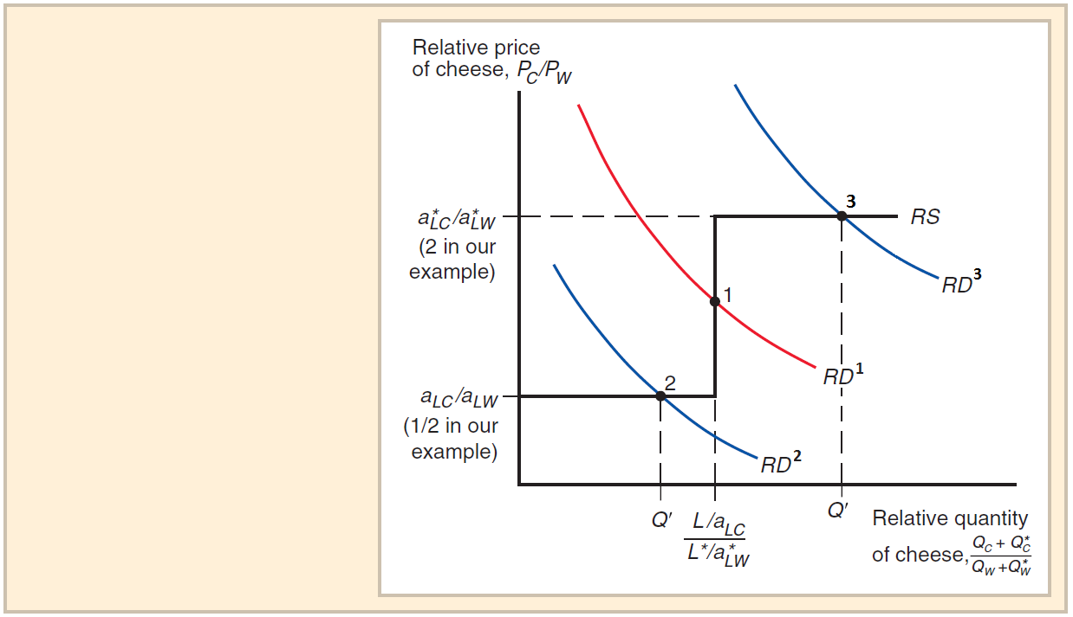
General equilibrium analysis: relative demand and relative supply
Note: RD is exogenously determined (‘given’ to us, we are not calculating it!)
Any RD that intersects relative supply between these prices leads to both countries fully specialising
[e.g. RD¹]
Any RD that intersects on a flat part of RS will lead to complete specialisation in one country, and no specialisation in the other [e.g. RD² or RD³]

Slide 30
Adding trade into the Model
RD¹: Both Home and foreign fully specialise according to their comparative advantage
RD²: Foreign fully specialises in wine, Home does not specialise (produces both)
RD³: Home fully specialises in cheese, Foreign does not specialise (produces both)
Note: Countries will never specialise against their comparative advantage (except with domestic distortions)

Slide 31
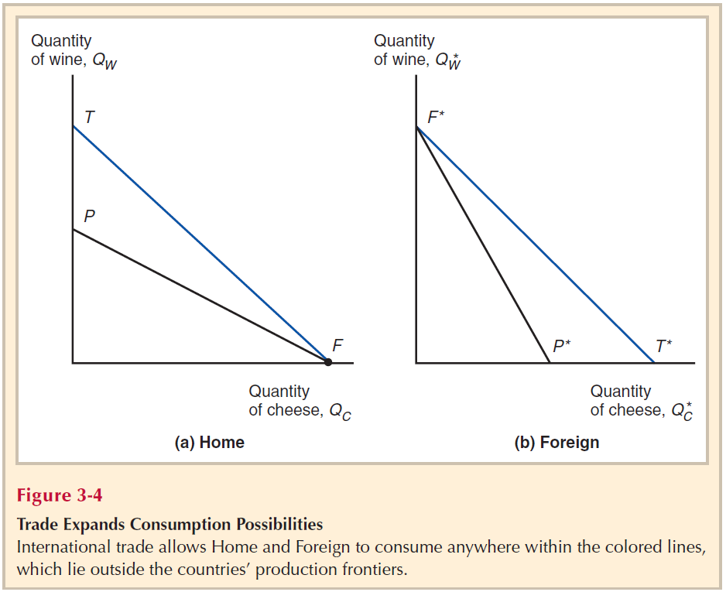
Back to the PPFs...

Slide 32
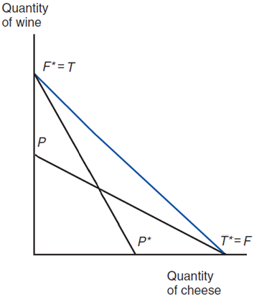
Combined:
Both Foreign and Home can consume outside of their PPFs, and at any given point within the blue line
Conclusion?
Both countries gain from trade!

Slide 33
Misconceptions about comparative advantage
“Free trade is only beneficial if you country is strong enough to stand up to foreign competition”
This is a statement about absolute advantage
But the Model is based on comparative advantage:
“The ability to produce a product at a lower opportunity cost than other producers” [Slide 8]
Countries would have to be exactly identical for them not to have a comparative advantage!

Slide 34
Misconceptions about comparative advantage
“Trade hurts countries when it is based on low wages”
This is the pauper labour argument
However, we can see that both countries gain from trade…
It is cheaper in terms of their own labour for them to specialise according to their comparative advantage, and then trade for the product that they do not have a comparative advantage in

Slide 35
Misconceptions about comparative advantage
“Trade exploits a country by keeping wages low”
There are actually two questions here:
Do countries that engage in international trade withhold some benefits that could have been paid to their partner countries as higher wages?
Yes, of course!
But are countries still better off trading than they would have been otherwise?
Yes, our Model proves this!

Slide 36
Empirical evidence for the Model
We do see specialisation according to the Model, but not full specialisation
The Model also does not consider:
Effects upon income distribution within countries [Chapter 4]
How differences in resource endowments specifically could be a cause of trade
[Chapters 4 & 5]
The effect of market power and economies of scale [Chapters 7 & 8]

