Slide 1
International Economics
Lecture 3: International
political economy

Slide 2
Overview
Narrative I: The West versus ‘the Rest’
Narrative II: Globalisation and the rise of ‘the Rest’
Narrative III: Rising equality, rising inequality
Narrative IV: Protectionism, free trade, or Fair Trade?

Slide 3
Firstly…
What is political economy?
Where does economics intersect with politics?
EVERYWHERE!

Slide 4
Narrative I: The West versus ‘the Rest’
The legacy of colonialism and imperialism
A search for resources and markets
Neocolonial dependency theory:
The centre exploits the periphery
Problems:
Just the ‘West’?
Is the exploitation deliberate?

Slide 5
Narrative II: Globalisation and the rise of ‘the Rest’
The rise of (some) of ‘the Rest’
Economic globalisation:
Free(-er) trade and investment
Dismantling of protectionist barriers
Technology transfer
= ‘trade liberalisation’

Slide 6
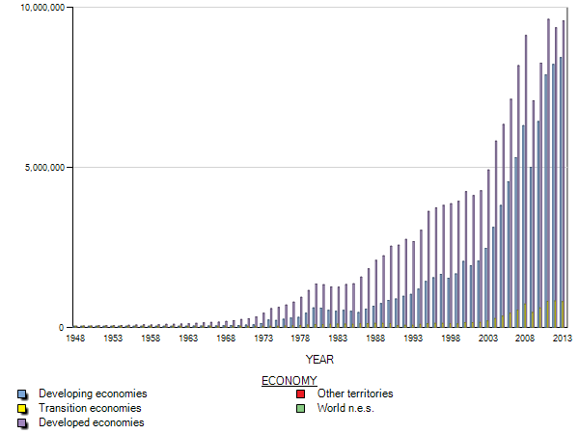
Value of International Trade
(2013 USD millions)
Source: UNCTAD, 2014 [http://unctad.org/en/pages/Statistics.aspx]

Slide 7
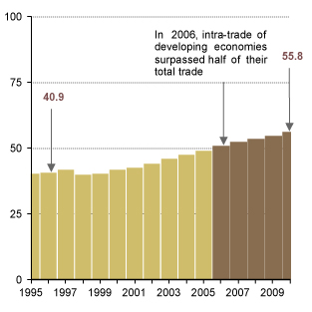
‘South-south’ trade
(as a % of total developing country trade)
Source: UNCTAD, 2012 [http://dgff.unctad.org/chapter1/1.1.html]

Slide 8
Narrative II: Globalisation and the rise of ‘the Rest’
Changing patterns of trade:
Initially dominated by horizontal linkages…
But now by vertical linkages!

Slide 9
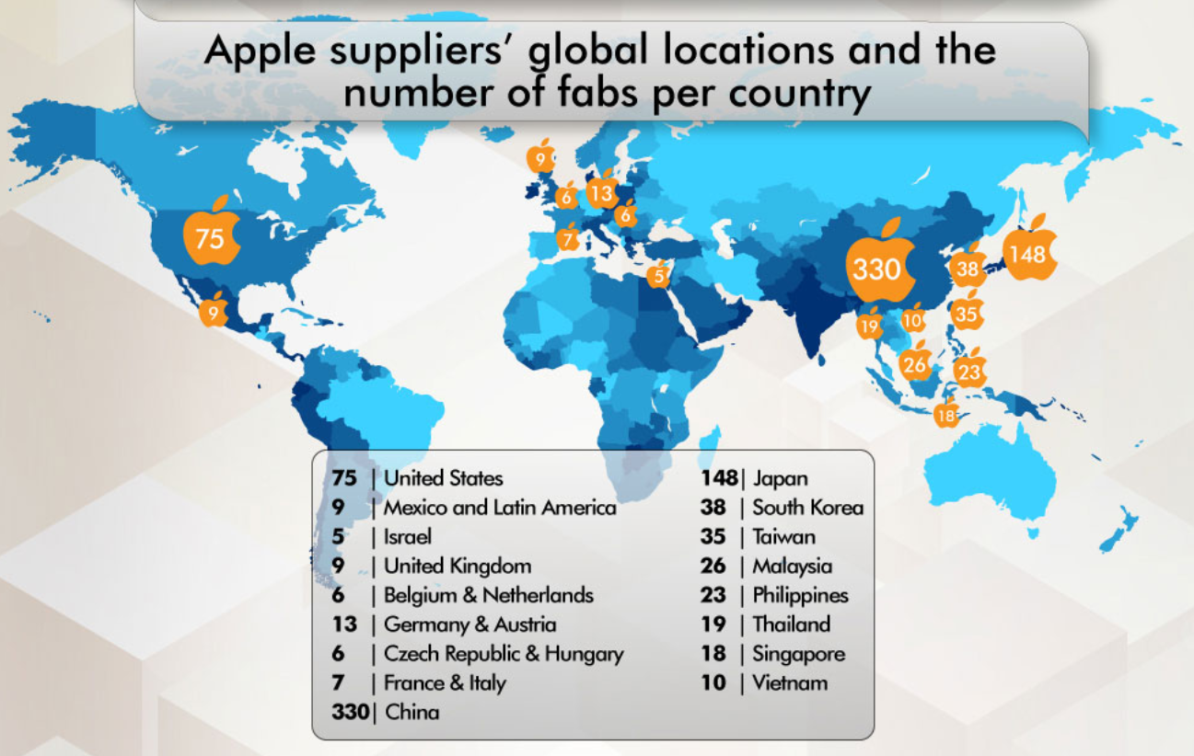
The Apple iPhone 5 value chain
(number of manufacturing processes)
Source: [http://financesonline.com/how-iphone-is-made/]

Slide 10
Narrative II: Globalisation and the rise of ‘the Rest’
The political story:
Distribution of economic power is changing international power dynamics
Unipolar -> multipolar
Some big risks:
Tensions in the Asia-Pacific
Climate change

Slide 11
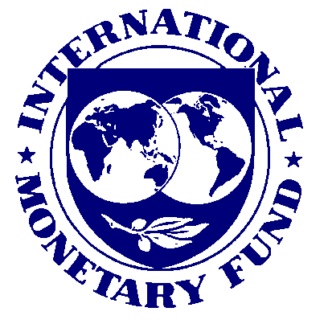
Narrative II: Globalisation and the rise of ‘the Rest’
Pressures on international economic governance
IMF + World Bank = Bretton Woods institutions
Intellectual ‘soft power’
Neoliberalism
An alternative
institutional architecture?

Slide 12
The rise of the....

Slide 13
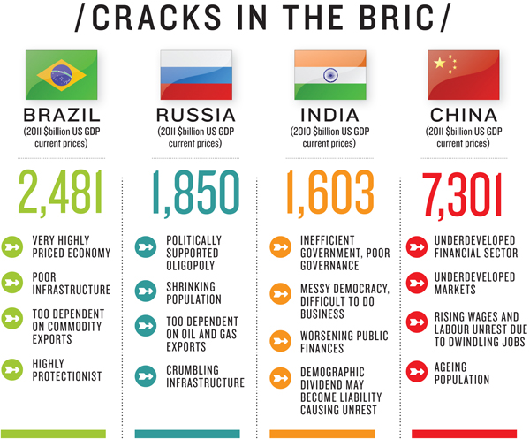
Source: Forbes India, 2012 [http://forbesindia.com/article/boardroom/bric-countries-hit-a-wall/33030/1]

Slide 14
Narrative III: Rising equality, rising inequality
Global income inequality decreasing since c. 2002
Income inequality within countries on the rise
Measuring income inequality:
The Gini coefficient
0 = perfect equality
1 = perfect inequality

Slide 15
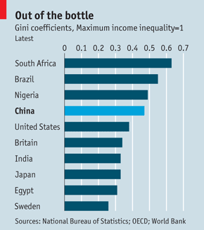
Source: The Economist, 2013 [http://www.economist.com/news/china/21570749-gini-out-bottle]

Slide 16
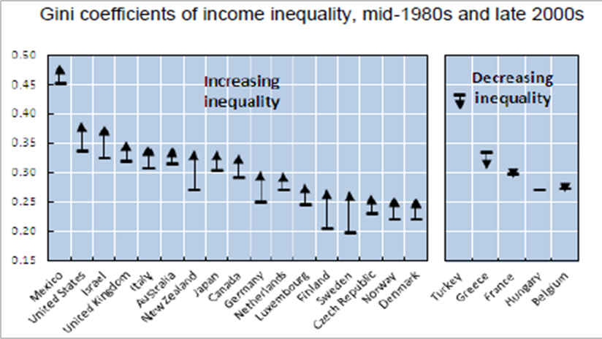
Source: The Economist, 2011 [http://www.economist.com/blogs/freeexchange/2011/05/income_inequality]

Slide 17
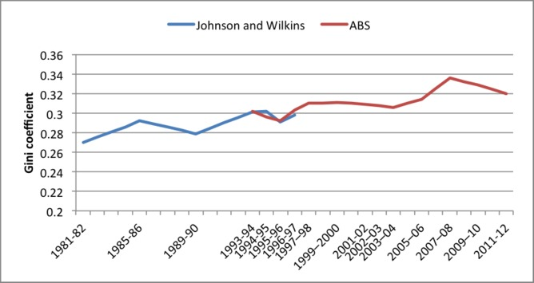
Australian income inequality
Source: Prof. Peter Whiteford, ANU, 2014 [https://theconversation.com/income-and-wealth-inequality-how-is-australia-faring-23483]

Slide 18
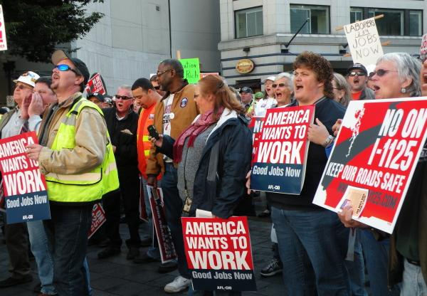

Slide 19
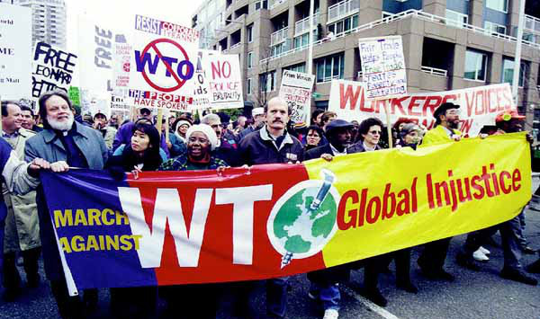

Slide 20
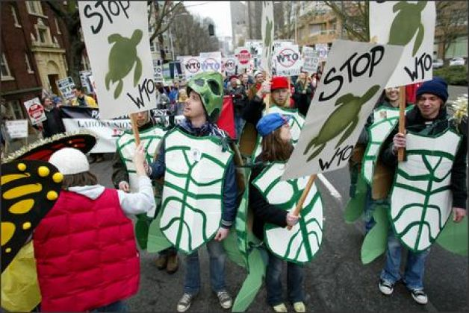

Slide 21
Narrative IV: Protectionism, free trade, or Fair Trade?
The WTO is decently representative of countries
But not necessarily of citizens?
Protectionism = barriers to free trade
Economic exchange => value creation
Nationality is irrelevant!

Slide 22
Narrative IV: Protectionism, free trade, or Fair Trade?
An Australian example: the car industry
Is corporate welfare a sustainable policy?
The best economic policy is the most direct:
Is stopping trade your goal, or are you trying to support a particular group in society instead?

Slide 23
Narrative IV: Protectionism, free trade, or Fair Trade?
Conclusion: Trade liberalisation is a net positive (cost < benefit)
BUT: Concentrated losses, thinly spread gains
A strong history (Australia, China, India, Vietnam, + many more!)

Slide 24
Narrative IV: Protectionism, free trade, or Fair Trade?
…but what about Fair Trade?
A niche market
Poorest farmers miss out: time and money costs
Some evidence that it depresses prices for those who miss out

Slide 25
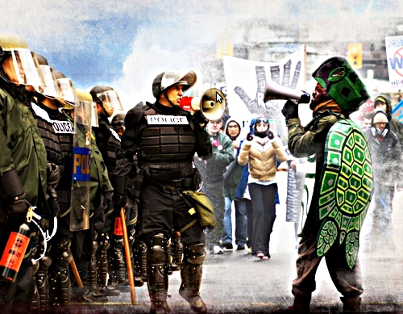
An exercise in mutual futility...?

