Slide 1
International Economics
Lecture 17: The History of the International
Monetary System

Slide 2
Overview
Review: Types of exchange rates
Internal balance
External balance
The open-economy trilemma
The Gold Standard: 1870 – 1914
The Interwar Years: 1918 – 1939
The Bretton Woods System: 1945 – 1973
‘Bretton Woods Plus’: 1973 – now

Slide 3
Review: Types of exchange rates
Fixed exchange rates
Floating exchange rates
Prone to price volatility, speculation
‘Managed float’
Occasional intervention
Can be done through the use of ‘bands’
And in PNG?

Slide 4
Internal balance
Full employment and price stability
Imbalances:
Underemployment or over-employment
High inflation or deflation

Slide 5
External balance
Unlike with internal balance, there are no unambiguous benchmarks!
Often it is assumed that balanced, Balance of Payments Accounts creates ‘external balance’
However, it depends on the country’s strategy

Slide 6
External balance
For example, running a current account deficit because of loans from the rest of the world is not a problem as long as the loans receive a higher return than the interest paid on them
Deficits (i.e. debts) are not intrinsically bad!

Slide 7
External balance
Consumption-smoothing is another reasonable justification for a current account deficit
E.g., if there is a current account deficit due to a natural disaster or crop failure

Slide 8
External balance
Long-term trends are more important than short-term imbalances
Just as with a government budget, or personal budget!!

Slide 9
External balance
Problems with excessive current account deficits:
If it is cause by debt repayment flows, are investment opportunities in the country truly good enough to warrant huge debts?
Danger of a ‘sudden stop’ (in lending)

Slide 10
External balance
Problems with excessive current account surpluses:
Implies low domestic investment, which may indicate faulty domestic policies
Potential lost domestic tax revenues
Potential domestic underemployment

Slide 11
External balance
Problems with excessive current account surpluses (cont.):
Usually comes at a cost to domestic consumption
Will the country get the money lent overseas back?
E.g., Greece!

Slide 12
The open-economy trilemma
In an open-economy, it is impossible to have more than two from the following list:
Exchange rate stability
Monetary policy autonomy
Freedom of movement of capital

Slide 13
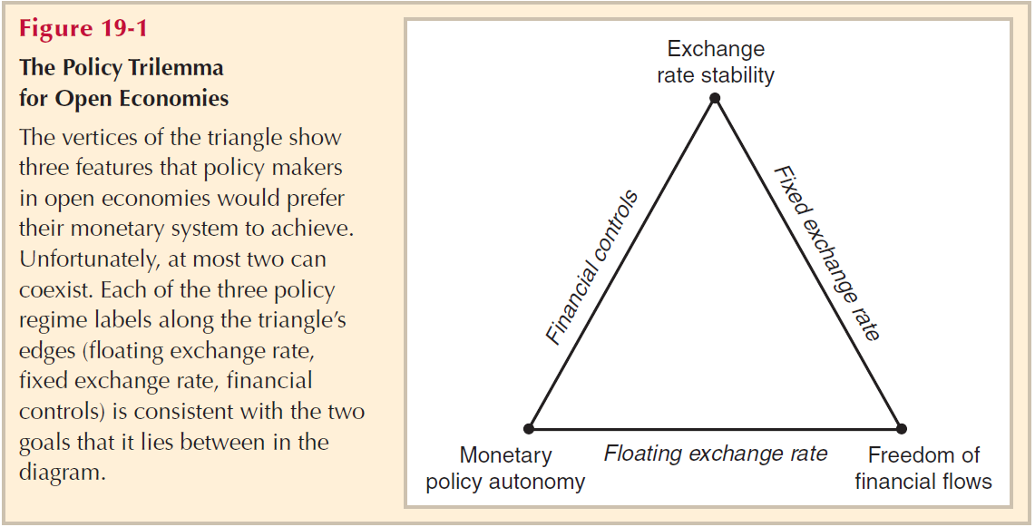
The open-economy trilemma

Slide 14
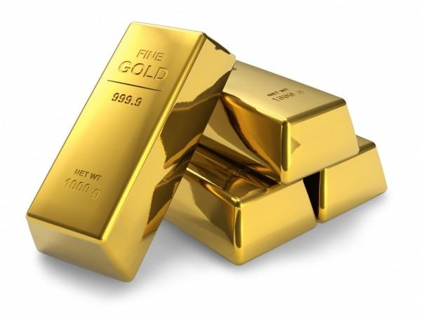
The Gold Standard: 1870 – 1914
London was the centre of the international monetary system
Governments fixed the
exchange rate between
gold and their own currencies
And gold was convertible on demand!

Slide 15
The Gold Standard: 1870 – 1914
External balance was achieved by not selling or acquiring too much gold
Balance of payments surpluses and deficits were financed by shipping gold between central banks!
Prices tended to adjust according the amount of gold circulating in an economy

Slide 16
The Gold Standard: 1870 – 1914
E.g., gold flows into countries with a current account surplus (earned from exports), and then prices rise in the country
Domestic goods then become more expensive and foreign goods become cheaper, reducing the current account surplus of the domestic country and reducing the current account deficits of the foreign countries

Slide 17
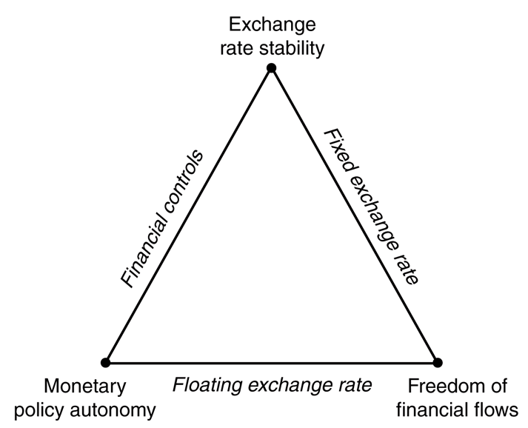
The Gold Standard: 1870 – 1914
Conclusions?
The gold standard acts an automatic stabiliser
The gold standard ‘solves’ the trilemma
by adopting ER stability and
freedom of international
capital movements
(...and there was reasonable
price stability)

Slide 18
The Interwar Years: 1918 – 1939
Governments resorted to printing money to finance their expenditures during WWI
This effectively suspended the gold standard
Governments attempted to return to the gold standard after WWI…
…but the Great Depression caused bank failures, and destroyed the confidence that governments would (or could!) maintain the convertibility of currency into gold

Slide 19
The Interwar Years: 1918 – 1939
The fixed exchange rate regimes under the gold standard disintegrated
The countries that suffered the worst were those who tried (but failed) to stay on the gold standard, thus giving up two of the three choices in the trilemma (fixed exchange rates and freedom of financial flows)

Slide 20
The Bretton Woods System: 1945 – 1973
Meeting held by Allies at Bretton Woods (US) near the end of WWII (1944)
Agreement to create a stable architecture for the international monetary system
They understood the contribution of economic instability to WWII!
Created the Bretton Woods Institutions:
The IMF
The World Bank

Slide 21
The Bretton Woods System: 1945 – 1973
Exchange rates were fixed to the USD
…which was in turn fixed to the gold standard (at $35 an ounce)
Global monetary policy was thus controlled by
the US

Slide 22
The Bretton Woods System: 1945 – 1973
The intention was to avoid volatile exchange rates, which was viewed as the cause of the interwar instability
Except that this was a symptom of the instability, rather than the cause!

Slide 23
The Bretton Woods System: 1945 – 1973
In 1960, a Belgian/American economist, Robert Triffin, highlighted a long-term problem with this system
The global economy was growing faster than the global supply of gold, and central banks around the world had started accumulating more and more USD into their own international reserves…

Slide 24
The Bretton Woods System: 1945 – 1973
Eventually, the huge and growing global supply of USD would make convertibility into gold impossible!
Once the global market decided that convertibility into gold was impossible, they would not be willing to keep accumulating USD…
And so it was only a matter of time before the system would have to break down!

Slide 25
‘Bretton Woods Plus’: 1973 – now
Triffin was right!
With increasing concerns about a speculative attack on the USD, President Nixon ended the fixed exchange rate between the USD and gold
The fixed exchange rates between the USD and major European currencies was replaced by floating exchange rates in 1973
Many developing countries maintained fixed exchange rates with the USD

Slide 26
‘Bretton Woods Plus’: 1973 – now
The benefits of floating exchange rates:
Monetary policy autonomy
Symmetry (between the US and other countries)
The US would no longer be able to set global monetary policy, and could choose influence its exchange rate just like other countries can

Slide 27
‘Bretton Woods Plus’: 1973 – now
The benefits of floating exchange rates:
Exchange rates as automatic stabilisers
I.e., ↓X => depreciation => ↓M and ↑X
=> appreciation => ↑M & ↓X… and so on!
Exchange rates and external balance
Exchange rates would help reduce big current account deficits and surpluses

Slide 28
‘Bretton Woods Plus’: 1973 – now
Many developing countries
Developed countries and some developing countries

Slide 29
What about PNG?
PNG is currently flicking between these two choices…
But is mostly trying to use financial controls (mostly through foreign exchange rationing)

