Slide 1
International Economics
Lecture 13: Trade Policy –
The Tools

Slide 2
Overview
Introduction
Import tariffs
Import quotas
Voluntary export restraints
Export subsidies
The Theory of Second Best
Other protectionist measures
‘Free’ trade agreements

Slide 3
Introduction
Trade policy:
Naturally, countries seek to maximise the benefits from trade, and minimise the costs
But for whom?
Obviously politics still plays a role!

Slide 4
Introduction
The basic toolbox of policies is protectionist in nature, e.g.:
Tariffs
Quotas
Voluntary export restraints
Production subsidies
+ more…!

Slide 5
Introduction
Assumptions for our analysis:
We are analysing a small open economy
Thus, changes in our economy’s domestic prices will not affect the world price
…and also not affect prices in other economies

Slide 6
World price above domestic eq.
Price
Domestic supply
Exports
CS
P_{W}
World price (P_{World})
P*
Producer Surplus
Domestic demand
0
Q_{D}
Q*
Q_{S}
Quantity

Slide 7
World price below domestic eq.
Price
Domestic supply
Consumer Surplus
P*
World price (P_{World})
P_{W}
PS
Domestic demand
Imports
0
Q_{S}
Q*
Q_{D}
Quantity

Slide 8
Import tariffs
Tariffs are taxes on international trade
Technically, both import tariffs and export tariffs are possible
However, import tariffs are much more common
The aim of import tariffs is to protect the domestic producer, and indirectly, the employees of that producer
E.g. the Australian car industry

Slide 9
Without a tariff (world price below eq.)
Price
Domestic supply
Consumer Surplus
P*
World price (P_{World})
P_{W}
PS
Domestic demand
Imports
0
Q_{S}
Q*
Q_{D}
Quantity

Slide 10
Adding an import tariff
Price
Domestic supply
Domestic price = world price + tariff
P_{+Tariff}
A
B
C
D
P_{World}
P_{W}
Domestic demand
0
Q_{S}
Q_{S(tariff)}
Q_{D(tariff)}
Q_{D}
Quantity
Loss of consumer surplus | = | Increase in producer surplus | + | Government tariff revenue | + | Deadweight loss
A + B + C + D |  | A |  | C |  | B + D

Slide 11
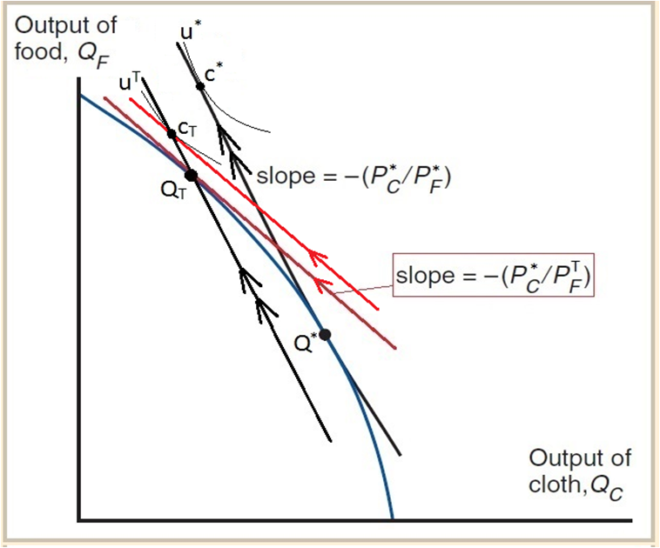
Note:
Cloth is the exported product
Standard Model:
Effect
of an import tariff

Slide 12
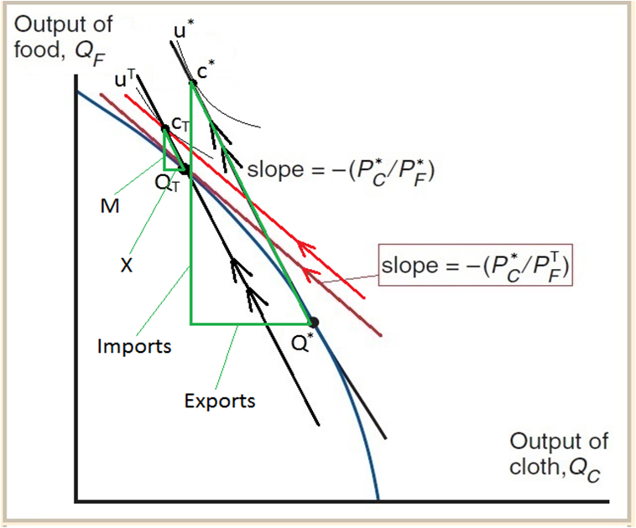
Note:
Cloth is the exported product
Standard Model:
Effect
of an import tariff
[Now with trade triangles!]

Slide 13
Import quotas
Quotas are quantitative limits on international trade
Whilst a tariff is a price-based form of protectionism, a quota is a quantity-based form of protectionism
Related to quotas are voluntary export restraints, where countries agree to voluntarily restrict certain exports to one another

Slide 14
Without a quota (world price below eq.)
Price
Domestic supply
Consumer Surplus
P*
World price (P_{World})
P_{W}
PS
Domestic demand
Imports
0
Q_{S}
Q*
Q_{D}
Quantity

Slide 15
Price
The govt. could get this as revenue instead by auctioning off the quotas to foreign producers
Domestic supply
Quota (imports)
P_{Domestic}
A
B
C
D
P_{World}
Domestic demand
0
Q_{S}
Q_{S(quota)}
Q_{D(quota)}
Q_{D}
Quantity
Loss of consumer surplus | = | Increase in producer surplus | + | Gain to foreign producers | + | Deadweight loss
A + C + B + D |  | A |  | B |  | C + D

Slide 16
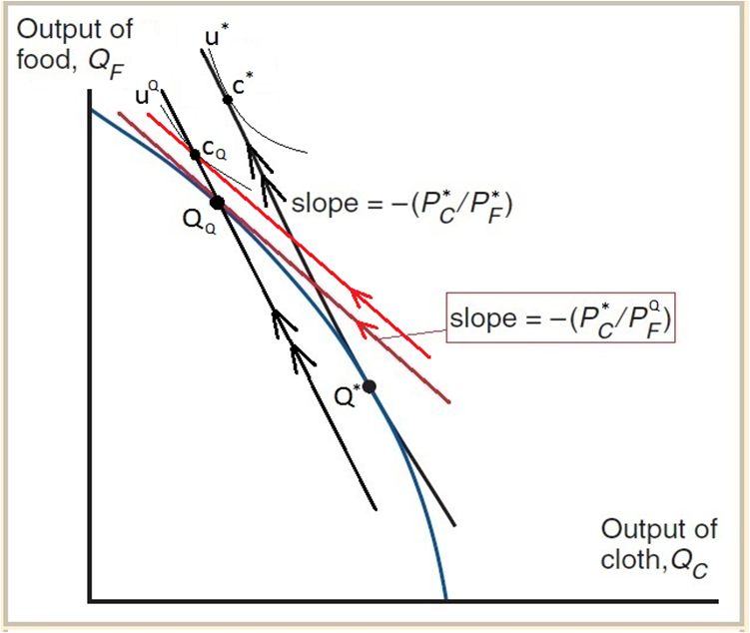
Note:
Cloth is the exported product
Standard Model:
Effect
of an import quota
[Same as an import tariff!]

Slide 17
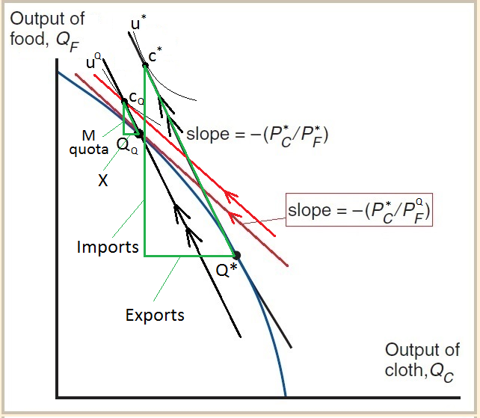
Note:
Cloth is the exported product
Standard Model:
Effect
of an import quota
[Now with trade triangles!]

Slide 18
Voluntary export restraints
Voluntary export restraints (VERs) are a quota on exports rather than imports
An exporting country will offer this in a trade agreement to appease the importing country
...and thus deter it from imposing its own protectionism, which is usually less flexible!
E.g. 1981: Japanese VERs on cars exported to the US

Slide 19
World price above domestic eq.
Price
Domestic supply
Exports
CS
P_{W}
World price (P_{World})
P*
Producer Surplus
Domestic demand
0
Q_{D}
Q*
Q_{S}
Quantity

Slide 20
The govt. could get this as revenue instead by auctioning off the quotas to domestic producers
Price
Export quota
Domestic supply
CS
P_{W}
DWL
DWL
World price (P_{World})
P_{VER}
Domestic price with VER (P_{VER})
Producer Surplus
Domestic demand
0
Q_{D}
Q_{D(quota)}
Q_{S(quota)}
Q_{S}
Quantity

Slide 21
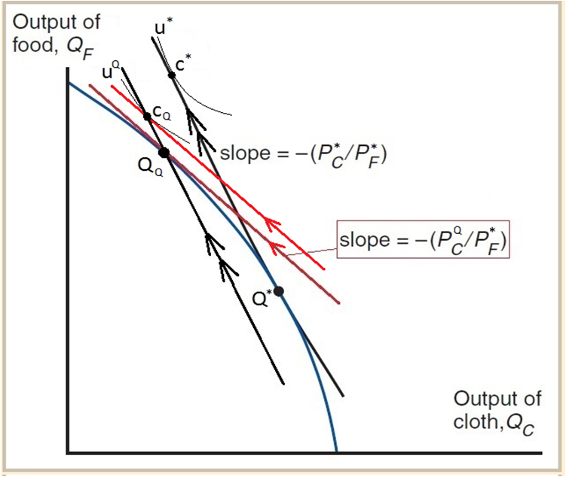
Note:
Cloth is the exported product
Standard Model:
Effect
of a VER (export quota)
[Almost the same as import tariff/quota!]
Note which price is changing!

Slide 22
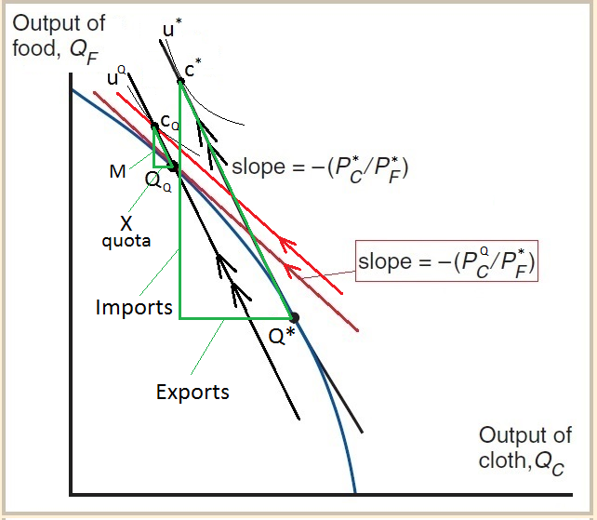
Note:
Cloth is the exported product
Standard Model:
Effect
of a VER (export quota)
[Now with trade triangles!]
Note which price is changing!

Slide 23
Export subsidies
An export subsidy is a supply-side subsidy for the producers who are in the export product sector
In our example, this is cloth

Slide 24
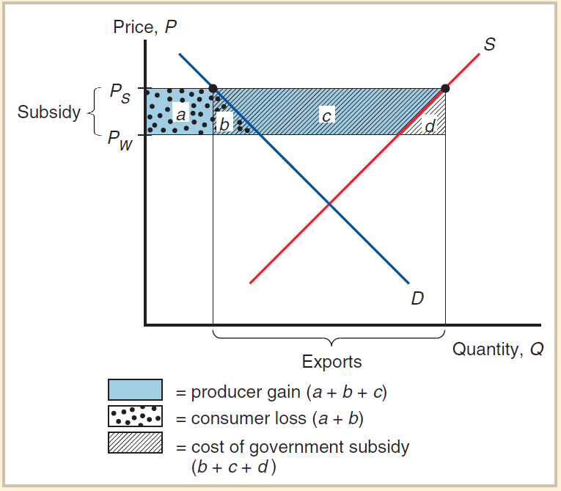
DWL = b + d

Slide 25
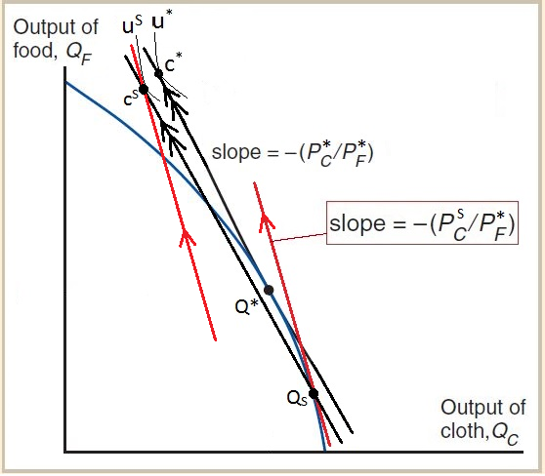
Note:
Cloth is the exported product
Standard Model:
Effect
of an export subsidy

Slide 26
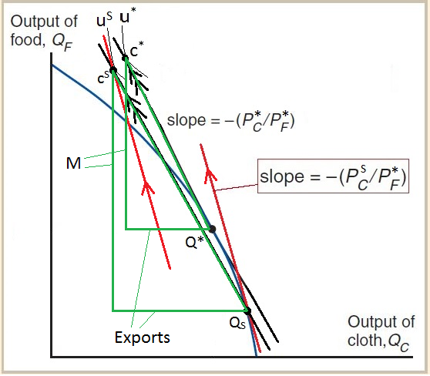
Note:
Cloth is the exported product
Standard Model:
Effect
of an export subsidy
[Now with trade triangles!]

Slide 27
Protectionism: The Theory of Second Best
In terms of increasing overall welfare, removing protectionism is (in general terms) the best policy!
However, sometimes it may be difficult to remove a protectionist measure that distorts trade for political reasons

Slide 28
Protectionism: The Theory of Second Best
In these cases, one possible response is to add in another measure that distorts trade, but partially counteracts the first measure
This is the Theory of Second Best
An example:
Facing a pre-existing import tariff?
Add in an export subsidy!

Slide 29
Protectionism: other measures
Domestic price controls (price floors/ceilings)
Tied procurement laws
i.e. government departments must buy domestically
Exchange rate manipulation
Intellectual property laws
Quarantines
Embargos
Product standards
Note:
Governments sometimes have good reasons to implement these measures!

Slide 30
‘Free’ Trade Agreements
Agreements between countries to promote trade between them
The name is misleading – they do not create free trade between two countries!
Technically they should be called Preferential Trade Agreements

Slide 31
‘Free’ Trade Agreements
Like any agreement, there is give and take
Three preferential trade agreements you should know about:
TTIP – Transatlantic Trade and Investment Partnership (being negotiated)
TPP – Trans-Pacific Partnership (signed but not in force yet)
PICTA – Pacific Island Country Trade Agreement (not fully in force yet)

Slide 32
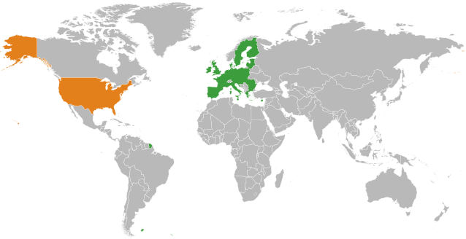
Transatlantic Trade and Investment Partnership

Slide 33
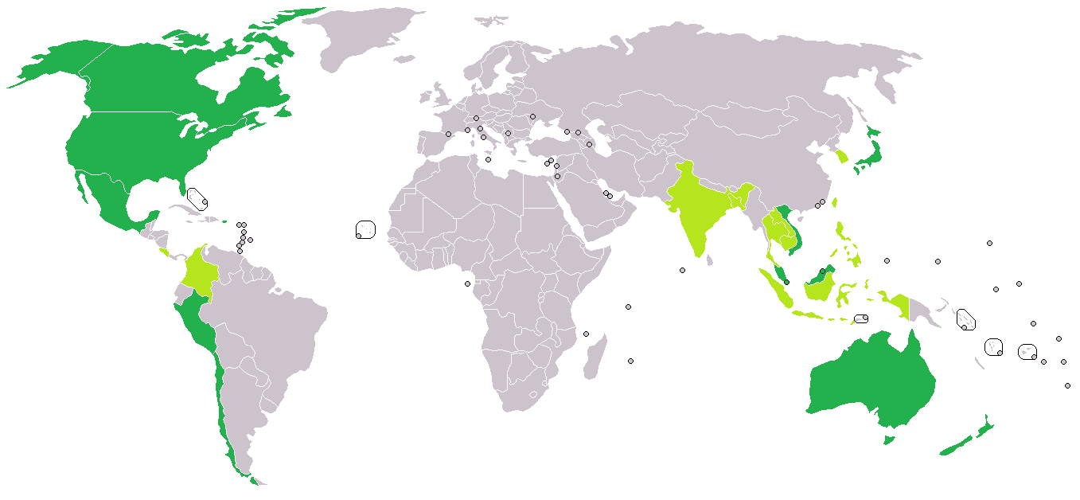
Trans-Pacific Trade Partnership

Slide 34
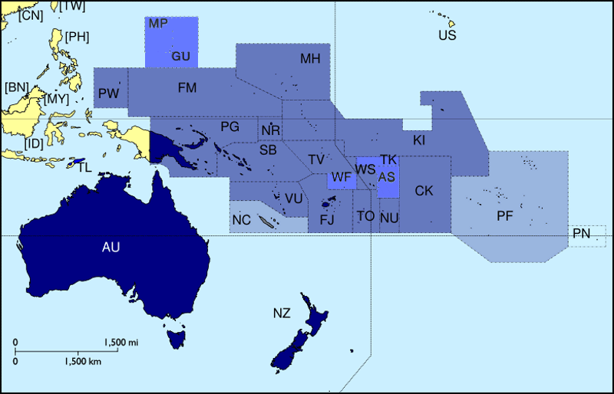
Pacific Island Countries Trade Agreement (PICTA)

