Slide 1
Principles of Microeconomics
Lecture 7: International trade

Slide 2
Overview
Gains from trade (again!)
Protectionism: import tariff
Protectionism: import quota
Protectionism: other measures
Free-trade v. protectionism
A quick case study: Tommy Tomscoll’s embargoes
Foreign exchange markets: an introduction

Slide 3
Gains from trade (again!)
A quick recap:
Absolute advantage
Comparative advantage
Gains from trade
What did we prove earlier? (see: Lecture 2)
Does trade always create winners?
Let’s investigate…

Slide 4
Gains from trade (again!)
New concepts:
Exports and imports
Free trade
Terms of trade:
The relative price of exports to imports
I.e. how many imports can be purchased per unit of exports?
Autarky
Economic self-sufficiency

Slide 5
World price above domestic eq.
Price
Domestic supply
Exports
CS
P_{W}
World price (P_{World})
P*
Producer Surplus
Domestic demand
0
Q_{D}
Q*
Q_{S}
Quantity

Slide 6
World price below domestic eq.
Price
Domestic supply
Consumer Surplus
P*
World price (P_{World})
P_{W}
PS
Domestic demand
Imports
0
Q_{S}
Q*
Q_{D}
Quantity

Slide 7
Protectionism: tariffs
Tariffs are taxes on international trade
Technically, both import tariffs and export tariffs are possible
However, import tariffs are much more common
The aim of import tariffs is to protect the domestic producer, and indirectly, the employees of that producer
E.g. the Australian car industry

Slide 8
Without a tariff (world price below eq.)
Price
Domestic supply
Consumer Surplus
P*
World price (P_{World})
P_{W}
PS
Domestic demand
Imports
0
Q_{S}
Q*
Q_{D}
Quantity

Slide 9
Adding an import tariff
Price
Domestic supply
Domestic price = world price + tariff
P_{+Tariff}
A
B
C
D
P_{World}
P_{W}
Domestic demand
0
Q_{S}
Q_{S(tariff)}
Q_{D(tariff)}
Q_{D}
Quantity
Loss of consumer surplus | = | Increase in producer surplus | + | Government tariff revenue | + | Deadweight loss
A + B + C + D |  | A |  | C |  | B + D

Slide 10
Protectionism: quotas
Quotas are quantitative limits on international trade
Whilst a tariff is a price-based form of protectionism, a quota is a quantity-based form of protectionism
Related to quotas are voluntary export restraints, where countries agree to voluntarily restrict certain exports to one another

Slide 11
Without a quota (world price below eq.)
Price
Domestic supply
Consumer Surplus
P*
World price (P_{World})
P_{W}
PS
Domestic demand
Imports
0
Q_{S}
Q*
Q_{D}
Quantity

Slide 12
Price
The govt. could get this as revenue instead by auctioning off the quotas to foreign producers
Domestic supply
Quota (imports)
P_{Domestic}
A
B
C
D
P_{World}
Domestic demand
0
Q_{S}
Q_{S(quota)}
Q_{D(quota)}
Q_{D}
Quantity
Loss of consumer surplus | = | Increase in producer surplus | + | Gain to foreign producers | + | Deadweight loss
A + C + B + D |  | A |  | B |  | C + D

Slide 13
Protectionism: other measures
Domestic price controls (price floors, price ceilings)
Domestic subsidies / export subsidies
Tied procurement laws
i.e. government departments must buy domestically
Exchange rate manipulation
Intellectual property laws
Quarantines
Embargos
Product standards
Note:
Governments sometimes have good reasons to implement these measures!

Slide 14
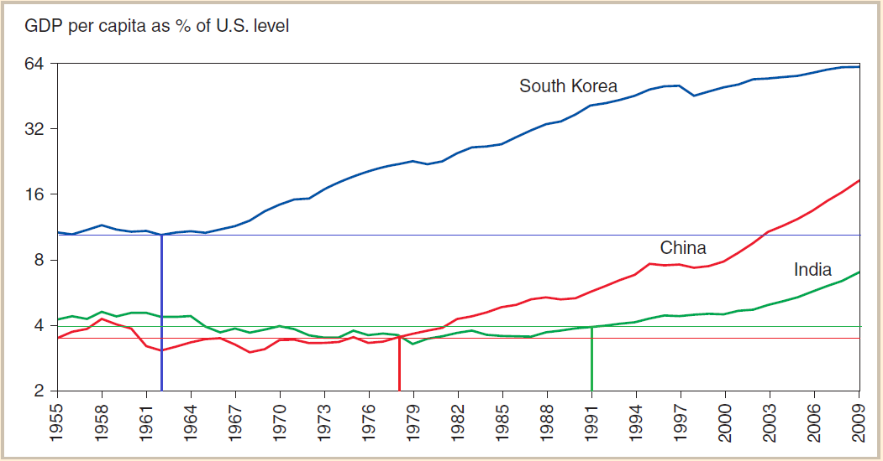
Year of trade liberalisation:
South Korea: 1962 China: 1978 India: 1991

Slide 15
Free trade v. protectionism
The (bad) arguments for protection:
Infant-industry argument
Argument is that industries need time to establish, so that they can compete with overseas firm
But can governments pick winners?
How do we know if the industry is an are of comparative advantage?
And does the ‘infant’ ever grow up?
Elite capture of protectionist policies

Slide 16
Free trade v. protectionism
The (bad) arguments for protection (cont.):
The dumping argument
Foreign firms may dump cheap products on a country that undercut local businesses and drive them out of business, allowing the foreign firms to capture the industry
But in practice, few foreign firms have enough power to dominate a market where there more foreign competition is allowed!

Slide 17
Free trade v. protectionism
The (bad) arguments for protection (cont.):
Saves jobs
International trade does destroy jobs, but it creates jobs too – price signals reallocate labour to where they are more efficient!

Slide 18
Free trade v. protectionism
The (bad) arguments for protection (cont.):
Allows rich countries to compete with cheap foreign labour
Wages are related to productivity when there is free competition
Rich countries have higher average productivity… so they don’t need protection to compete!

Slide 19
Free trade v. protectionism
The (bad) arguments for protection (cont.):
Prevent rich countries exploiting developing countries
Trading with developing countries increases the demand for their products, thus leading to increases in wages…

Slide 20
Free trade v. protectionism
The (bad) arguments for protection (cont.):
Penalises lax environmental standards
Often, poor countries need to increase their income in order to improve their capacity to undertake environmental protection
The Environmental Kuznets Curve
Not trading with developing countries denies them this chance to increase protection!

Slide 21
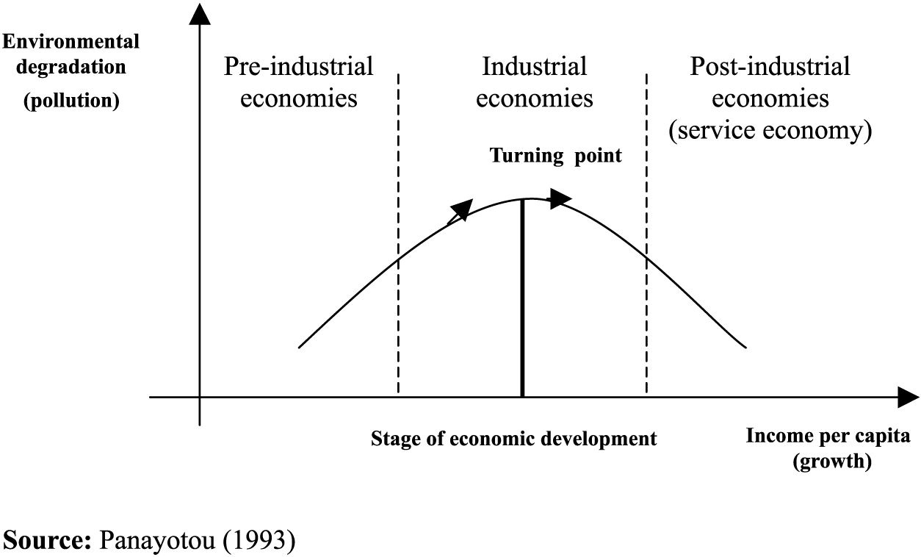
Environmental Kuznets Curve

Slide 22
Free trade v. protectionism
Conclusion?
Overall, the empirical evidence points toward free trade being the much better choice
But whilst free trade creates more winners…
…it does also create losers

Slide 23
Free trade v. protectionism
Losses to the losers are highly concentrated, whilst the benefits to the winners (usually consumers) are thinly spread
Consumers are usually not even aware how they are benefitting!!
Compelling argument that economic losers should be compensated so that they can adjust to the new economic reality
E.g. Provision of training

Slide 24
A quick case study: Tommy Tomscoll’s embargos
Tommy Tomscoll is PNG’s Minister for Agriculture and Livestock
Embargo = prohibition of imports
Placed embargos:
April 2015 – raw poultry from Australia
August 2015 – Australian vegetables
DURING A DROUGHT!!

Slide 25
A quick case study: Tommy Tomscoll’s embargos
Result?
Massive shortages!
Massive increases in the price of onions, garlic; increases in price of capsicum, eggplant, tomatoes, poultry + more!
Many regional centres could simply not source onion and garlic at all!

Slide 26
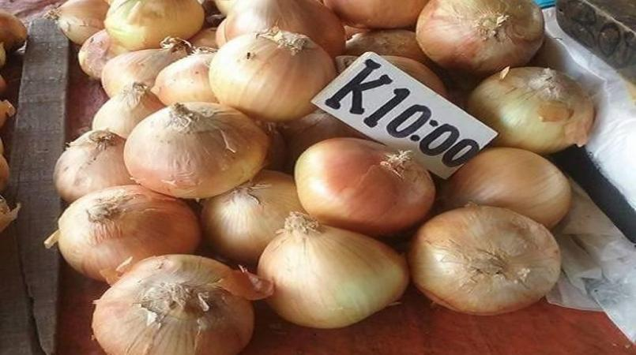

Slide 27
A quick case study: Tommy Tomscoll’s embargos
Who benefitted from the embargo?
Who suffered from the embargo?
Was the benefit of the embargo greater than the cost it created?

Slide 28
A quick case study: Tommy Tomscoll’s embargos
The National, 23 January, 2016:
‘Farmers must be encouraged to grow vegetables to meet local demand "because we cannot continue to import vegetables forever", Prime Minister Peter O’Neill says.
Does this make sense??
In my opinion, the self-sufficiency argument against trade is a very weak argument!

Slide 29
A quick case study: Tommy Tomscoll’s embargos
Both embargos lifted in late January 2016 in response to public pressure, and ongoing concerns from the drought
Verdict? By any economic analysis:
A VERY BAD ECONOMIC POLICY!!

Slide 30
Foreign exchange markets: an introduction
Price
(Domestic currency in terms of for. currency)
($ / ¥)
Supply of $
¥*
Demand for $
0
Q*
Quantity (of $)

