Slide 1
Principles of Microeconomics
Lecture 4: Elasticity

Slide 2
Overview
Price elasticity of demand
Cross-price elasticity of demand
Income elasticity of demand
Price elasticity of supply

Slide 3
Price elasticity of demand
Elasticity is a concept that measure the responsiveness of one variable to another
Price elasticity of demand measures the responsiveness of the quantity demanded to changes in price
Pε_{D} = % ΔQ_{D}
% ΔP

Slide 4
Price elasticity of demand
Example: The price of bread is $2, and the quantity
demanded is 5 million units.
The price increases to $2.50, and we see that the
quantity demanded drops to 4 million units.
Therefore, Pε_{D} = % ΔQ_{D} = (5 – 4) /5 = 1/5
% ΔP (2 – 2.5)/2 -0.5/2
= 0.2 = -0.8
-0.25
Note: Pε_{D} is always negative!
However, usual convention is to use the absolute value (to drop the minus sign)

Slide 5
Price elasticity of demand
Also note: because we use percentages to measure elasticity, Pε_{D} changes along a straight line demand curve
Why do we use percentages instead of units to measure elasticity?

Slide 6
Price elasticity of demand
So what does the Pε_{D} number mean?
Remember: the convention is
to use the absolute value...
Pε_{D} > 1 | Elastic [Q_{D} is highly responsive to Δs in P]
Pε_{D} = 1 | Unit elastic [Q_{D} is equally proportionally responsive to Δs in P]
Pε_{D} < 1 | Inelastic [Q_{D} is not very responsive to Δs in P]

Slide 7
Price elasticity of demand
D
P
Pε_{D} = 0
Perfectly inelastic demand
Q

Slide 8
Price elasticity of demand
P
Pε_{D} =
D
Perfectly Elastic
Q

Slide 9
Price elasticity of demand
For your interest only:
A unit elastic demand curve is a rectangular hyperbola, such that
P * Q is a constant
[i.e., P * Q = c]
P
Pε_{D} = 1
Unit Elastic
D
Q

Slide 10
Price elasticity of demand
Pε_{D} = 4
Note:
This applies only to a linear demand curve!
5
4
Elastic
Price ($ per smoothie)
Pε_{D} = 1
3
2.50
Inelastic
2
1
Pε_{D} = 1/4
0 5 10 12.5 15 20 25
Quantity (smoothies per hour)

Slide 11
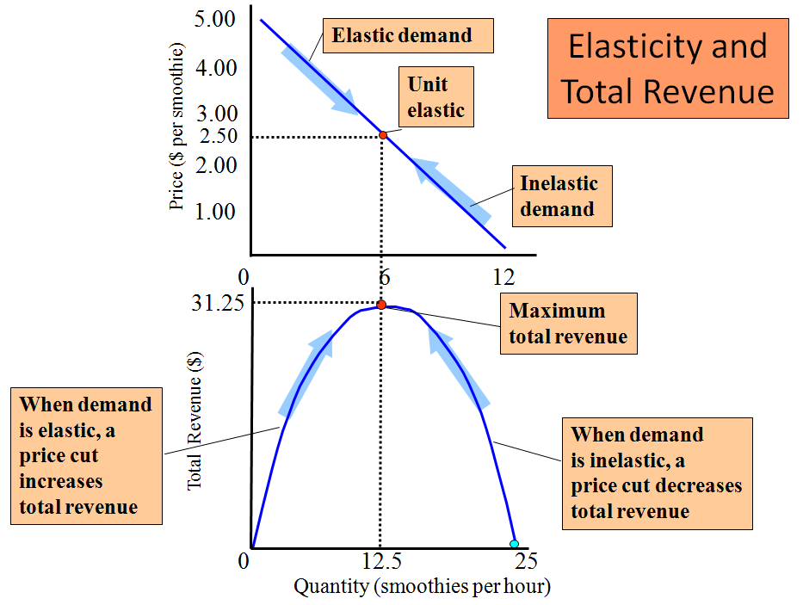
Note: TR = P * Q

Slide 12
Price elasticity of demand
The midpoint formula:
An alternative way of calculating elasticity, but at a point on a line (note, our previous formula calculated elasticity between two points)
Is an approximate measure (but a good approximate!)
Uses average of initial and final quantities and prices
(Q₂ – Q₁) ÷ (P₂ – P₁)
Pε_{D} = Q₁ + Q₂ P₁ + P₂
2 2

Slide 13
Price elasticity of demand
But why is Pε_{D} different in different markets?
More elastic More inelastic
Many close substitutes Few close substitutes
Luxuries Necessities
Big budget items Small budget items
Long run Short run
Market is narrowly defined Market is broadly defined
Not addictive Addictive

Slide 14
Cross-price elasticity of demand
Just as the price of a product helps determine the quantity demanded, so too can the price of another, related product help determine the quantity demanded…
The responsiveness of the quantity demanded to changes in the price of another product is called cross-price elasticity of demand
Cross-Pε_{D} = % ΔQ_{D}
% ΔP of another product

Slide 15
Cross-price elasticity of demand
If the products are… | Cross-Pε_{D} will be… | Example:
Substitutes | Positive | Lamb and chicken
Complements | Negative | Fish and chips
Unrelated | Zero | Economics textbooks and movie tickets

Slide 16
Income elasticity of demand
Income elasticity of demand measures the responsiveness of the quantity demanded to changes in income
Income ε_{D} = % ΔQ_{D}
% ΔY
Note: ‘Y’ is income

Slide 17
Income elasticity of demand
If income ε_{D} is... | Then the good is… | Example:
O > 1 | Normal | Milk
> 1 | Superior (normal and a luxury) | Caviar
< 0 | Inferior | Meat flaps (i.e. those horrible meat offcuts...)

Slide 18
Price elasticity of supply
Price elasticity of supply measures the responsiveness of the quantity supplied to changes in price
Pε_{S} = % ΔQ_{S}
% ΔP

Slide 19
Price elasticity of supply
S
P
Pε_{S} = 0
Perfectly Inelastic
0
Q

Slide 20
Price elasticity of supply
P
Pε_{S} =
S
Perfectly Elastic
0
Q

Slide 21
Price elasticity of supply
The price elasticity of supply increases as time passes:
‘Momentary supply’ reflects the immediate responsiveness of quantity supplied to a change in price: i.e. No change in quantity!
In the very long-run, quantity supplied is perfectly responsive to changes in price

Slide 22
Price elasticity of supply
P
S_{m}
‘Momentary supply’
=> There is no immediate response of quantity supply to a change in price (just a price response!)
P_{m}
P₀
D₁
D₀
Q₀
Q

Slide 23
Price elasticity of supply
P
Short run
=> An expansion in demand only leads to a small increase in quantity supplied
S_{s}
P_{S}
P₀
D₁
D₀
Q₀
Q_{S}
Q

Slide 24
Price elasticity of supply
P
Long run
=> An expansion in demand leads to a large increase in quantity supplied
S_{L}
P_{L}
P₀
D₁
D₀
Q
Q₀
Q_{L}

Slide 25
Price elasticity of supply
P
The ‘very’ long run
=> The quantity supplied is completely responsive to price
P₀; P_{L′}
S_{L′}
This same concept applies to demand over the long-run for most products
D₁
D₀
Q
Q₀
Q_{L′}

