Slide 1
Principles of Microeconomics
Lecture 13: Oligopoly

Slide 2
Overview
Introduction
Oligopoly
  Kinked demand model
  Dominant firm model
  Natural oligopolies
  Game theory
  Cartels

Slide 3
Introduction
Characteristic | Oligopoly
Number of firms | Few
Type of product | Identical or differentiated
Barriers to entry/exit | High
Price taker / maker? | Maker
Examples of industries | Banking Supermarkets
An oligopoly is a market
in which there is a small
number of firms or producers
  Sometimes we use another word for an oligopoly with two firms – ‘duopoly’

Slide 4
Introduction
Where there is a small number of firms, they become interdependent
  I.e., the actions of one firm affects the actions of the others!

Slide 5
Oligopoly: Kinked demand model
Assumptions:
  As each firm raises its price, other firms will not follow
  As each firm cuts their price, other firms will follow

Slide 6
Oligopoly: Kinked demand model
P
The firm’s demand
and marginal
revenue curves
D₁
MR₁
Q

Slide 7
P
Rivals demand
and marginal
revenue curves
D₂
MR₂
D₁
Q
MR₁

Slide 8
P
Rival tends to
follow a price cut
D₂
MR₂
D₁
MR₁
Q

Slide 9
P
Firm tends to
follow a price cut
(or ignore the
price increase)
D₂
MR₂
D₁
MR₁
Q

Slide 10
P
Effectively creating…
D₂
D_{Market}
MR₂
D₁
MR₁
Q

Slide 11
P
…a kinked demand curve!
MC₁
P*
MR₂
MC₂
D_{Market}
Q*
MR₁
Q

Slide 12
Oligopoly: Dominant Firm Model
A dominant firm oligopoly is where one firm is dominant in the market because they have a big cost advantage over their smaller competitors
The small competitors are price-takers
  Often called the ‘competitive fringe’
The dominant firm sets the market price as if it were a monopoly
  The competitive fringe must then adopt this price!

Slide 13
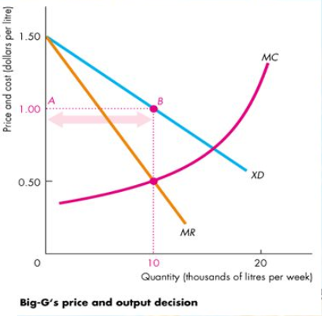
Oligopoly: Dominant Firm Model
The dominant firm faces a D curve (‘XD’) equal to the market D curve minus the supply curve of the competitive fringe (see next slide)
The dominant firm then sets its price just like a monopoly would…

Slide 14
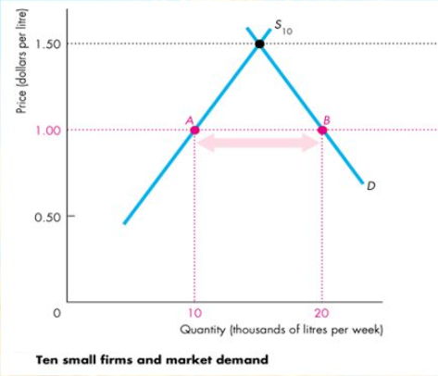
Oligopoly: Dominant Firm Model
The competitive fringe
(in this case, ‘S₁₀’, which means ‘ten firms’ – but it could be many more than ten in other examples!)
then supplies the remaining quantity demanded at the price set by the dominant firm

Slide 15
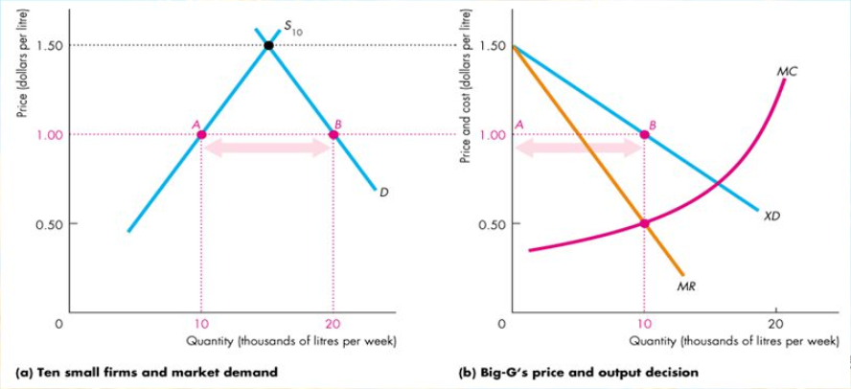
Oligopoly: Dominant Firm Model

Slide 16
Oligopoly: Natural oligopolies
“An industry in which production by a greater number of firms is more costly than production by the existing number of firms”
  Similar to natural monopoly, except with more firms!

Slide 17
Oligopoly: Natural oligopolies
Occurs where the existing oligopolists have an overwhelming cost advantage over potential competitors
  I.e. Usually there are huge fixed costs to overcome in order to enter the market!

Slide 18
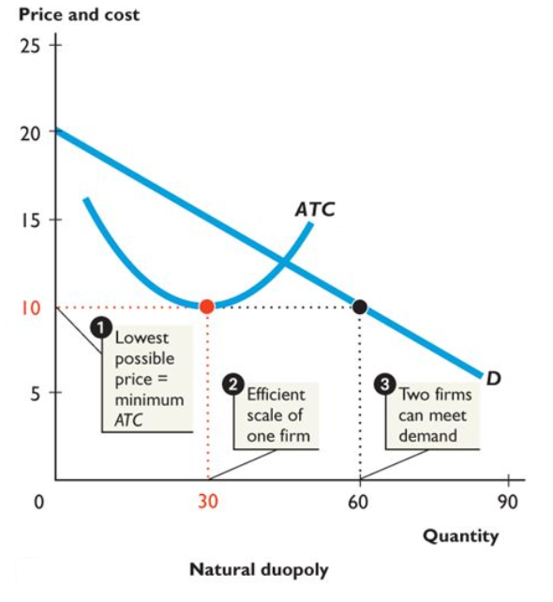
A natural oligopoly with two firms
(a natural duopoly)

Slide 19
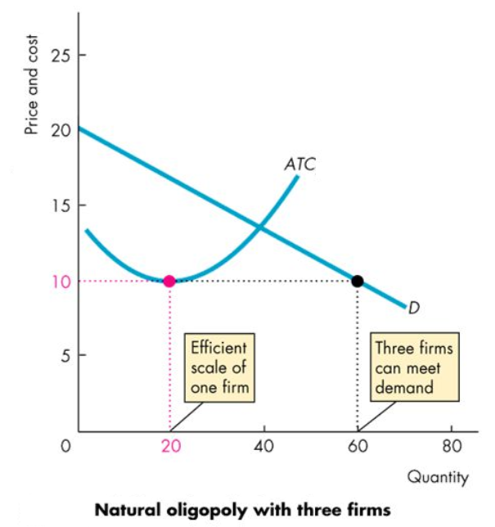
A natural oligopoly with three firms
(a ‘triopoly’? ☺)

Slide 20
Oligopoly: Game theory
Game theory:
  The study of how people make decisions in situations where attaining their goals depends on their interactions with others
In economics?
  The study of the decisions of firms in industries where the profits of each firm strongly depends on its interactions with other firms

Slide 21
Oligopoly: Game theory
Key characteristics of all games:
Rules that determine what actions are allowable
Strategies that players employ to attain their objectives in the game
Payoffs that are the results of the interaction between the players’ strategies

Slide 22
Oligopoly: Game theory
Other relevant terms:
Payoff matrix: A table that shows the payoffs that each firm earns from every combination of strategies adopted by the firms
Dominant strategy: A strategy that is the best for a firm, regardless of what strategies other firms use
Nash equilibrium: Each firm is making the best decision that the can, taking into account the decisions of the other firms

Slide 23
Oligopoly: Game theory
We’re going to keep things simple and analyse duopolies (a 2 firm market) using game theory
There are many different types of ‘games’ (and thus outcomes), but I will show you a common example – the Prisoner’s Dilemma

Slide 24
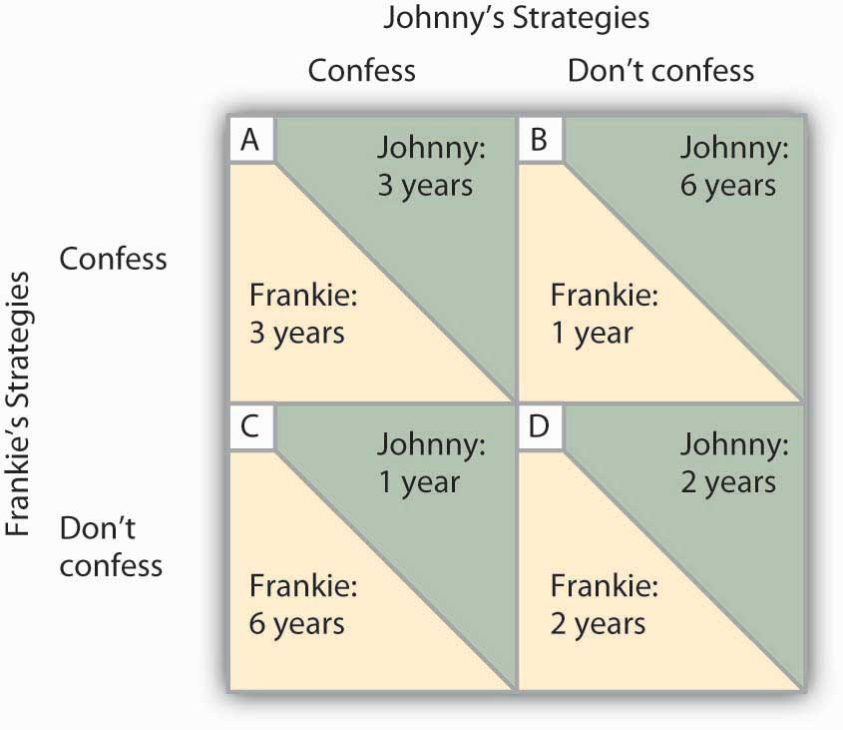
A non-economic example: The prisoners’ dilemma
Nash Equilibrium is at A
Dominant strategy for both prisoners is to confess (as it maximises average benefit / minimises average losses)

Slide 25
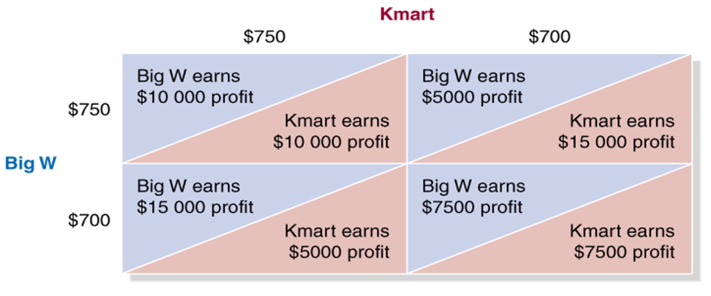
Now making it about firms, and what price to choose for a product...
Dominant strategy for both firms is to set the lower price (as it maximises average benefit / minimises losses)
Nash Equilibrium
Note: The payoff matrix does not necessarily follow the ‘prisoner dilemma’ payoff pattern!

Slide 26
Oligopoly: Game theory
Collusion:
  Firms coordinate their behaviour to maximise profits
  Illegal in most countries
  Competition policy helps to combat collusion
Tit-for-tat strategy:
  A form of tacit collusion (e.g. price leadership)
  If a firm is non-cooperative, the other firm ‘punishes them’ by undercutting them (once)
  in retaliation before adopting a cooperative strategy

Slide 27
Oligopoly: Cartels
Cartel:
An collection of firms or producers that act together to exert monopoly power
Is unstable, as it is not the dominant strategy (i.e. Risk of being undercut by a cartel member breaking ranks...)
There are international cartels too; e.g. OPEC

Slide 28
Oligopoly: Cartels (just like a monopoly!)
Price
S_{Cartel}
$60
Profit = TR - TC
ATC
Profit-
maximising
price
B
42
30
A
Demand
0
6
Quantity
Profit-maximising quantity
MR

Slide 29
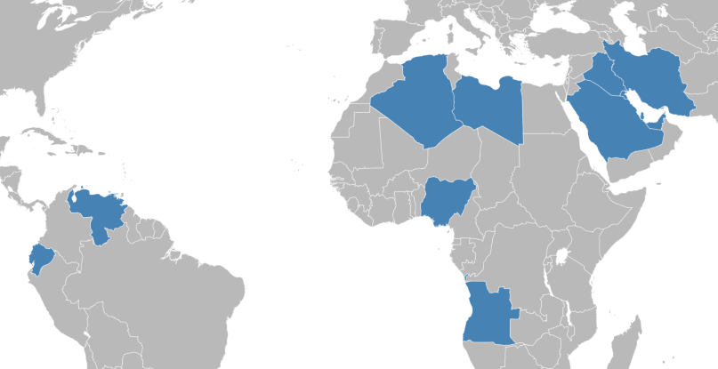

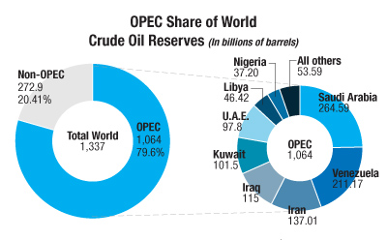
(2010)

Slide 30



Oligopoly: Conclusions
Productive efficiency?
Allocative efficiency?
Dynamic efficiency?
  But:
  Can often lead to strong product innovation and choice
  May be unavoidable (‘natural oligopolies’)
Usually

