Slide 1
Economic Development
Lecture 8: Agriculture

Slide 2
Overview
Agriculture: An overview
Case Study: The Green Revolution
International institutions
Focus by regions
Case Study: Cut flowers in Kenya
Agricultural transition
Market failures
Policy options

Slide 3
Agriculture: An overview
2/3 of the world’s poor work in agriculture
Basic nutritional needs not met for 800m people
As much as 80-90% income from developing countries can come from agriculture
As much as 50% GDP derived from agriculture
Role of women:
60-80% labour force (Asia, Africa)
40% labour force (Latin America)

Slide 4
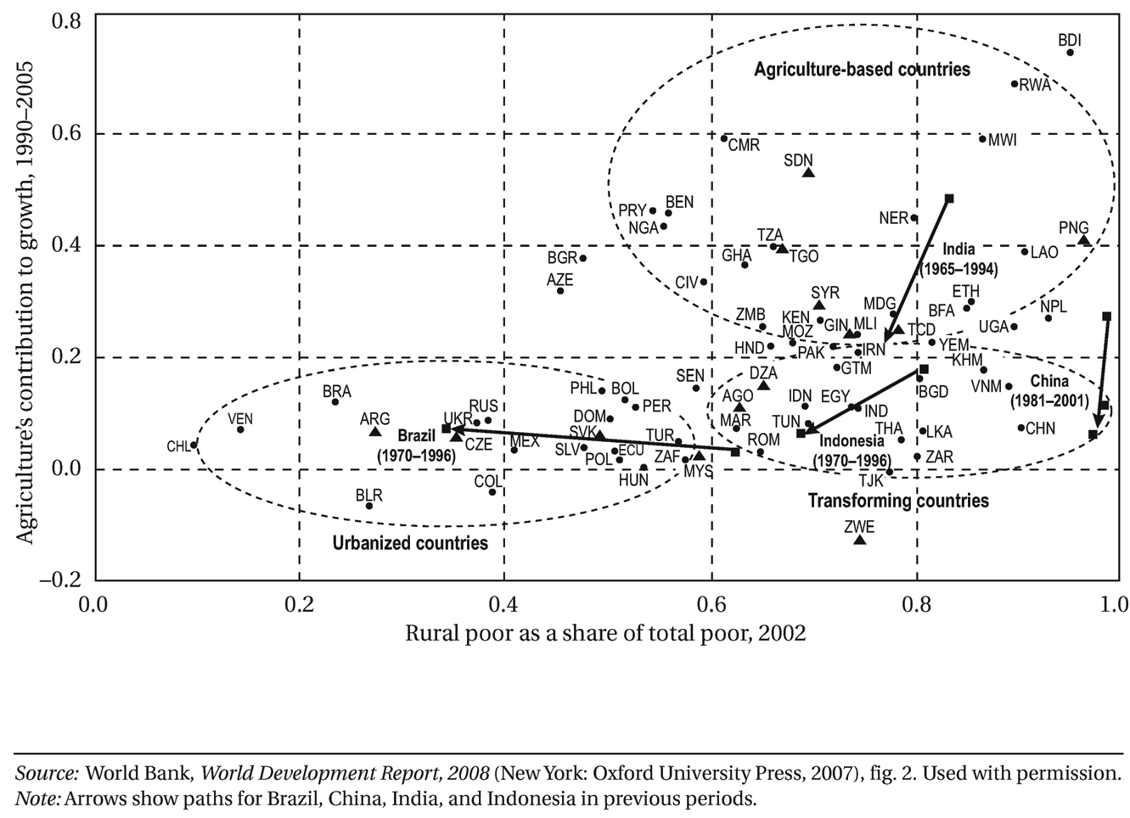
Agricultural and the Economy: 3 Phases

Slide 5
Agriculture: An overview (cont.)
Historical industrialisation
Labour forces mirrored output
MP_{L} in both sectors similar
Contemporary industrialisation
Greater share of the LDC labour force in agriculture than its share of output
Lower MP_{L} in LDC agriculture
Recap: Is the Malthus’ model applicable?
Medical technology
Agricultural technology and innovation

Slide 6
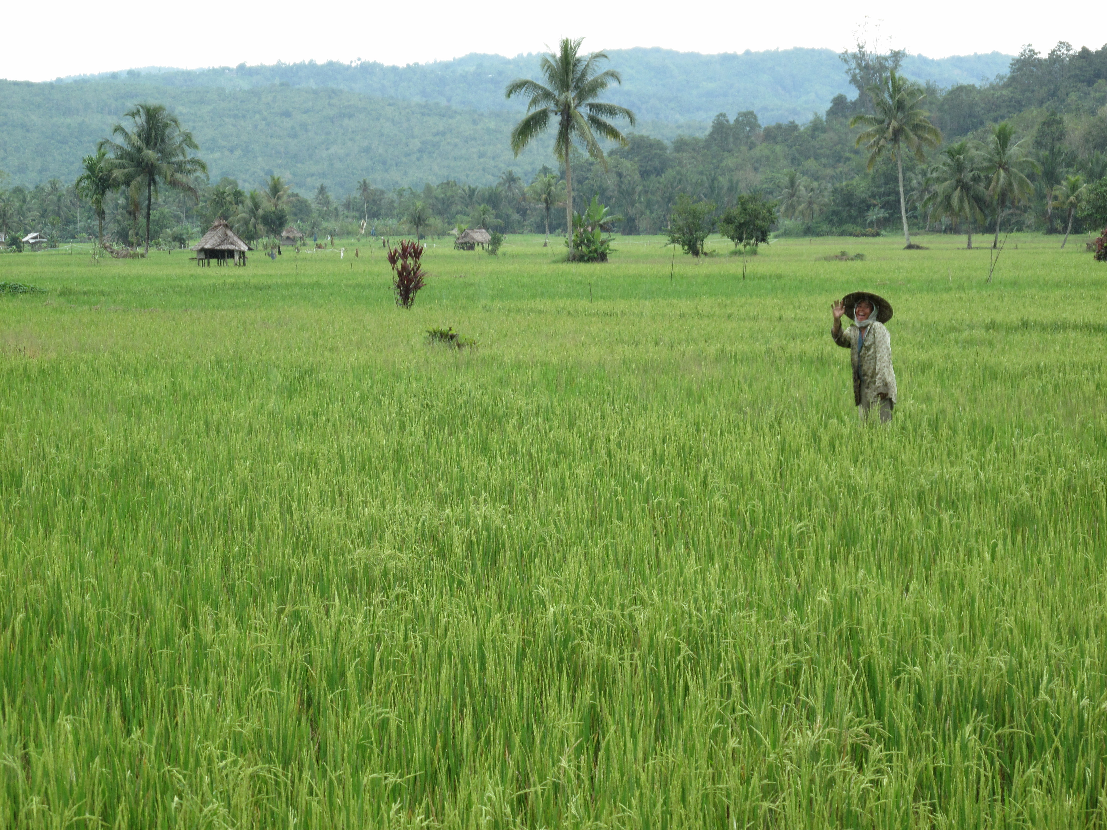
Case Study: The Green Revolution

Slide 7
Case Study: The Green Revolution

Slide 8
International Institutions
Food and Agricultural
Organisation (FAO)
World Food Program (WFP)
International Fund for
Agricultural Development
(IFAD)

Slide 9
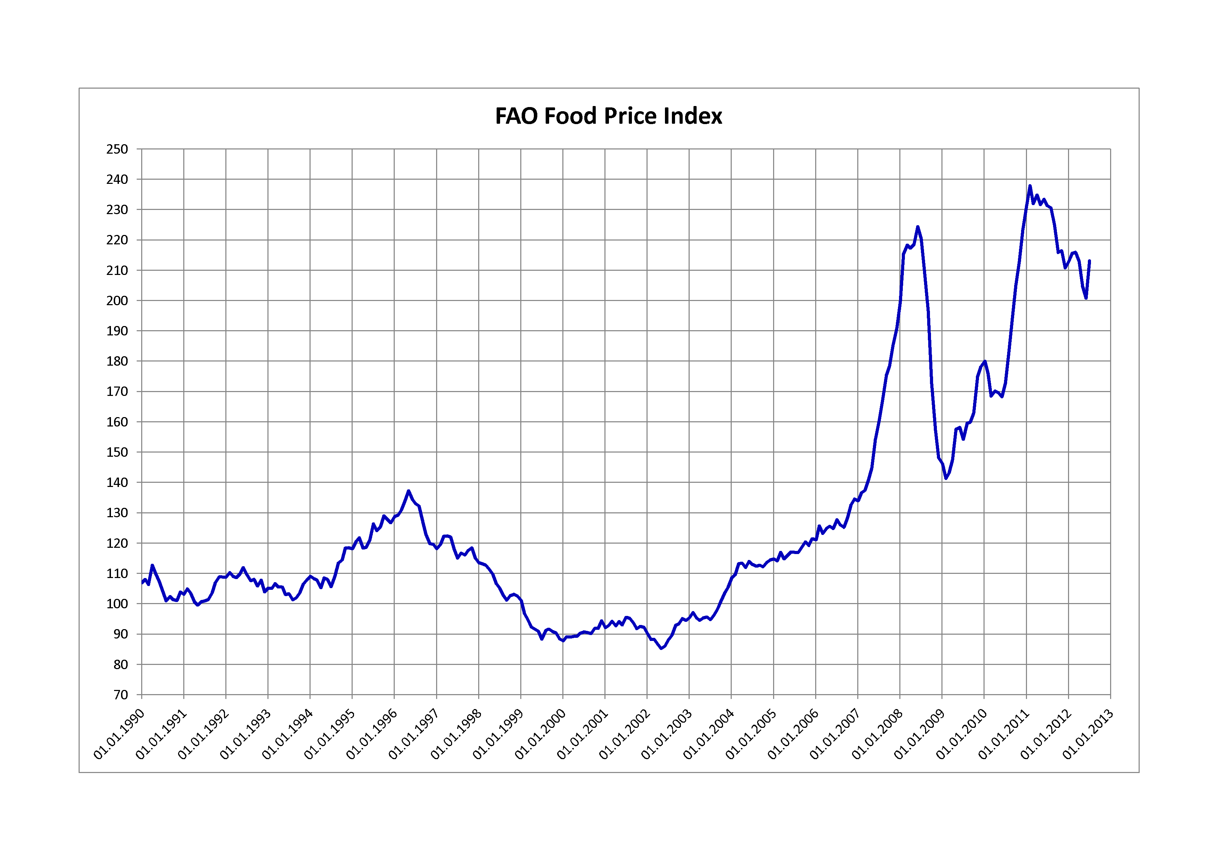
Food Prices

Slide 10
Focus by Regions: Latin America
Gross inequality
1.3% of landowners own approx. 72% of land!
Latifundios – the land owners
Minifundios - the (largely) indigenous smallholdings
Medium sized - the family farms

Slide 11
Focus by Regions: Asia
Too many people, not enough land…
Traditional structures
European colonisation
Property rights
Moneylenders
Freehold ownership ⇨ Tenancy farming
⇨ Landless labour ⇨ Urban slum-dwellers

Slide 12
Focus by Regions: Africa
Family farms
Shifting cultivation
Especially slash and burn agriculture
More marginal regions in Africa
Sahel-belt

Slide 13
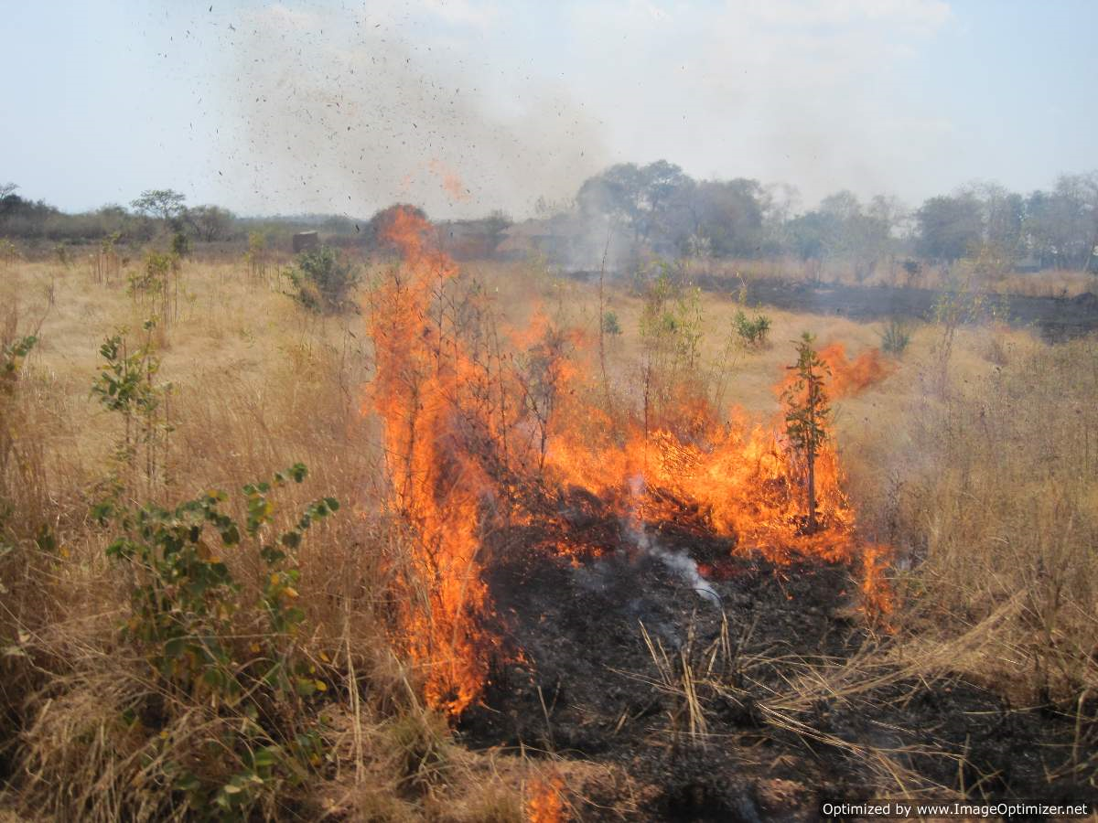
Slash and Burn Agriculture

Slide 14
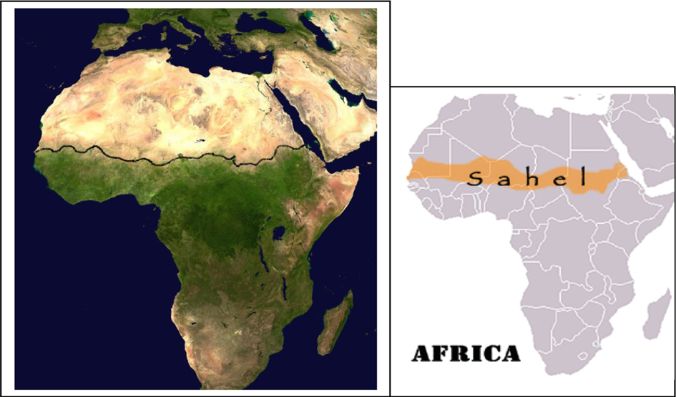
The Sahel Belt

Slide 15
The Sahel Belt: Senegal

Slide 16
Focus by Regions: Africa
Low agricultural output:
Human labour as the primary source of physical power
Scarcity of labour during the peak periods of agricultural activity
Population growth is causing increasing pressure on existing land
Agricultural practice needs to become sedentary

Slide 17
Use of modern inputs

Slide 18
Case Study: Cut flowers in Kenya

Slide 19
Successes
Horticulture second biggest foreign exchange earner
Employs:
50,000 directly
500,000 indirectly
Supports up to 2 million (7% of population)
Rural based industry
Many employees are young women

Slide 20
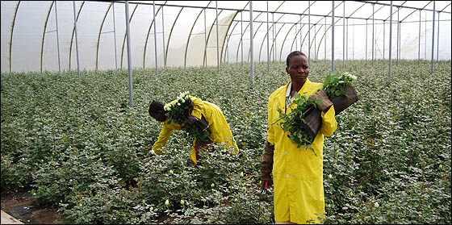
Case Study: The flowers in Kenya

Slide 21
How?
FDI
Technology
Capital and labour intensive process
Limited role of government
Kenya a hub for the air freight in east Africa
Passable infrastructure
Good climate

Slide 22
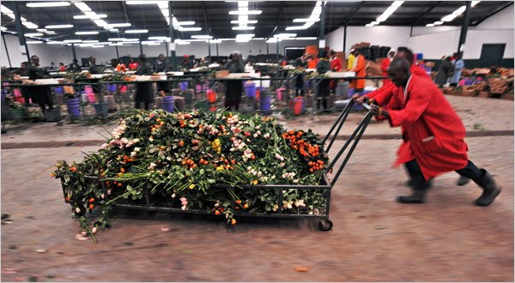
Case Study: The flowers in Kenya

Slide 23
Potential Issues…?
Standards and codes of conduct managed by peak industrial body, Kenyan Flower Council
Many workers on seasonal / casual contracts
Working conditions
Unions
Only 7% of population
Competition for water

Slide 24
Conclusions
Neoclassical growth, endogenous growth
Needs investigation at microeconomic level
Some inevitable tensions?
Employment v higher wages and better conditions
Growth v environmental sustainability

Slide 25
Agricultural Transition
1/ Subsistence
Low technology, low productivity, low output
Underemployed labour
Risk aversion
Maximising survival
Information gaps
Limited access to credit and insurance

Slide 26
Illustrating Risk Aversion…

Slide 27
Agricultural Transition
2/ Diversified
Staple crops grown for consumption
Cash crops grown for sale
3/ Specialised
Profits from cash crops used to buy food and reinvestment

Slide 28
Role of Government
Market failures
Environmental externalities
R&D
Monopolies and oligopolies in agricultural input markets
Infrastructure
Information gaps, coordination failure

Slide 29
Policy Options
Role of women
Technology and innovation
Overcome risk aversion
Incentives for farmers
Microfinance
Agricultural extension programs
Reduce costs of agricultural inputs?
Address market failures
Land reform and property rights (next lecture...)

