Slide 1
Economic Development
Lecture 7: Population

Slide 2
Overview
Global population growth
Fertility / mortality trends
The Malthusian model
The demand for children
High population growth: Good, bad, or otherwise?
Policy options

Slide 3
Global Population Growth: An overview
Current population: 6.8 bn
Projected by 2050: 9.2 bn (UN)
Currently increasing @ 75 m / year
97% will come from developing countries

Slide 4
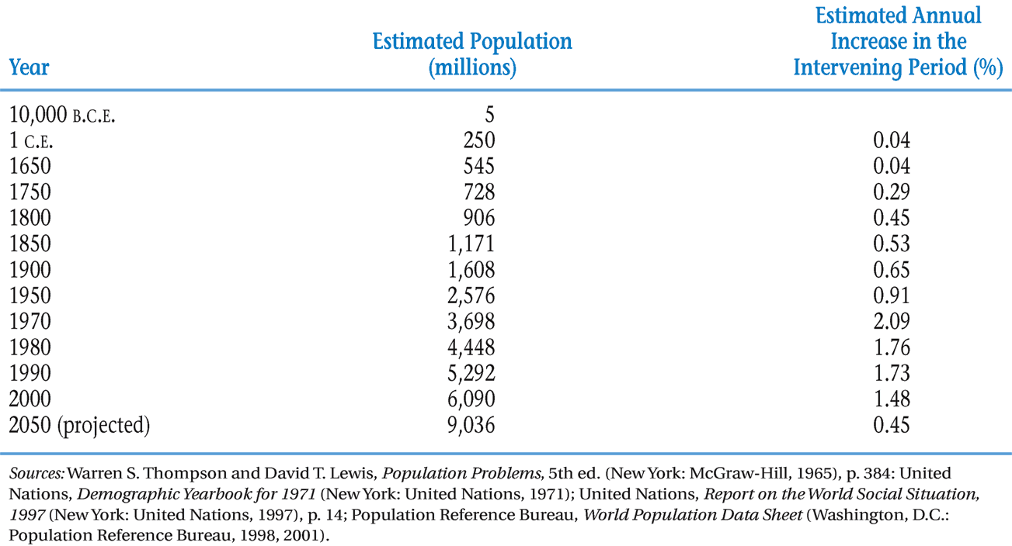
Estimated World Population Growth

Slide 5
World Population Growth

Slide 6
Population Doubling Times

Slide 7
Global Population Growth: Structure
More than ¾ world live in developing countries
By 2050:
Africa:  210% to 2.1 bn (current: 1 bn)
Asia:  50% to 5.82 bn (current: 3.88 bn)
Latin America:  70% to 0.85 bn (current: 0.5 bn)

Slide 8
Global Population Distribution

Slide 9
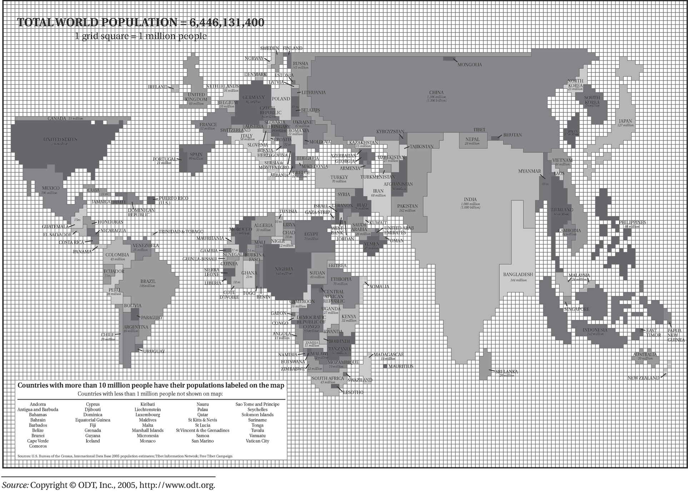
Global Population Distribution: A Map

Slide 10
Most Populous Countries: Top 10
Country | Population
China | 1.37 bn
India | 1.28 bn
USA | 321 m
Indonesia | 255 m
Brazil | 204 m
Pakistan | 190 m
Nigeria | 182 m
Bangladesh | 158 m
Russia | 146 m
Japan | 127 m
+ for interest: EU | 507 m
Sources: Various!

Slide 11
Fertility / mortality trends
Population growth = birth rate – mortality rate + (immigration rate – emigration rate [‘net migration’])
LDC birth rates and mortality rates are higher
Total fertility rate = Average number of children a woman has if current rates hold throughout her childbearing years
Sub-Saharan Africa: 5.5 children
Asia: 3.4 children

Slide 12
Fertility / mortality trends
Replacement level fertility = 2 + average rate of child mortality
Narrowing mortality gap between developed and developing countries
Average lifespan in developed world only 12 years higher
However in Africa, average life expectancy = 48 yrs

Slide 13
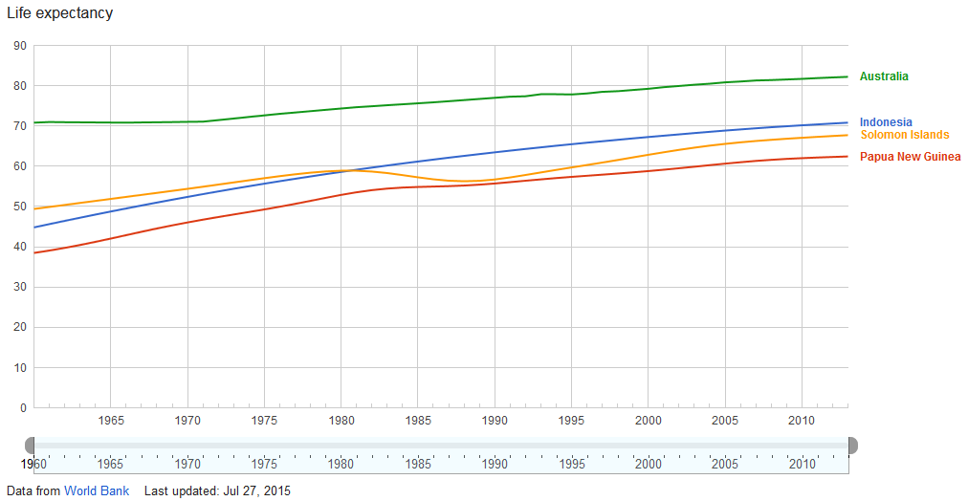

Slide 14
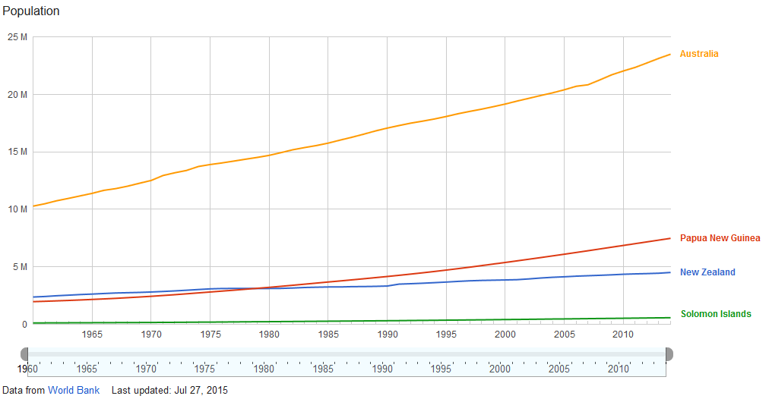

Slide 15
Dependency Burden
Non-economically productive individuals place an economic burden on societies
Higher in developing countries: 35% are under 15 (excluding China)
Opposite, but smaller problem in developed countries with aging population

Slide 16
Hidden momentum
Birth rates adjust slowly
Delay in effect of decreased population growth
Waiting for the ‘youth bulges’ to age
Demographic transition

Slide 17
Population Pyramids and the Youth Bulge

Slide 18
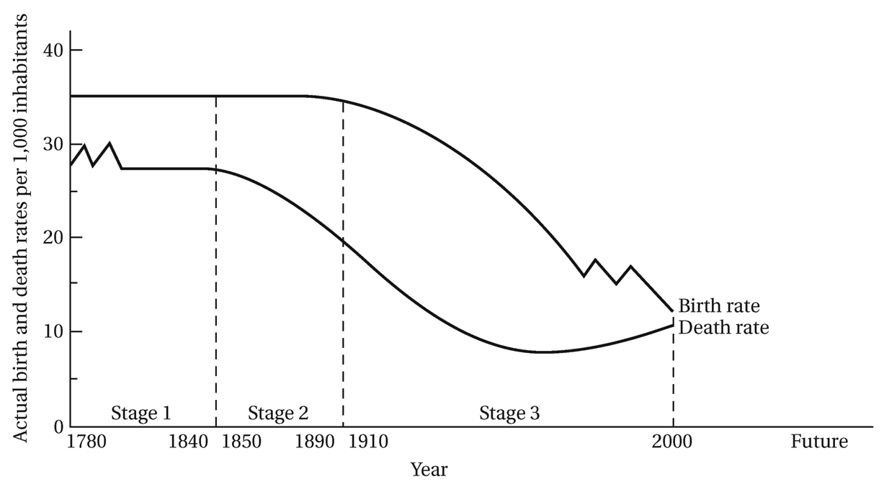
Demographic Transition

Slide 19
The Malthusian model
Essays on the Principle of Population (1798)
Population growth is geometric
Diminishing returns to land
As L increases, MP_{L} drops to zero in agriculture
Leads to subsistence living
Low-level equilibrium population trap, or ‘Malthusian Trap’
Avoid through ‘moral restraint’ (Malthus)

Slide 20
Malthusian Population Trap

Slide 21
The Malthusian model
Equilibriums:
A: The Malthusian trap
Avoidable with preventative checks (birth control)
Otherwise positive checks will ensue
B: Unstable – big push required?
C: Developed country

Slide 22
The Malthusian model
Criticisms
Ignores effects of technology
Compares national population growth with per capita incomes – what about income distribution?
Alternative approaches?
Microeconomic Household Theory of Fertility

Slide 23
The demand for children
Conclusions from the Microeconomic H. T. of Fertility
Demand determined by:
Ensuring enough survive
Aged-care needs
Male child bias
Opportunity cost
Cultural reasons

Slide 24
High population growth: Good, bad, or otherwise?
Not the real problem
General underdevelopment
Limited resources / environmental destruction
Distribution of population
Gender inequality

Slide 25
High population growth: Good, bad, or otherwise?
False issue
Subjugation of developing countries by developed countries
Hypocrisy of developed countries

Slide 26
High population growth: Good, bad, or otherwise?
Good
Surplus L
Where there is low population
Innovation
Geopolitical security
Security of minorities

Slide 27
High population growth: Good, bad, or otherwise?
Bad
‘Poverty bomb’
Poverty trap (Malthusian trap)
Reduces output to labour ratios (Neoclassical growth model)
Increases inequality
Lower levels of education
Health effects of fertility
Stretched food supplies
Environmental pressures
International migration?

Slide 28
Policy Options
Developing Countries
Decrease D for children - increase opportunity cost!
Women’s education
Reduce child mortality
Aged-care
Access / quality of education
Restrict child labour
Family planning

Slide 29
Policy Options
Developed Countries
Global imbalance of resource consumption and incomes
Increase immigration
Help developing countries…
To develop!
Especially via population programs

