Slide 1
Economic Development
Lecture 4: Growth Theories II

Slide 2
Overview
Structural-change Model (cont.)
Patterns of Development Analysis
Case Study: The Great Leap Forward
International Dependence Revolution
Neocolonial Dependence Theory
False Paradigm
Dualistic Development Thesis
Neoclassical Growth Model

Slide 3
Structural-change Model
Patterns of Development Analysis
Realised that the Lewis Model was not exhaustive
Many other structural changes required
However, did not detail any holistic development agenda in the way Lewis had

Slide 4
Case Study: The Great Leap Forward
1959: ‘Smelt a lot of good steel and accelerate socialist construction’

Slide 5
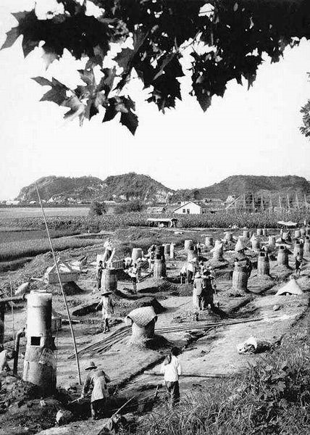
Backyard furnaces

Slide 6
1959:
‘The vegetables are green, the
cucumbers plump, the yield is
abundant’

Slide 7
Case Study: The Great Leap Forward
Conclusions
Surplus agricultural worker has clear limits
Capital quality has a critical effect on capital-output ratios
Transition from traditional to modern sector needs to be facilitated, but cannot be forced

Slide 8
International Dependence Revolution
Political economy model
Developed country dominance of LDCs
LDC dependence on developed economies

Slide 9
International Dependence Revolution
Neocolonial Dependence Theory
‘Centre-periphery’
Ruling elite in LDCs form another centre-periphery subset
Centre exploits periphery due to power imbalances
Underdevelopment is thus externally rather than internally induced
Very radical !

Slide 10
International Dependence Revolution
False Paradigm
Gap between developed countries and LDCs not a result of exploitation, but misguided and imposed policies
Stresses pre-existence of power imbalances within LDCs

Slide 11
International Dependence Revolution
Dualistic Development Thesis
Explores the static parallel between rich and poor
1/ Coexisting but ‘different sets of conditions’
2/ Parallel is chronic and not simply transitional
3/ Gap in conditions is widening
4/ Limited ‘trickledown’

Slide 12
Neoclassical Growth Theory
Supremacy of markets
Government interference leads to misallocation of resources
Prescribes:
Privatisation
Free trade
Export-led growth

Slide 13
Neoclassical Growth Theory
Three approaches
Free-market
Public-choice
‘Market friendly’

Slide 14
Neoclassical Growth Theory
Solow (Solow-Swan) Growth Model
Y = K^{α} (AL)^{1-α}
A = productivity of labour
α = elasticity of output derived from capital
Assumes diminishing returns to K and L
Growth from:
Increases in L
Increase in K
Increases in A
Open v closed

Slide 15
Neoclassical Growth Theory
Graph
Divide Y = K^{α} (AL)^{1-α} by L to get output per worker: ‘y’
Results in y = f(ƙ)
ƙ = K to L ratio
Growth of ƙ: Δƙ = sf(ƙ) – (n + d)ƙ
s = savings rate
n = population growth
d = depreciation

Slide 16
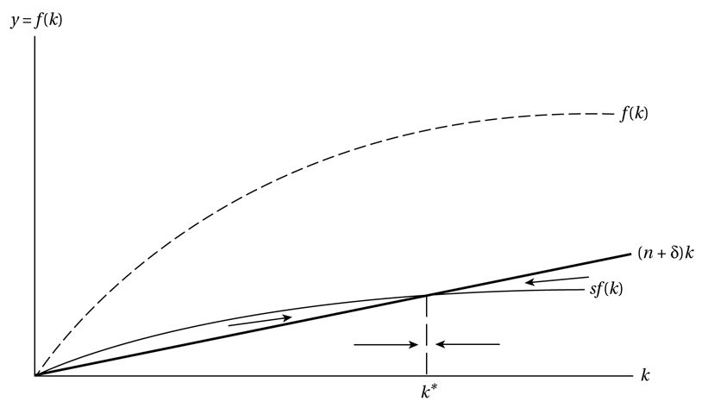

Slide 17
Neoclassical Growth Theory
What happens when we change the savings rate
What can we do to permanently improve output?
Improve productivity of L
Increase population

Slide 18
Neoclassical Growth Theory
Criticisms
Assumes decreasing returns to scale
Markets are imperfect
Limited capacity of LDC institutional and political structures
Conclusions
Pro-market approach needs to tailored to LDC environment, government intervention not only good in certain situations, but required
Look to the endogenous growth model...

Slide 19
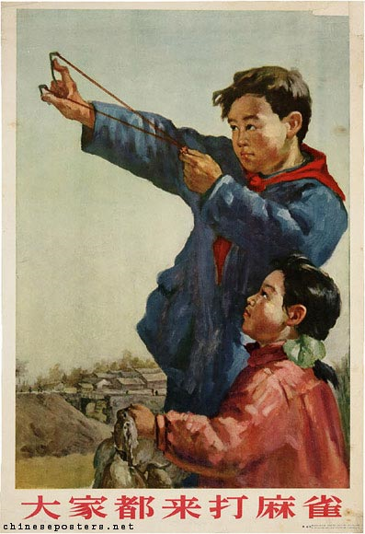
1956:
‘Everybody comes to
strike sparrows’

