Slide 1
International Economics
Lecture 9: Trade Theorems
and Extensions

Slide 2
Overview
Specific Factors Model:
International labour mobility
Heckscher-Ohlin Model / Standard Model:
Factor price equalisation
The Stolper-Samuelson Theorem
The Leontief Paradox
The Rybczynski Theorem
Intertemporal comparative advantage

Slide 3
International labour mobility
An extension of the Specific Factors Model
In the Specific Factors Model, we saw what happened to the distribution of income when we opened to trade
But what about when we open our borders to workers?

Slide 4
International labour mobility
When wages are different between sectors in an economy, workers will want to move from a low wage sector to a high wage sector
The same is true internationally!
Workers want to move from low wage countries to high wage countries

Slide 5
International labour mobility
Just like the specific factors model, let’s have two economies each with two sectors:
Land is specific to one sector
Capital is specific to the other sector
Labour is mobile between sectors
However, there is no trade (only free movement of labour)
Let’s also assume real wages are different between the two countries in our model

Slide 6
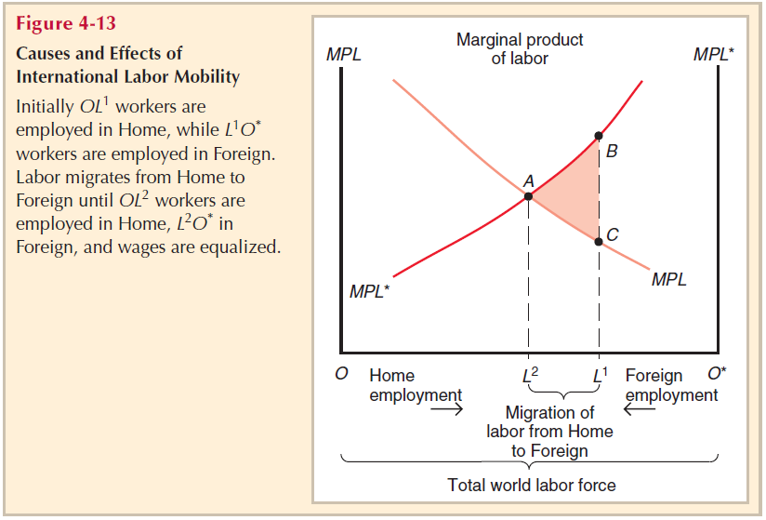
Real wages in Foreign start at B, and real wages in Home start at C.
Under free movement of labour, workers from Home will migrate to Foreign until real wages equalise at A.

Slide 7
International labour mobility
Who wins?
Migrant workers from Home (as w_{F}>w_{H})
Workers who stay in Home (↑w_{H})
Owners of land / capital in Foreign (↓w_{F})
Who loses?
Workers in Foreign
Owners of land / capital in Home (↑w_{H})

Slide 8
Factor price equalisation
Factor price equalisation is a conclusion of the Heckscher-Ohlin Model
When countries trade we expect to see an equalisation of factor prices when adjusted for risk and transport costs
I.e. wages should equalise, and rental yields on capital and land should equalise
Why??

Slide 9
Factor price equalisation
When countries trade a final product with one another, they are also indirectly trading the factors of production used in that product
I.e. the hours of labour, and hours of capital / land usage, etc.
Thus, a country effectively exports its abundant factors of production

Slide 10
Factor price equalisation
One problem though: in the real world, we do not get full factor price equalisation!
Although we do observe a general trend towards convergence

Slide 11
Factor price equalisation
Why not?
Both countries may not produce both products
[see Chapter 5 Appendix for a detailed explanation]
Differences in technology
Protectionism!
Note:
The theory face problems with factor heterogeneity!
Does not apply to non-tradeable products

Slide 12
The Stolper-Samuelson Theorem
A conclusion of the Heckscher-Ohlin Model
A rise in the relative price of a product will lead to:
A rise in the return to the factor
of production that is used more intensively in its production
...and, conversely, to a fall in
the return to the factor of
production that is used less-intensively
Note:
We’ve actually already covered this, but now we are giving it a name!

Slide 13
The Leontief Paradox
An extension of the Heckscher-Ohlin Model
Famous paper by Wassily Leontief in 1953
Tried to explain why trade data between Europe and the United States after World War II (specifically, in 1947) showed the opposite of what the Heckscher-Ohlin Model predicted
I.e., the US was relatively capital abundant, Europe was relatively labour abundant, but the US was exporting labour-intensive products to Europe!

Slide 14
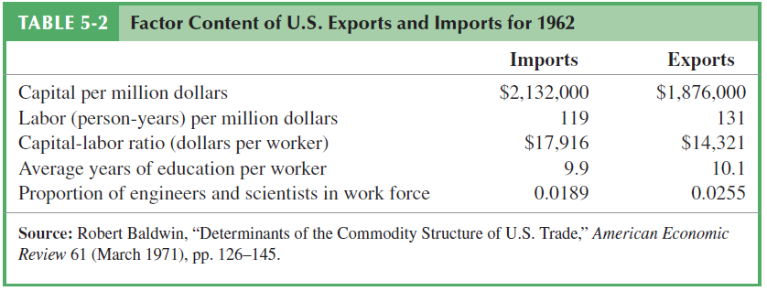
The Leontief Paradox
This is not the data from 1947, but it shows the same effect:

Slide 15
The Leontief Paradox
Possible explanations:
‘Demand reversals’ (i.e., completely different consumption preferences)
E.g., was there a big demand for labour-intensive goods in US export markets?
The H-O model does not hold under a demand reversal
However, no strong empirical evidence of this

Slide 16
The Leontief Paradox
Possible explanations:
Factor intensity reversals (e.g. different production techniques)
Assumes K and L can be substituted in production process (e.g., textiles can be either relatively L or K intensive)

Slide 17
The Leontief Paradox
Possible explanations:
1947 was just not an ordinary year – high food stress in Europe and Japan
But what is ‘ordinary’ ?
US protectionism
Specifically, did the US tariff structure significantly distort trade?
Empirical evidence not strong

Slide 18
The Leontief Paradox
Possible explanations:
The H-O Model is just too simplistic!
For example, we should add in other factors of production (e.g., different skill categories for labour, natural resources, etc.)
This holds up empirically!

Slide 19
The Leontief Paradox
Possible explanations:
Home bias
Could there be a bias towards consuming domestic products in preference to foreign products?
Yes, but it is not usually strong!
High levels of imperfect factor mobility?
High levels of imperfect competition?

Slide 20
The Leontief Paradox
My conclusion (for what it’s worth) is that #5 is the biggest effect [the H-O Model is just too simplistic]
Especially around the issue of accounting for differences in technology

Slide 21
The Rybczynski Theorem
A conclusion of the Heckscher-Ohlin Model
Assuming constant relative prices, an increase in the endowment of one factor of production will lead to a more than proportional increase in output in the sector that uses that factor intensively

Slide 22
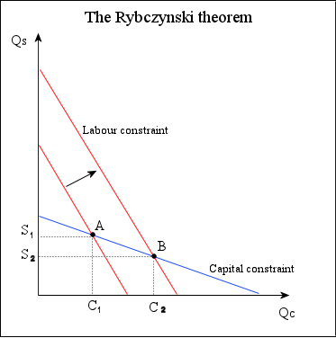
Two products:
Steel (capital-intensive); and Cloth (labour-intensive)
An expansion in the amount of one factor of production (↑L) leads to:
An increase in production in the product that uses it intensively (C₁⇨ C₂);
...and a decrease in the production of the other product (S₁⇨ S₂)

Slide 23
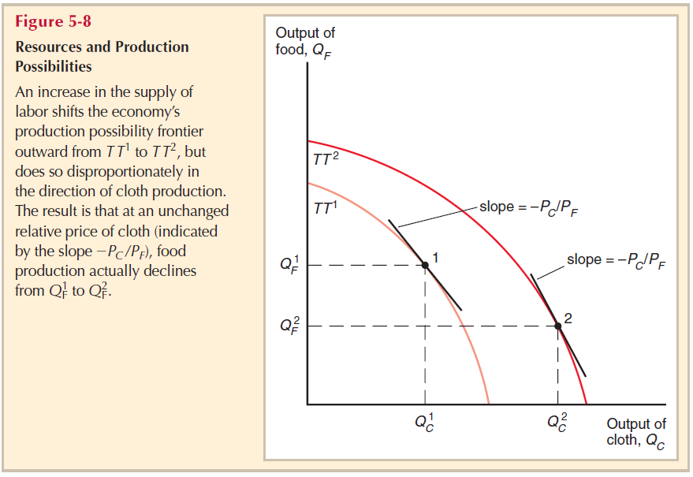
And we get the same result when we relax the assumption about production required factors in fixed proportions

Slide 24
Intertemporal comparative advantage
We can also think about what happens to comparative advantage over time (‘intertemporal’)
Should a country invest in building productive capacity now (capital goods), or in producing consumption goods? What about in the future?

Slide 25
Intertemporal comparative advantage
Assuming we are in autarky:
A country has a comparative advantage in the future production of consumption goods if it currently has a high real interest rate
I.e., the opportunity cost of forgoing current investment is higher!

Slide 26
Intertemporal comparative advantage
Still assuming we are in autarky:
A country has a comparative advantage in the current production of consumption goods if it has a low real interest rate now
I.e., the opportunity cost of forgoing current investment is lower!

Slide 27
Intertemporal comparative advantage
If we relax the autarky assumption:
…then our previous conclusions would only apply to a countries opportunity cost in terms of consumption rather than production
I.e. because a country can always produce consumption goods that it exports, and then ‘consume’ imported capital goods

