Slide 1
International Economics
Lecture 11: Internal Economies of Scale

Slide 2
Overview
Introduction
Monopolistic competition: A review
Internal Economies of Scale:
Setting up the model
Adding in the trade
Conclusions

Slide 3
Introduction
A few lectures ago we talked about internal and external economies of scale…
External economies of scale occur when the cost per unit of production depends on the size of the industry, but not necessarily on the size of any one firm
[See: Lecture 8]

Slide 4
Introduction
Internal economies of scale occur when the cost per unit of production depends on the size of an individual firm, but not necessarily the size of the industry…
Today’s lecture!

Slide 5
Introduction
Internal economies of scale could take the form of three possible structures:
Monopoly
‘Pure’ monopoly is unlikely in global markets
Oligopoly
Pricing strategy depends on the choices of other firms => requires game theory!

Slide 6
Introduction
Monopolistic competition
Pricing strategy does not depend on other firms
Empirical evidence shows that this is by far the most common form of global market structure
So this is what we will concentrate on!

Slide 7
Monopolistic competition: A review
Characteristic | Monopolistic competition
Number of firms | Many
Type of product | Differentiated
Barriers to entry/exit | Low
Price taker / maker? | Taker
Classic examples of industries | Hairdressers Restaurants

Slide 8
Monopolistic competition: A review
Lots of firms, price-taking… so how is it different from perfect competition?
Because of product differentiation, each firm in monopolistic competition faces their own downwards-sloping demand curve…
And thus a downwards sloping MR curve!
As usual, profit maximisation occurs in accordance to where MC = MR

Slide 9
Price
(and revenue)
To sell more, the price must be lowered.
Thus the marginal revenue curve will be below the demand curve.
Demand = average revenue
Marginal revenue
0
Quantity

Slide 10
Monopolistic competition: A review
Costs:
Economies of scale means we have a downwards sloping average total cost (ATC) curve
We assume that the economies of scale come from the fixed production cost being distributed across more units of production
This means marginal cost is constant!

Slide 11
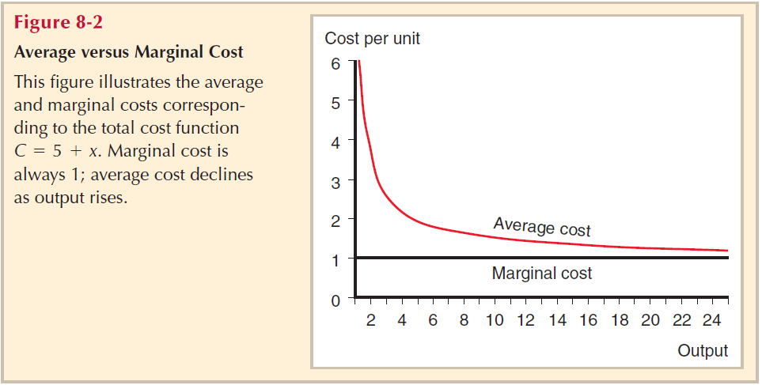
Monopolistic costs
ATC = average total cost = AC = average cost
[Note: these are all the same!]
Note:
The numbers are not important: what is important is that MC is constant, and ATC is asymptotic

Slide 12
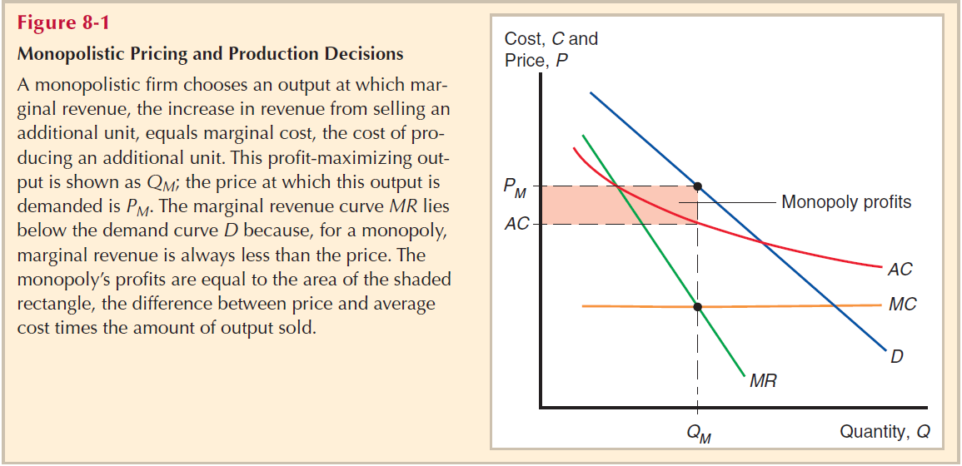
Putting revenue and costs together: Monopolistic pricing

Slide 13
Internal economies of scale: Setting up the model
Two key assumptions that allow us to adopt monopolistic competition as our market structure of analysis:
Firms can differentiate their products
Firms have some level of monopoly in their specific product
…meaning that competition is not highly price sensitive

Slide 14
Internal economies of scale: Setting up the model
Firms take the prices of its rivals as a given
I.e. the firm ignores the impact of their own prices on competitors
In this way, the firm acts like a monopolist… hence the name, monopolistic competition!

Slide 15
Internal economies of scale: Setting up the model
The equation for an individual firm’s supply curve:
Q_{Firm} = Q_{Industry} * [(1/n) – b * (P – )]
Where:
n = number of firms in the industry [1/n is market share]
P = price charged by our chosen firm
= the average price charged by competitors
b = a constant to reflect the responsiveness of the
firm’s sales to price

Slide 16
Internal economies of scale: Setting up the model
This equation means that a firm that charges a high price will have a smaller market share, and vice versa
Now we need to find the market equilibrium
And for this we need to find out what n and are…

Slide 17
Internal economies of scale: Setting up the model
The number of firms determines average costs
If all the firms were identical:
Q_{Firm} = Q_{Industry}/n
Thus:
ATC = FC/Q_{Firm} + MC = [n * (FC/Q_{Industry})] + MC
Where:
FC = fixed cost; MC = marginal cost

Slide 18
Internal economies of scale: Setting up the model
What does that equation tell us?
The more firms there are in the industry, the higher the average cost
Which just reflects what we understand about economies of scale!

Slide 19
Internal economies of scale: Setting up the model
The number of firms determines the price
Markup over marginal cost = (P – MC)
(P – MC) = 1 / (b * n)
How did we end up with these equations??
You can follow the algebraic proofs in Chapter 8, p161-163 of the textbook notes
But you won’t be tested on the proofs!

Slide 20
Internal economies of scale: Setting up the model
What does this second equation tell us?
The more firms there are in the industry, the lower the price they charge
Which just reflects what we understand about economies of scale when we have competitive pricing!

Slide 21
Internal economies of scale: Setting up the model
Ok, let’s put our conclusions about costs and prices together!
CC: The more firms there are in the industry, the higher the average cost
PP: The more firms there are in the industry, the lower the price they charge

Slide 22
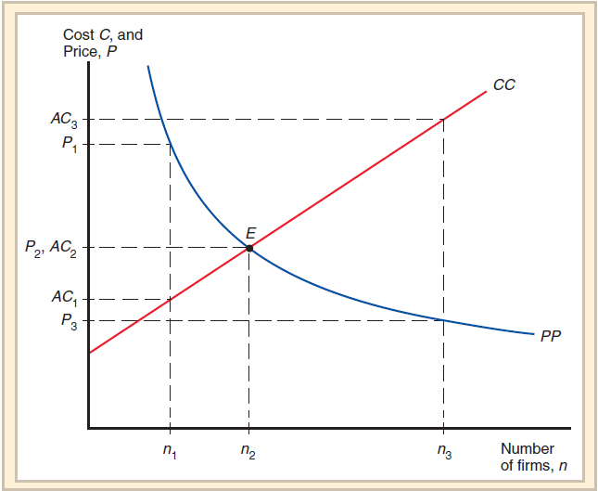

Slide 23
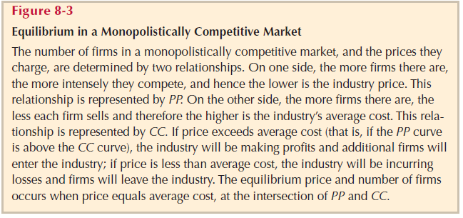
Explanatory note for previous slide...

Slide 24
Internal economies of scale: Adding in the trade
Adding trade into the model has a simple effect:
It increases the size of the market (↑Q_{Industry})
…and increases the number of firms!
(↑n)

Slide 25
Internal economies of scale: Adding in the trade
Using our formula for ATC again:
ATC = [n * (FC/Q_{Industry})] + MC
We see that if we increase the size of the market (Q_{Industry}), ATC goes down for any given number of firms (n)

Slide 26
Internal economies of scale: Adding in the trade
However, using our price formula (markup formula):
(P – MC) = 1 / (b * n)
Rearranged: P = MC + [1 / (b * n)]
…we see that the size of the market (Q_{Industry}), is not relevant at all to the price charged by firms!

Slide 27
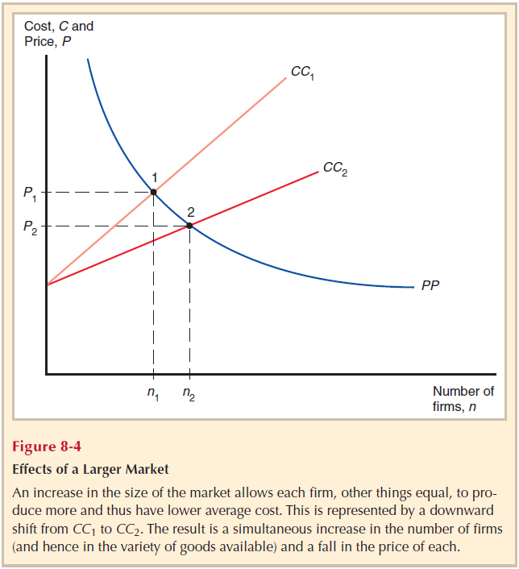
Internal economies of scale: Opening to trade
Note:
As discussed, ↑Q_{Industry} leads to lower costs (for any given n), and no change in the price charged (for any given n)

Slide 28
Conclusions
This combining of domestic markets into one global market is called market integration
Who loses out?
Some firms are kicked out of the market
Ambiguous effect on total employment

Slide 29
Conclusions
But everyone else is definitely better off a result of market integration:
Costs are lower => remaining firms are happy!
Prices are lower => consumers happy!
More total product differentiation => consumers happy again!

Slide 30
Conclusions
Trade due to consumer demand for product differentiation is called intra-industry trade
I.e. Germans buy Porsches from Italy, Italians buy Mercedes from Italy…
Intra-industry trade has grown significantly since World War II

