Slide 1
International Economics
Lecture 10: Trade Models V –
External Economies
of Scale..... .
+........ ....
Modern Trade Models

Slide 2
Overview
Introduction
External Economies of Scale
Modern Trade Models
Differences in Demand
Linder’s Representative Demand
Vernon’s Product Cycle Theory
The Gravity Model

Slide 3
Introduction
Thus far, we have assumed that the markets are in our models are always perfectly competitive
But markets are not always in perfect competition, even when competing globally!

Slide 4
Introduction
Economies of scale occur where production is more efficient (lower cost per unit) as we increase the quantity of production
E.g., doubling inputs more than doubles output
By way of example, imagine a bookshop…

Slide 5
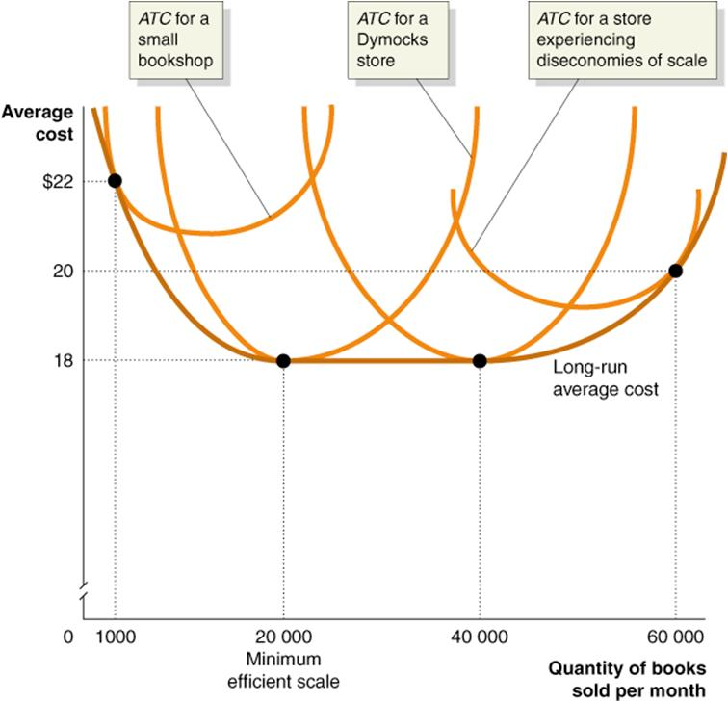
In this example, a book store enjoys economies of scale as it moves from producing 1,000 to producing 20,000 books per month

Slide 6
Introduction
External economies of scale occur when the cost per unit of production depends on the size of the industry, but not necessarily on the size of any one firm
Internal economies of scale occur when the cost per unit of production depends on the size of an individual firm, but not necessarily the size of the industry… [This we will cover next lecture!]

Slide 7
External economies of scale
What can cause external economies of scale?
Specialised suppliers
Labour market pooling
Knowledge spillovers

Slide 8
External economies of scale
Specialised suppliers
The development of some industries requires the development of specialised goods and/or services
For example, as Silicon Valley grew, specialised manufacturing firms developed to make the IT designs that were sent to them…
Designers from other locations would be at a competitive disadvantage

Slide 9
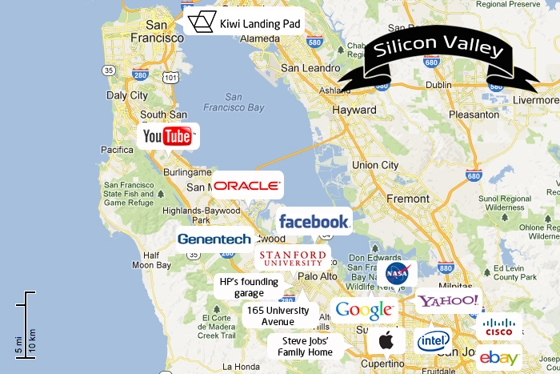

Slide 10
External economies of scale
Labour market pooling
Just as with specialised suppliers, workers with specialised skills will be attracted to industrial clusters where their skills are in high demand
For example, computer technicians and designers flock to Silicon Valley
Companies are then more easily able to find employees with the right skills from this pool of workers

Slide 11
External economies of scale
Labour market pooling (cont.)
A worker from Silicon Valley:
“…it wasn’t that big a catastrophe to quit your job on Friday and have another job on Monday… You didn’t even necessarily have to tell your wife. You just drove off in another direction on Monday morning.”

Slide 12
External economies of scale
Knowledge spillovers
An industrial cluster also allows for its workers to informally exchange knowledge about their work, improving their knowledge base
This happened in Silicon Valley…
…and it happens here in Port Moresby between aid advisers!

Slide 13
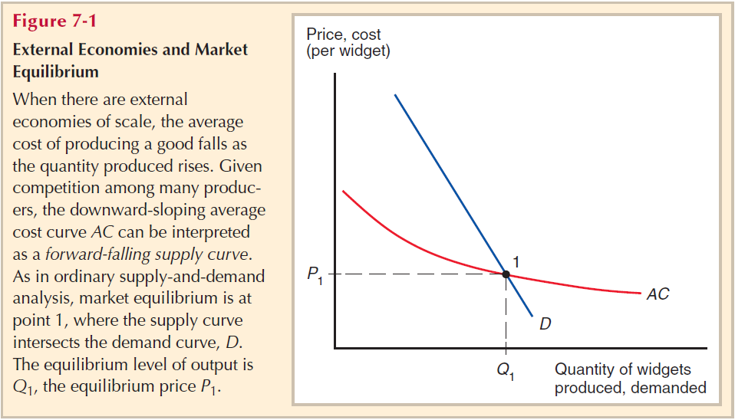
External economies of scale: The forward-falling supply curve

Slide 14
External economies of scale
One implication of external economies is that patterns of trade can be explained by historical accidents
I.e., if Home is the first country in history to establish a particular industry, it will continue to do so, even if later on other countries could produce the same product at a lower cost...
Thus, trade based on external economies is not necessarily efficient!

Slide 15
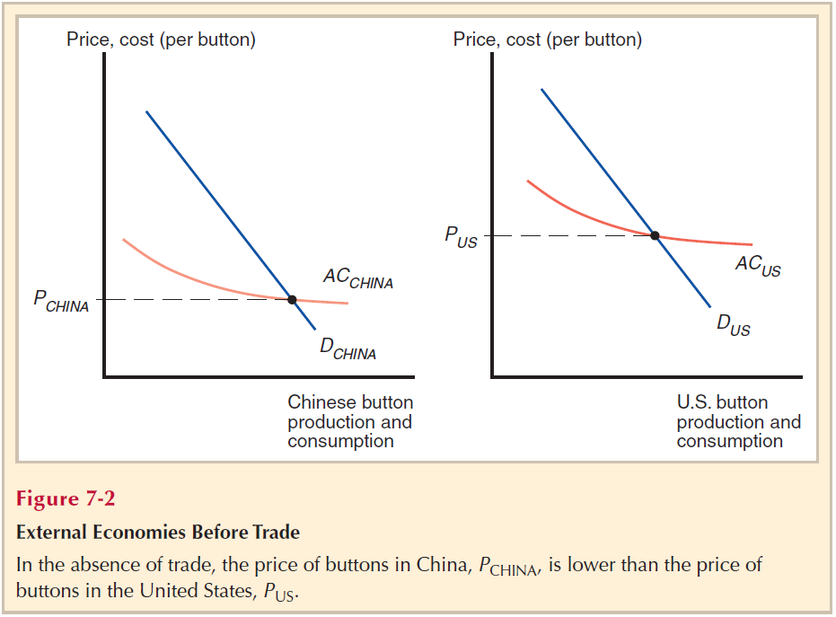
External economies of scale: Before trade

Slide 16
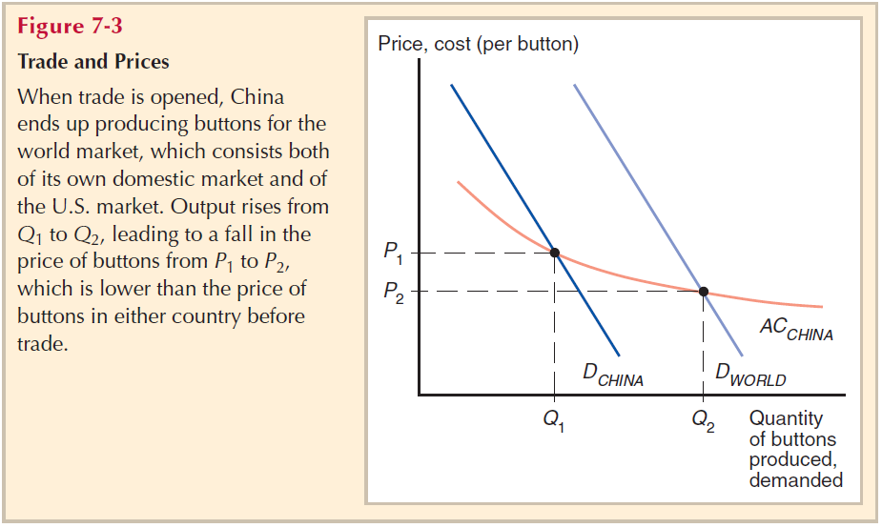
External economies of scale: With trade

Slide 17
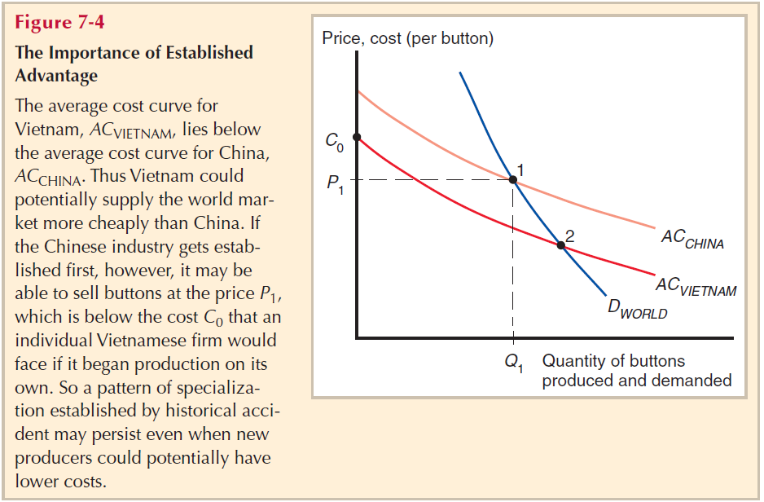
External economies of scale: Established/entrenched advantage

Slide 18
External economies of scale
The issue of entrenched advantage can potentially justify protectionism in the form of the infant industry argument
I.e., Industries should have protection until they are developed enough to compete globally
However, competition promotes efficiency!
So the danger is that companies will not become efficient with protection (unless it is phased out slowly), and will just lobby for it to continue

Slide 19
Differences in demand
Trade can be due to differences in consumer preferences
Differences in the demand curves lead to different relative prices across countries
E.g. Italians prefer to eat more pasta, the Chinese prefer to eat more rice, etc...
Thus, countries may trade just because they can get a cheaper price for their preferred product in another market

Slide 20
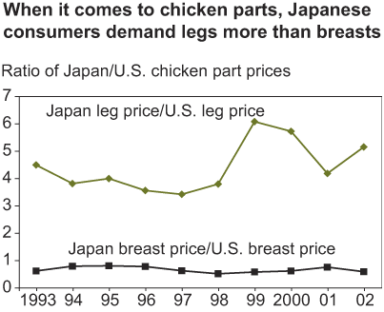
Example: Differences in demand
Note:
There is no model specifically for differences in demand, although it is partly covered by trade by monopolistic firms [Next lecture + Chapter 8]
Source:
Structure of the Global Markets for Meat, by John Dyck and Kenneth Nelson, USDA, Economic Research Service, September 2003

Slide 21
Linder’s Representative Demand
Linder, An essay on trade and transformation, 1961
Product specialisation is initially driven by in-country demand
Most trade occurs between countries of similar levels of development, because it is those products that face the greatest demand
Plus, there is the demand for product differentiation at that level of product

Slide 22
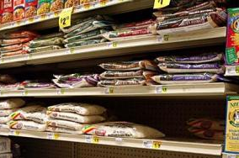
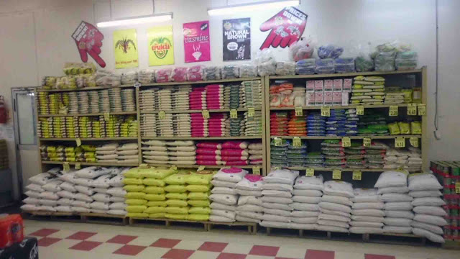
For example...
Variations of rice in Australian shops...
...versus Papua New Guinea!

Slide 23
Vernon’s Product Life Cycle Theory
Raymond Vernon, International Investment and International Trade in the Product Cycle
Vernon’s theory argues that the trade follows product cycles, with multiple phases:
Product created and exported by a high income country
Other high income countries enter export market
Entrance of low income countries into export market, decline of high income countries

Slide 24
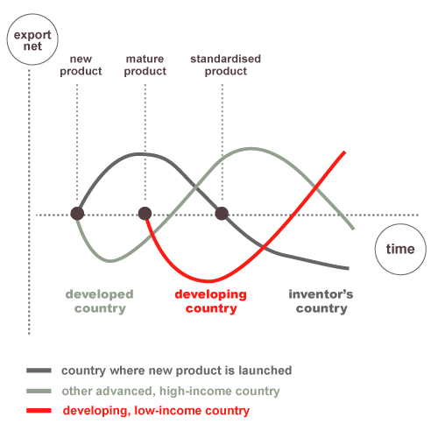
Vernon’s Product Life Cycle Theory

Slide 25
The Gravity Model
Empirical evidence show that countries that are close to each other trade more
This is regardless of transport costs!
Economists have found a general equation that predicts the volumes of trade between countries based on their size and distance from each other
Hence the term Gravity Model

Slide 26
The Gravity Model
Simple version of the function:
T_{ij} = (A * Y_{i} * Y_{j}) / D_{ij}
T_{ij}: value of trade between country i and j
Y_{i}: GDP of country i
Y_{j}: GDP of country j
D_{ij}: distance between country i and j
A: a constant
This is necessary to reflect the general level of trade in both countries relative to GDP

